Slide 1
Graph Databases: An innovative tool to improve the management & quality of linked data
Christos Chatzoglou, Data Linkage team, ONS

Slide 2
Overview
Challenges experienced with the linked data
How can you use a Graph Database to manage linked data?
Progress on our pilot project: Using a Graph Database to manage linked data
Future work

Slide 3
Challenges faced with linked files
Need to update linked datasets over time -additional sources arrive, time-points and data amendments
Requirements for different linkage quality from different users
Need to target clerical resource for the most difficult cases
Inconsistent link status when linking more than two sources
Large datasets which require long data load, querying time and storage memory
Notes:
Even when linking the same datasets
If the researchers desire links with different quality standards, all the record comparison computations & the manual clerical review must be performed again!!!
How easy it is to apply an automated targeted clerical review to the most difficult cases? E.g. one-to-many. Record pairs that fall in the middle region of the similarity score distribution and are classified as possible links also need to be clerically reviewed. However, this may be impractical and costly, especially if clerical review is to be applied in all the middle region pairs.
Looking at the relational database and asking for:
all of those associated records where the transitive closure is violated (triangulation issues) , or
all cases of one-to-many or many-to-many links in order to make them subjected to clerical review and decide about their match status… Queries like this in a Relational Database are computationally very difficult & time-consuming!

Slide 4
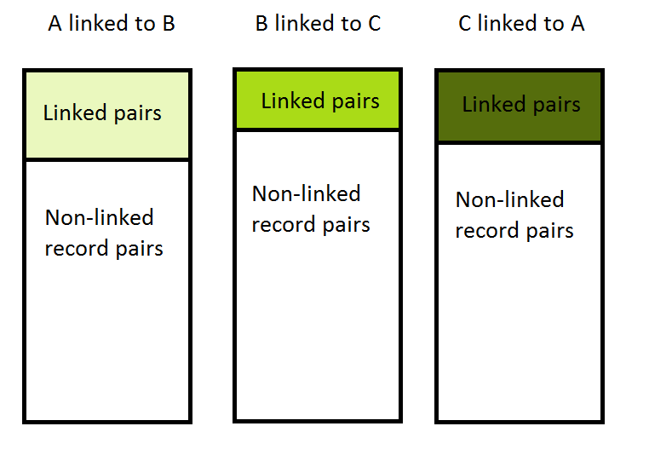
Problems with the traditional storage of linkage products
Current storage of the outcomes of a linkage project is done using Relational Databases (tables joined together)
When linking three datasets e.g. A, B, and C three linkage projects will take place: A-B, B-C, A-C
Incorrect links
Missed matches
Notes:
Note: an association may exist between a missed match and an incorrect link. A missed match may be a result of an
incorrect link!
Relational databases permit navigation via “JOIN”s , but such navigation is more cumbersome and less natural.
We want to avoid computationally expensive / time consuming “JOIN” operations when we query this kind of inter-related data.

Slide 5
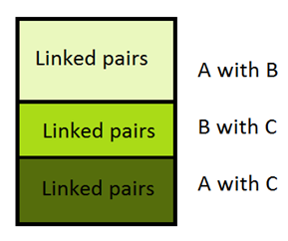
Keeping only linked pairs? A dangerous approach!
Do we have enough computer power available to load & store all of the relationships between the records?
At the moment only the links are retained and anything else is thrown away.
Notes:
Incorrect links may be a result of each individual linkage. Therefore, it would be desirable to store every kind of information on the relationships between the datasets in the matching output tables and the master-file. For instance, the pairs classified as non-links in a linkage project together with every detail associated with it (e.g. similarity score indicating a weak lower score link) should be taken into account. These extra bits of information could potentially be used as an additional tool to determine (or possibly change) the final link status of any record pair.
On the other hand, using relational databases to retain in a table all of the linked and non-linked record pairs with the additional information regarding their link status would require a huge master which is not easily manageable.

Slide 6
Why do we need a graph database?
Store and keep all the outcomes of any linkage process!
Doing the linkage is computationally intensive, storage of linkage outcomes is easy.
Relational databases are not good at modelling underlying relationships of the data
Feasible to change the link status of a pair in the future
Improve processing time due to the underlying data structure
Notes:
As said before in real-life data-linkage problems we are trying to model how similar two records are. Also, although the graph databases can help us with linkage, the linkage process is something that happens outside the graph-databases domain. Therefore, data linkage is a separate bit and every time we have to link something we have to redo that processing. So a dataset can only be linked with another dataset and then this process has to be done again for more datasets. Hence, in a case of linking records from more than 2 sources together it is possible that after applying a subsequent second linkage project we may come up with a 1) conflicting and 2) maybe false/incorrect link.
Storing the data relationally does not adequately capture the underlying structure of the data!
Using a graph database and the structure of the relationships of the data we can easily see and identify other links that failed to be found in the first place. Processing time is better due to the underlying storage of the graph in a matrix form with 0s and 1s for non-links and links where only the links are read! We can then easily traverse the graph asking from the database to bring us back related nodes.

Slide 7
Why do we need a graph database?
Use the graph structure of the available linked data to cut incorrect links
Notes:
The graph databases will be explored for their potential to break clusters of linked records and as a result to facilitate the link decision while reducing the clerical burden.

Slide 8
Graphical visualisation of a linked pair
0.83
No link below a Score Threshold of e.g. 0.55
A1
B1
0.35
0.52
A2
B2
A3
0.98
Graph terminology…
Persons A1, A2, A3, B1 and B2 are called ‘nodes’
The links between the nodes A1-B1 and A2-B2 are called ‘edges’
Nodes and edges can have attributes (e.g. similarity score, date & type of linkage etc)
Notes:
No edge=no link

Slide 9
Graphical representation of linked data
Add in data on weaker links
Model strength of linkage score
D1
C4
0.86
0.95
C1
D4
C3
1.0
C2
D3
0.45
D2

Slide 10
Graphical representation of linked data
Add a third data source
Z2
D1
C4
0.86
0.95
C1
D4
Z3
Z1
Can detect duplicate records (Z1, Z2)
C2
C3
1.0
D3
Z4
0.45
D2
The weak link between C2 & D2 now looks more plausible.

Slide 11
So do we ‘link’ using a GD? …Answer is NO!
Dataset 1
Dataset 2
Perform linkage
(keep results from all pair comparisons)
Import linked data into Neo4j graph database
Analysis of graph
Automated review of links (graph topology)
Clerical review of links
Cluster extraction

Slide 12
Graph databases (progress)
Made good progress (from a standing start)
Learned about technology
Used synthetic data
Increasing size
Up 0.5 million records per source
Improvement in linkage quality
Next step is to use real data - lots of it!
Larger data sets (whole population)
Multiple data sources
Notes:
Learned about technology
Imported data in to Neo4j
Interactive graphical visualisation of linked data
Query language: CYPHER
Graph analytics

Slide 13
Our pilot project
Two synthetic datasets are linked and their linkage quality has been assessed given we know their true match status.
Datasets are first imported in a graph database (Neo4j).
The resulting graph is queried with an appropriate query language (CYPHER) and visualised.
Notes:
Mention that matches are the real links!!!! Focus on that!!! Audience is not familiarised with the terminology we use! True links= matches! We don’t want to cut matches (true positives)!

Slide 14
Our pilot project
Graph Metrics (eg. EB, modularity) based on the structure of the graph have been applied to cut one-to-many or many-to-many links in clusters of linked records.
Based on those cuts the linkage quality is re-calculated to see if there was an improvement
Does the linkage quality improve?

Slide 15
What did we do on the graph domain?
Based on similarity score and graph structure we can use:
Modularity: We use this graph metric in order to confirm the existence of truly tightly-knit communities / sub-clusters having few links between them in a cluster
Edge Betweenness: We use this graph metric in order to pick these edges/links that are connecting the sub-clusters
…to remove links

Slide 16
What did we do on the graph domain?
For all the smaller clusters of one-to-two linked records we applied “rules” to target the clerical review and to set the link status
E.g. Only if the difference in the match scores is greater than 0.2, consider the higher score as a link.
0.8 ✓
b1
0.59 
a1
b1
a1
0.55 ✗
0.52 
b2
b2

Slide 17
What can we do on the graph domain?
a1
a5
a6
b5
b6
a12
b1
b2
a7
b7
b9
a3
a2
a11
a9
b10
b8
b3
b1
Two clusters of linked records both having a positive value of modularity
a10
a4
a8
b4
b12
a14
b16
a13
b15
b13
a15

Slide 18
What can we do on the graph domain?
a1
a5
a6
b5
b6
a12
b1
b2
a7
b7
b9
a2
a3
a11
a9
b10
b8
b3
a10
b11
We cut a4-b5 and a15-b15 having the highest edge betweenness. Three clusters of linked records are then left. Two clusters have a positive modularity-they can be further partitioned!
a4
a8
b4
a14
b16
b12
b15
a13
a15
b13

Slide 19
What can we do on the graph domain?
a1
a5
a6
b5
b6
a12
b1
b2
a7
b7
b9
a3
a2
a11
a9
b10
b8
b3
a10
b11
a4
a8
b4
a14
b16
b12
a13
b15
b13
a15

Slide 20
What can we do on the graph domain?
a1
a5
a6
b5
b6
a12
b1
b2
a7
b7
b9
a3
a2
a11
a9
b10
b8
b3
a10
b11
Six smaller ‘clusters’ of linked records left so far…
a4
a8
b4
a14
b16
b12
a13
b15
b13
a15
Notes:
With GD we can set up rules to identify all the triangulation cases (b12,b13-a13,but not b12/b13), set up rules and easily target the clerical review!

Slide 21
What can we do on the graph domain?
In the case of 2000x20000
Notes:
Compromise between precision and recall: best compromise between incorrect links and missed matches. The higher the f the better it is!

Slide 22
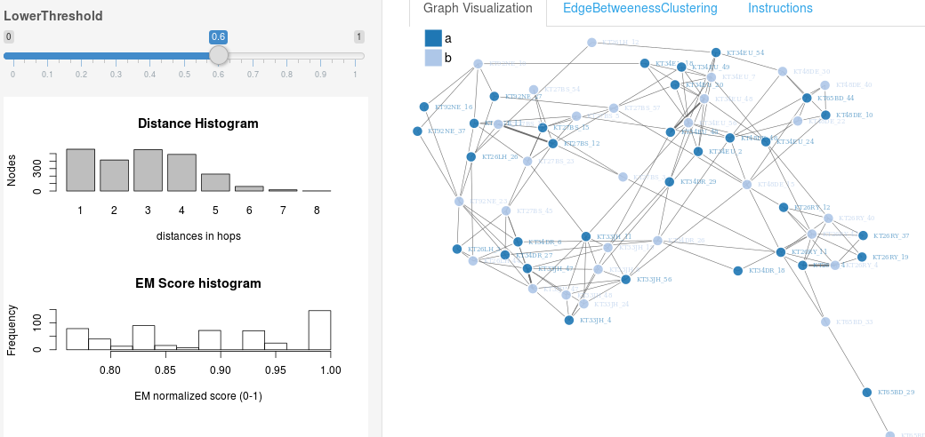
An interactive demo
Everything above this threshold score is considered as a link
tinyurl.com/graphreclink
Notes:
Only the links that we are making above a score threshold are displayed in the graph!!!!! And not all the true matches are displayed here. The matches that have a score below the threshold we set could not be found so they are missed matches and they are not appeared in the graph!
There is a lower similarity score threshold setting slider on the upper left hand side. You can play with it and see what graphs are created in the Graph Visualisation page. The graph produced in the Graph Visualisation page is just the representation of all the links above the threshold you set. (Hence, not all candidate record pairs are plotted in the graph). There is also another page called Edge Betweeness clustering which is an example of how the biggest sub-graph in the Graph Visualisation page breaks into smaller clusters after applying certain graph theory techniques to break some links.
How do the links we break using the structure of the graphs relate with an increase in the overall linking quality?
The aim of the whole project is to investigate the ability of several graph theory techniques to identify record linkage errors (e.g. incorrect links) given we know the truth match status due to the use of synthetic data. Also, the ability of graph databases to store, process and visualise two or more datasets is being explored. The development of more efficient methods of improving linkage quality will result in higher quality datasets that can be delivered to researchers in shorter timeframes.

Slide 23
Summary
Graph databases can be used to store and process linked data more efficiently than the traditional relational databases.
Graph theory metrics based on the Structure of the visualised linked synthetic data seem promising in removing false links
automatically improve the linkage quality
save money from targeted
clerical review
Need to test the robustness of the method!!!
Notes:
Instead of deeming the uncertain outcome of any linkage project as the only truth over time, use a graph database to store all kinds of relationships between the records in a form of a graph and allow a dynamic determination-manipulation of all those relationships over time.

Slide 24
Future Work
Using more than two data sources
Include duplicates in a dataset
Generalise to other versions of synthetic datasets
Test it on Real Data
Scalability

Slide 25
Any Questions?
?
Thank you very much!
Contact Emails:
Christos.chatzoglou@ons.gov.uk
datalinkage@ons.gsi.gov.uk

Slide 26
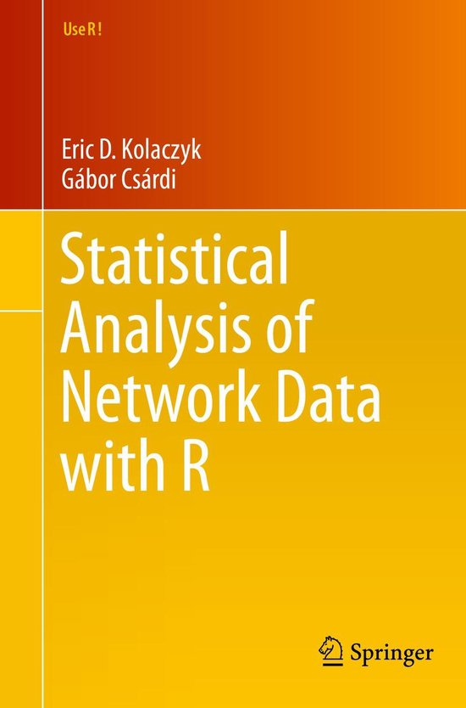
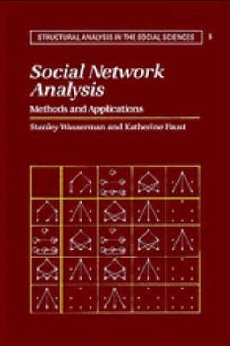
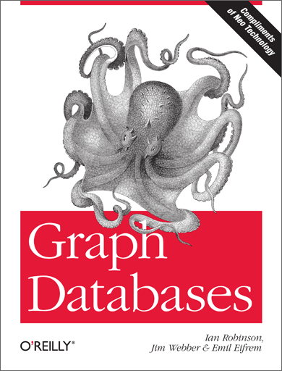
Interested in Graph theory & DB’s ?

