Slide 1
Developments in measuring the burden placed on businesses responding to statistical surveys
Date: 6th July 2016
Adam Tucker
Office for National Statistics
adam.tucker@ons.gov.uk

Slide 2
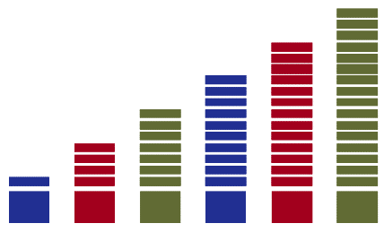
Outline
Background
History of measurement of respondent burden
Motivation for this project
Possible methods for measuring burden
Pilot of a streamlined approach
Selection of surveys
Results of statistical modelling
Next steps
Notes:
Good Afternoon
I'm Denise Williams and I work in the Quality Centre within the Office for National Statistics.
We are responsible for a range of quality initiatives to ensure the statistics we produce meet the needs of our users in our own organisation as well as across the UK Government Statistical Service (GSS).
My main responsibility is for Respondent Burden and Compliance, which we also cover both within ONS and The GSS.
My presentation today is about Developments in measuring the burden placed on businesses responding to statistical surveys

Slide 3
Background
The UK Statistics Code of Practice sets out requirement to “report annually the estimated costs of responding to statistical survey”
ONS reports these costs through the Online List of Government Statistical Surveys
There is an agreed methodology for measuring the burden placed on businesses
Notes:
With the establishment of the UK Statistics Authority in 2008 government departments conducting surveys contributing to official statistics were required under the Code of Practice to report annually the compliance cost burden of conducting surveys to businesses, Local Authorities, individuals and households.
ONS collects annually information on all statistical surveys not just those contributing to official statistics from government departments across the Government Statistical service. This information is collated and published on the Online List of Government Statistical surveys. Therefore, the information requested extends wider than our obligations to the code. This list is published on the government website where it can be accessed by all government departments.
The methodology used to calculate compliance cost burden was commissioned by the government statistical services policy and standards committee and approved by government departments conducting statistical surveys, this has resulted in a consistent methodology used by all departments when reporting to the Online list.
It is also important to mention that information relating to compliance cost burden is not just collated to meet our obligation to the Code, information relating to burden tells us so much more, it holds us accountable particularly, when looking for new initiatives to reduce the burden we place on our respondents. This is something ONS strive to do.

Slide 4
Background
The Online List of Government Statistical Surveys (OLGSS) provides a comprehensive picture of government statistical survey activity including surveys to businesses, local authorities, households and individuals. It has two main functions:
Be a single source of information helping departments to reduce duplication
Aid compliance and monitoring of practices 1,2 and 5 of Principle 6 of the UK Code of Practice for Official Statistics
https://gss.civilservice.gov.uk/about/surveys/survey-control-unit/online-list-of-government-statistical-surveys/
Notes:
With the establishment of the UK Statistics Authority in 2008 government departments conducting surveys contributing to official statistics were required under the Code of Practice to report annually the compliance cost burden of conducting surveys to businesses, Local Authorities, individuals and households.
ONS collects annually information on all statistical surveys not just those contributing to official statistics from government departments across the Government Statistical service. This information is collated and published on the Online List of Government Statistical surveys. Therefore, the information requested extends wider than our obligations to the code. This list is published on the government website where it can be accessed by all government departments.
The methodology used to calculate compliance cost burden was commissioned by the government statistical services policy and standards committee and approved by government departments conducting statistical surveys, this has resulted in a consistent methodology used by all departments when reporting to the Online list.
It is also important to mention that information relating to compliance cost burden is not just collated to meet our obligation to the Code, information relating to burden tells us so much more, it holds us accountable particularly, when looking for new initiatives to reduce the burden we place on our respondents. This is something ONS strive to do.

Slide 5
OLGSS
Notes:
With the establishment of the UK Statistics Authority in 2008 government departments conducting surveys contributing to official statistics were required under the Code of Practice to report annually the compliance cost burden of conducting surveys to businesses, Local Authorities, individuals and households.
ONS collects annually information on all statistical surveys not just those contributing to official statistics from government departments across the Government Statistical service. This information is collated and published on the Online List of Government Statistical surveys. Therefore, the information requested extends wider than our obligations to the code. This list is published on the government website where it can be accessed by all government departments.
The methodology used to calculate compliance cost burden was commissioned by the government statistical services policy and standards committee and approved by government departments conducting statistical surveys, this has resulted in a consistent methodology used by all departments when reporting to the Online list.
It is also important to mention that information relating to compliance cost burden is not just collated to meet our obligation to the Code, information relating to burden tells us so much more, it holds us accountable particularly, when looking for new initiatives to reduce the burden we place on our respondents. This is something ONS strive to do.

Slide 6
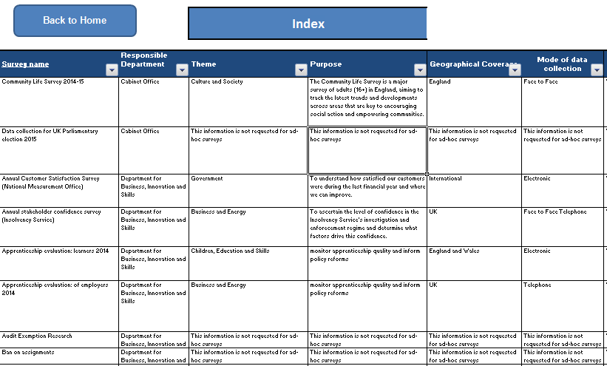
OLGSS
Notes:
With the establishment of the UK Statistics Authority in 2008 government departments conducting surveys contributing to official statistics were required under the Code of Practice to report annually the compliance cost burden of conducting surveys to businesses, Local Authorities, individuals and households.
ONS collects annually information on all statistical surveys not just those contributing to official statistics from government departments across the Government Statistical service. This information is collated and published on the Online List of Government Statistical surveys. Therefore, the information requested extends wider than our obligations to the code. This list is published on the government website where it can be accessed by all government departments.
The methodology used to calculate compliance cost burden was commissioned by the government statistical services policy and standards committee and approved by government departments conducting statistical surveys, this has resulted in a consistent methodology used by all departments when reporting to the Online list.
It is also important to mention that information relating to compliance cost burden is not just collated to meet our obligation to the Code, information relating to burden tells us so much more, it holds us accountable particularly, when looking for new initiatives to reduce the burden we place on our respondents. This is something ONS strive to do.

Slide 7
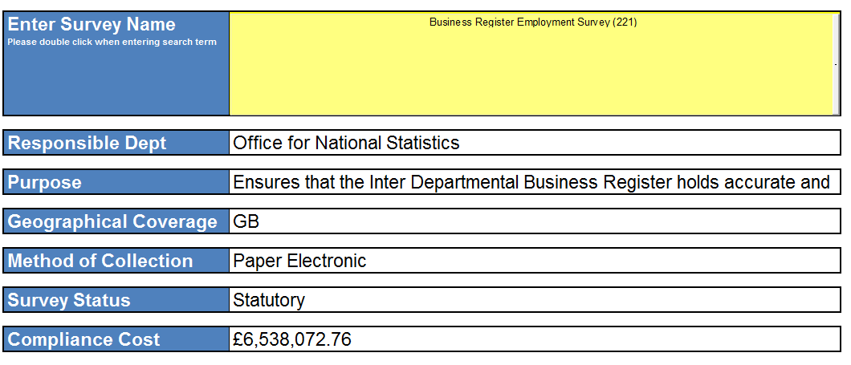
OLGSS
Notes:
With the establishment of the UK Statistics Authority in 2008 government departments conducting surveys contributing to official statistics were required under the Code of Practice to report annually the compliance cost burden of conducting surveys to businesses, Local Authorities, individuals and households.
ONS collects annually information on all statistical surveys not just those contributing to official statistics from government departments across the Government Statistical service. This information is collated and published on the Online List of Government Statistical surveys. Therefore, the information requested extends wider than our obligations to the code. This list is published on the government website where it can be accessed by all government departments.
The methodology used to calculate compliance cost burden was commissioned by the government statistical services policy and standards committee and approved by government departments conducting statistical surveys, this has resulted in a consistent methodology used by all departments when reporting to the Online list.
It is also important to mention that information relating to compliance cost burden is not just collated to meet our obligation to the Code, information relating to burden tells us so much more, it holds us accountable particularly, when looking for new initiatives to reduce the burden we place on our respondents. This is something ONS strive to do.

Slide 8
Methodology
Government Statistical Service (GSS) has agreed the following definition for measuring respondent burden for business surveys
Notes:
There are several components required when applying the GSS methodology to calculate complaince cost burden,
N refers to the number of respondents
T is the median time to complete the main survey questionnaire, as shown in the equation we than add the number of respondents recontacted for validation purposes and the median recontact time. The hourly rate is based on the person completing the questionnaire, and is taken from the Annual survey of hours and earnings. We also include the proportion of respondents who incur external costs and the median external cost.

Slide 9
History of measuring respondent burden
Until 2012, formal reviews were carried out every 3 and 5 years
These reviews collected information on respondent burden
Replaced by the introduction of the Quality, Methods and Harmonisation Tool
Self-assessment tool completed by statistical output managers
Used information from previous reviews and knowledge of changes to estimate burden
Notes:
Until 2012 ONS conducted reviews, these were resource intense and could take up to a year to complete, but they did collect information directly from the respondent. These reviews were replaced by a self assessment tool called the Quality Methods and Harmonisation tool which concentrated on outputs, Therefore, obtaining information from respondents was omitted. information used to calculate compliance cost burden relied on information previously collected through survey reviews, but soon became outdated

Slide 10
Motivation
Requirement to gather more up-to-date measures of respondent burden for business surveys
Drivers include: electronic data collection, use of administrative data
Traditional approach was an additional review survey
Need a streamlined, efficient process of collecting the required information
Notes:
The motivation for gathering more up-to-date measures of respondent burden for business surveys was mainly driven by the new electronic data collection tool, and the increased use of admin data. Without good baseline figures we would not be able to measure the impact on the change in data collection and the reduction in burden when changing our mode of data collection.
For this purpose we looked at a streamlined, efficient process of collecting the required information. We looked at the old review process and eliminated a lot of the unnecessary processes involved. This included:
Using automated systems to collate and analyse the data
Centralising the process which reduced the number of staff involved in each review
Reducing the number of variables asked on each review questionnaire, and
Using management information systems such as the Cloud telephone system

Slide 11
Possible methods for measuring burden
Method | Pros | Cons
1. Collect time information on survey questionnaire | No addition burden placed on respondents | Only collects time, not external costs Has to be included as a voluntary question
2. Conduct a short review survey | Allow all required information to be collected | Costs – both for the questionnaires and to carry out the reviews Could be perceived as additional burden to respondents
3. Model burden from one survey to another | Information does not need to be collected for all surveys | Need to identify similar surveys Relies on variables that are correlated with completion time Still requires the collection of information for some surveys
Notes:
The we considered how we would collect this information.
We considered three methods in which to base our pilot:
Option 1. We could add an additional “time”question to the main survey questionnaire, this option had limitations, for example it would fall short of requirements, ONS surveys are statutory, the additional question would have to be identified as voluntary, this could cause confusion and have implications on our Enforcement Procedures. The additional question could lengthen the questionnaire causing additional pages. On the upside, we didn’t think it would be deemed more burdensom when compared to other options.
Option 2. required sending out a short questionnaire as a seperate request. This would allow us to collect all the requirements for calculating compliance but would be deemed a burden to our respondents and would incur additional costs for printing etc.
As the pilot was to be twofold information would be used to test a modelling approach, using burden cost information from the pilot reviews for calculating compliance for surveys of similar complexity, made how we collected the information in the first place important. Option 1 was discounted at this stage because it was deemed unfit for purpose, as not all the required information could be collected.

Slide 12
Method 1
Collect time information on the survey questionnaire
Add the question to the end of the survey
Pros:
No additional burden placed on respondents
No separate activity needed, therefore less resource intensive
Cons;
Needs to be clear that the question is voluntary
Only collects time, no external costs are considered
Notes:
The approach chosen (option 2), consisted of sending a short questionnaire to a representative sample selected and designed by ONS methodologists. The questionnaire was despatched within two days of the main survey questionnaire. This was done to aid the quality of information returned.
As previously stated, the process was streamlined considerably when compared to how we used to conduct these reviews.
It was also important that we engaged early in the process with our survey managers, if review questionnaires were sent directly to survey managers/statisticians they were able to redirect them to the necessary department or person conducting the review, and of course they could also deal with explaining why we had sent them an additional questionnaire.

Slide 13
Method 2
Conduct an independent short review survey
Model burden from one survey to another
Pros;
All required information can be collected
Clearly explained that the survey is voluntary
Information does not need to be collected for all surveys
Notes:
The approach chosen (option 2), consisted of sending a short questionnaire to a representative sample selected and designed by ONS methodologists. The questionnaire was despatched within two days of the main survey questionnaire. This was done to aid the quality of information returned.
As previously stated, the process was streamlined considerably when compared to how we used to conduct these reviews.
It was also important that we engaged early in the process with our survey managers, if review questionnaires were sent directly to survey managers/statisticians they were able to redirect them to the necessary department or person conducting the review, and of course they could also deal with explaining why we had sent them an additional questionnaire.

Slide 14
Method 2 cont...
Cons;
-Need to identify similar surveys
-Relies on variables that are correlated with completion time
-Still requires the collection of information for some surveys
Increased costs to both the NSI to produce the survey
The extra questionnaire could be perceived as additional
burden placed on respondents.
Notes:
The approach chosen (option 2), consisted of sending a short questionnaire to a representative sample selected and designed by ONS methodologists. The questionnaire was despatched within two days of the main survey questionnaire. This was done to aid the quality of information returned.
As previously stated, the process was streamlined considerably when compared to how we used to conduct these reviews.
It was also important that we engaged early in the process with our survey managers, if review questionnaires were sent directly to survey managers/statisticians they were able to redirect them to the necessary department or person conducting the review, and of course they could also deal with explaining why we had sent them an additional questionnaire.

Slide 15
Method 2 progressed
Short voluntary review questionnaire sent to a
sub-sample of the main survey
Sample representative of the main survey
Process steps streamlined to remove any
unnecessary steps
Engaged with survey managers early
Scheduled to send out review questionnaire-
2 days after main survey
Notes:
The approach chosen (option 2), consisted of sending a short questionnaire to a representative sample selected and designed by ONS methodologists. The questionnaire was despatched within two days of the main survey questionnaire. This was done to aid the quality of information returned.
As previously stated, the process was streamlined considerably when compared to how we used to conduct these reviews.
It was also important that we engaged early in the process with our survey managers, if review questionnaires were sent directly to survey managers/statisticians they were able to redirect them to the necessary department or person conducting the review, and of course they could also deal with explaining why we had sent them an additional questionnaire.

Slide 16
Selection of Surveys
Three similar surveys identified
All monthly, economic surveys
All have same sampling frame, therefore same explanatory variables available
From previous data, expected similar completion times
Surveys:
Monthly Business Survey (Retail Sales Index[RSI])
Monthly Wages and Salaries Survey (MWSS)
Vacancies Survey
Notes:
Three similar surveys were identified, this was important for the modelling analysis. They were all economic surveys selected from the same sample frame, the interdepartmental business register. These surveys had previous data therefore, we could expect similar completion times.
The surveys selected were:
Monthly Business Survey (Retail Sales Index,
RSI)
Monthly Wages and Salaries Survey (MWSS)
Vacancies Survey

Slide 17
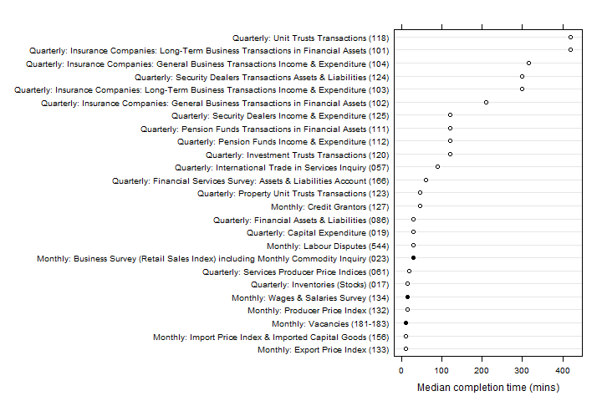
Selection of Surveys
Notes:
this graph shows quarterly and monthly surveys with previous compliance time history, the solid circles show the surveys used in the pilot, and again as you can see they have similar average times

Slide 18
Sample sizes and response rates
Pilot ran from October – December 2014
 | Monthly Business Survey (Retail Sales Index) | Monthly Wages and Salaries Survey | Vacancies Survey
Main survey sample size | 4,959 | 9,295 | 6,030
Review survey sample size | 501 | 773 | 600
Review sample response rate | 41% | 71% | 47%
Notes:
This slide shows the number of respondents selected for the main survey, and the number of respondents included in the sub sample for the review. Again the sub sample was designed by ONS methodologists.
The response rates were, at the close of the review encouraging. Even after closing the review, we continued to receive responses to the review. Therefore, the response rates are higher than the response rates shown here.
For the Monthly wages and salaries survey we conducted a response chasing exercise, this was conducted in-line with response chasing of the main survey review (business as usual). This entailed working with our response chasing teams, if the main survey questionnaire and review questionnaire were outstanding the operator would remind the respondent on both counts. However, we would never contact a respondent who had only the review questionnaire outstanding as this was deemed a further burden on our responders. As shown in this slide, response chasing did have an impact when compared to the Monthly Business survey review and the Vacancy review response rates.

Slide 19
Results related to modelling
The returned data showed:
Poor correlation with possible explanatory variables (employment, turnover)
Time recorded to nearest 5 or 10 minutes, therefore masking true variation
Notes:
The returned data when analysed by our methodologist appeared to show a poor correlation with possible explanatory variables, time recorded appeared to be rounded to the nearest 5 or 10 minutes masking true variation. This can be seen on the next slide.

Slide 20
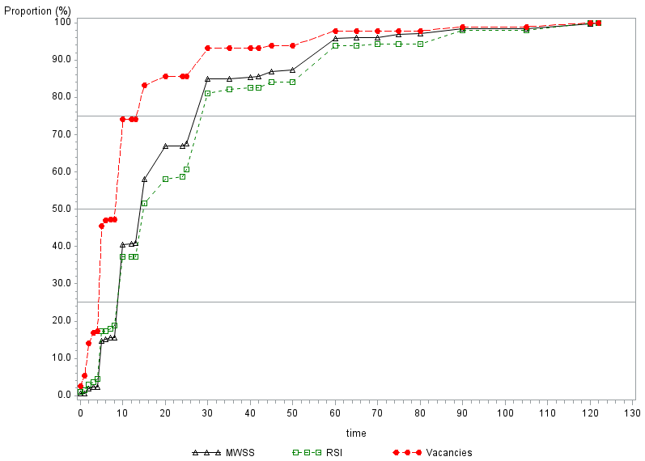
Notes:
extensive exploratory analysis was carried out for the purpose of the modeling exercise, but there did not appear to be any variables that were strongly or significantly associated with compliance time.
The data was found to be very uncertain and difficult to model, none of the models examined explained the variation in the compliance times.
Even though some of the surveys may appear similar, they actually exhibited quite different compliance times. and were deemed not appropriate in the modeling of compliance time for other surveys.

Slide 21
Results related to the option 2
Reviews timetabled in-line with new collection mode (electronic data collection)
Reduction in time to complete a survey review by approximately 7 months
Automative systems caused a reduction in staff costs
Notes:
When looking at the streamlined process for conducting reviews we found it to be successful. The reviews used in the pilot are also scheduled to move to the new electronic data collection system. We now how more accurate baseline figures in order to measure the change in data collection mode, and any other changes undertaken on these surveys.
The time to complete the review reduced by approximately 7 months this was mainly due to taking out a lot of manual imputation and using automated systems for collecting the data for example, scanning questionnaires. Having a centralised process meant that less people were involved and could be co-ordinated more easily.

Slide 22
Conclusion
Method 2, modelling approach was not achievable
Method 2, streamlined review process would be implemented
Notes:
Modelling compliance cost burden = The data was found to be very uncertain and difficult to model, and was deemed not appropriate in the modeling of compliance time for other surveys.
Streamlined review process = When looking at the streamlined process for conducting reviews we found it to be successful and continues to be used in ONS.

Slide 23
Going forward
Continue to review each survey as a separate exercise
Provide baseline figures for measuring changes in mode of data collection
Time question and external question to be added to electronic questionnaire
Continue to use information from management systems
- Cloud telephone systems replaces manual exercise
Notes:
The review team will continue to work with our electronic data division to ensure reviews are conducted prior to being moved to Electronic Data Collection methods. Once surveys are on EDC, a new approach for collecting information will be investigated.
Reviews will be conducted every 3 and 5 years dependent on the frequency of the survey (monthly and quarterly surveys every 3 years and annual surveys every 5 years). We could choose to use para data but this would not be a true measure because it would only include the time it took to complete the questionnaire online.
Currently we ask respondents to include:
time to become familiar with the questionnaire
time of everyone who helped to complete the questionnaire
time spent extracting and preparing information from Their systems, and
any other time spent in relation to completing the questionnaire
Once move to EDC respondents would have told us through registration, their position in the company, this question will then be removed from the review questionnaire, we will continue to look for new innovative ways of collecting information required for calculating compliance cost burden without the need to burden respondents any more than we have to.

Slide 24
Questions?
Thank you for listening.
Questions?
Contact:
E-mail: adam.tucker@ons.gsi.gov.uk

