Slide 1
Mapping migration
Bruce Mitchell
GIS and Mapping Unit
ONS Geography
Special thanks are due to Martin Ralphs, Theo Manassis, Iva Špakulová and Jeremy Brocklehurst

Slide 2
Brief to identify
Migration catchment areas, and ‘stagnant’ areas in England and Wales
Defined in terms of towns or cities
Very quick turnaround required – so published data
Local authority level

Slide 3
Scope of this presentation
The use of spatial analysis, mapping and unconventional graphics to answer a high-profile research question.
Not an exposition of demographic change.
Implications of the geography must be understood for sensible conclusions to be drawn.
The geography may conceal, or misrepresent, spatial characteristics of the data.

Slide 4
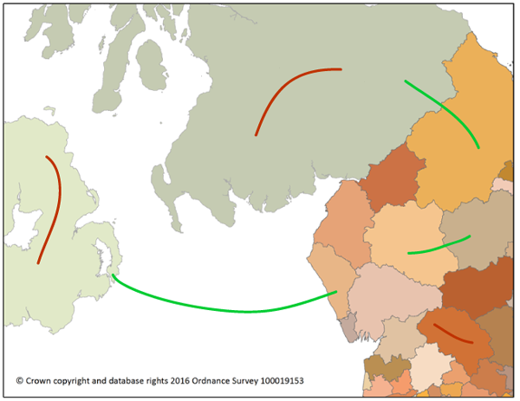
The data
All persons (aged 25-64) making a residential move of at least a year.
Estimates based in part on the NHS Patient Register (NHSPR).
Migrations only recorded where person changes GP and where new address in different district.

Slide 5
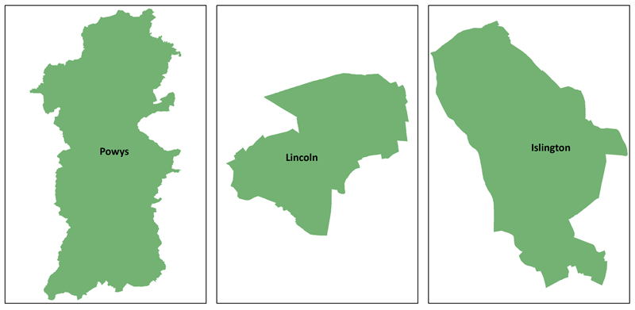
The Local Authority Geography
© Crown copyright and database rights 2016 Ordnance Survey 100019153

Slide 6
The Local Authority Geography
Pop. 132,700
Area 5,195 km²
Pop. Dens. 26 pers./ km²
© Crown copyright and database rights 2016 Ordnance Survey 100019153

Slide 7
The Local Authority Geography
Pop. 132,700
Area 5,195 km²
Pop. Dens. 26 pers./ km²
Pop. 96,200
Area 36 km²
Pop. Dens. 2,679 pers./ km²
© Crown copyright and database rights 2016 Ordnance Survey 100019153

Slide 8
The Local Authority Geography
Pop. 132,700
Area 5,195 km²
Pop. Dens. 26 pers./ km²
Pop. 96,200
Area 36 km²
Pop. Dens. 2,679 pers./ km²
Pop. 221,000
Area 15 km²
Pop. Dens. 14,517 pers./ km²
© Crown copyright and database rights 2016 Ordnance Survey 100019153

Slide 9
Average migration distance
Research on 2001 Census data (Spatial Analysis Unit ) demonstrated that, on average, people move less than 10km
People who move but do not cross a LAD boundary are not recorded in migration statistics
Moves of average distance are most likely to go unrecorded in large areas as migrants need to move further to cross a border.
Moves of average distance are more likely to be recorded when they begin in small LADs, because here, they need move a shorter distance to cross a border.

Slide 10
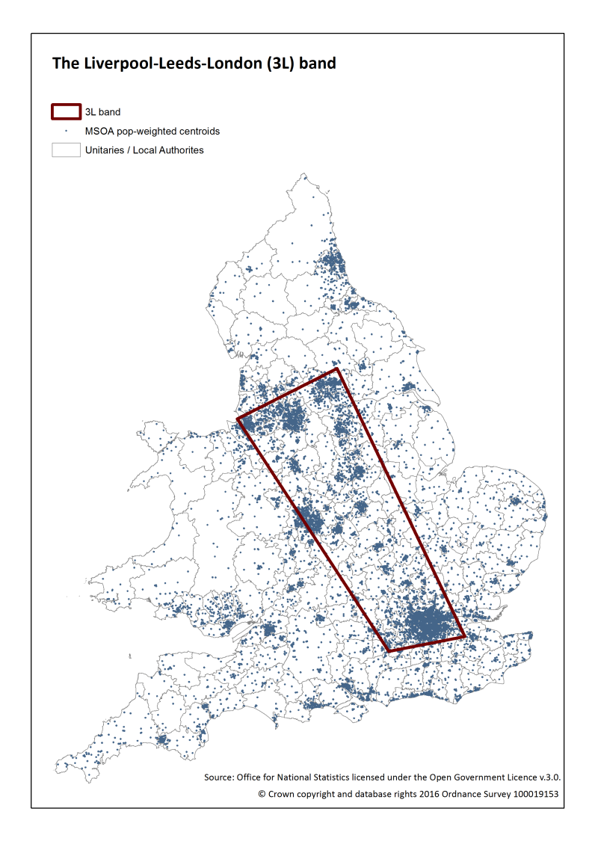
The majority of the population of England and Wales is located in a band between Liverpool, Leeds and London (3L).
Most of the LADs within this band are small.
Average distance from one LAD to any other LAD is much shorter within the 3L band than outside it.
Moves within the 3L band are more likely to be picked up than those beyond it.
This produces a spatial bias in the dataset.

Slide 11
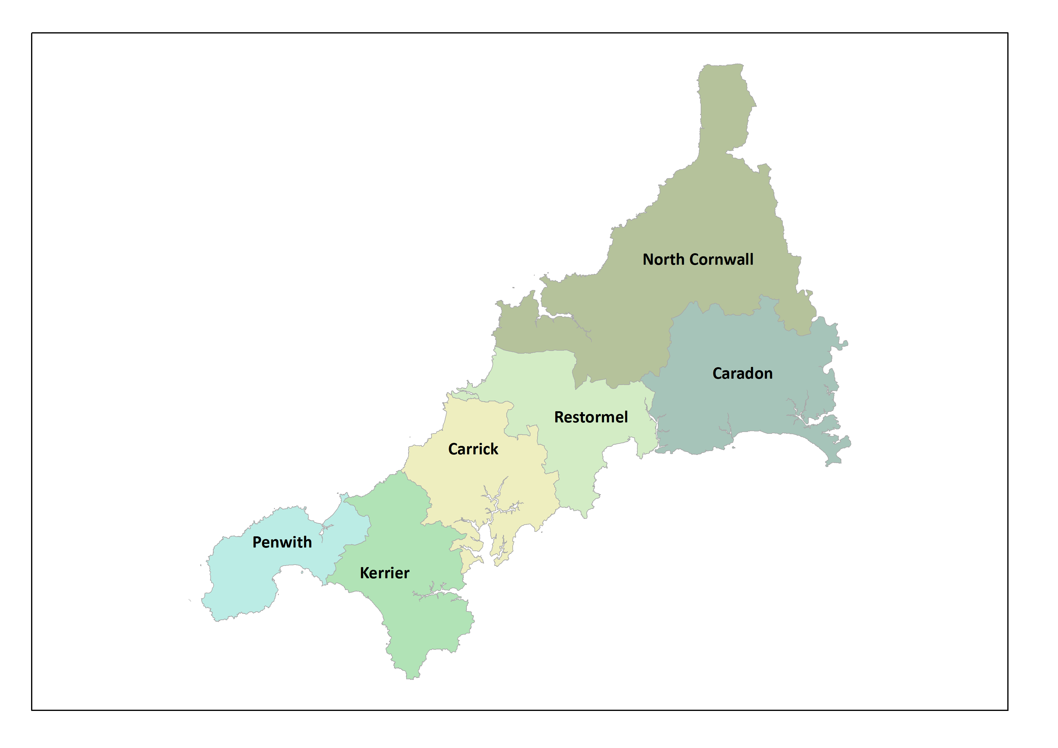
Cornwall 2008
© Crown copyright and database rights 2016 Ordnance Survey 100019153
Notes:
This spatial bias has been strengthened by the creation of large unitary authorities (e.g. Wiltshire, Herefordshire, Cornwall)
Six Cornish districts were replaced by a single Cornwall UA in 2009.
Any moves between the former districts are now suppressed. This does not mean that migration within the county of Cornwall has ceased. It’s just MAUP.
A move of up to 70 miles can now begin and end in Cornwall and not be registered as a migration.

Slide 12
Cornwall 2008
St Ives
Falmouth
26 miles
© Crown copyright and database rights 2016 Ordnance Survey 100019153
Notes:
This spatial bias has been strengthened by the creation of large unitary authorities (e.g. Wiltshire, Herefordshire, Cornwall)
Six Cornish districts were replaced by a single Cornwall UA in 2009.
Any moves between the former districts are now suppressed. This does not mean that migration within the county of Cornwall has ceased. It’s just MAUP.
A move of up to 70 miles can now begin and end in Cornwall and not be registered as a migration.

Slide 13
Cornwall 2008
Padstow
39 miles
Falmouth
© Crown copyright and database rights 2016 Ordnance Survey 100019153
Notes:
This spatial bias has been strengthened by the creation of large unitary authorities (e.g. Wiltshire, Herefordshire, Cornwall)
Six Cornish districts were replaced by a single Cornwall UA in 2009.
Any moves between the former districts are now suppressed. This does not mean that migration within the county of Cornwall has ceased. It’s just MAUP.
A move of up to 70 miles can now begin and end in Cornwall and not be registered as a migration.

Slide 14
Cornwall 2008
Padstow
Torpoint
44 miles
© Crown copyright and database rights 2016 Ordnance Survey 100019153
Notes:
This spatial bias has been strengthened by the creation of large unitary authorities (e.g. Wiltshire, Herefordshire, Cornwall)
Six Cornish districts were replaced by a single Cornwall UA in 2009.
Any moves between the former districts are now suppressed. This does not mean that migration within the county of Cornwall has ceased. It’s just MAUP.
A move of up to 70 miles can now begin and end in Cornwall and not be registered as a migration.

Slide 15
Cornwall 2008
Launceston
78 miles
Sennan Cove
© Crown copyright and database rights 2016 Ordnance Survey 100019153
Notes:
This spatial bias has been strengthened by the creation of large unitary authorities (e.g. Wiltshire, Herefordshire, Cornwall)
Six Cornish districts were replaced by a single Cornwall UA in 2009.
Any moves between the former districts are now suppressed. This does not mean that migration within the county of Cornwall has ceased. It’s just MAUP.
A move of up to 70 miles can now begin and end in Cornwall and not be registered as a migration.

Slide 16
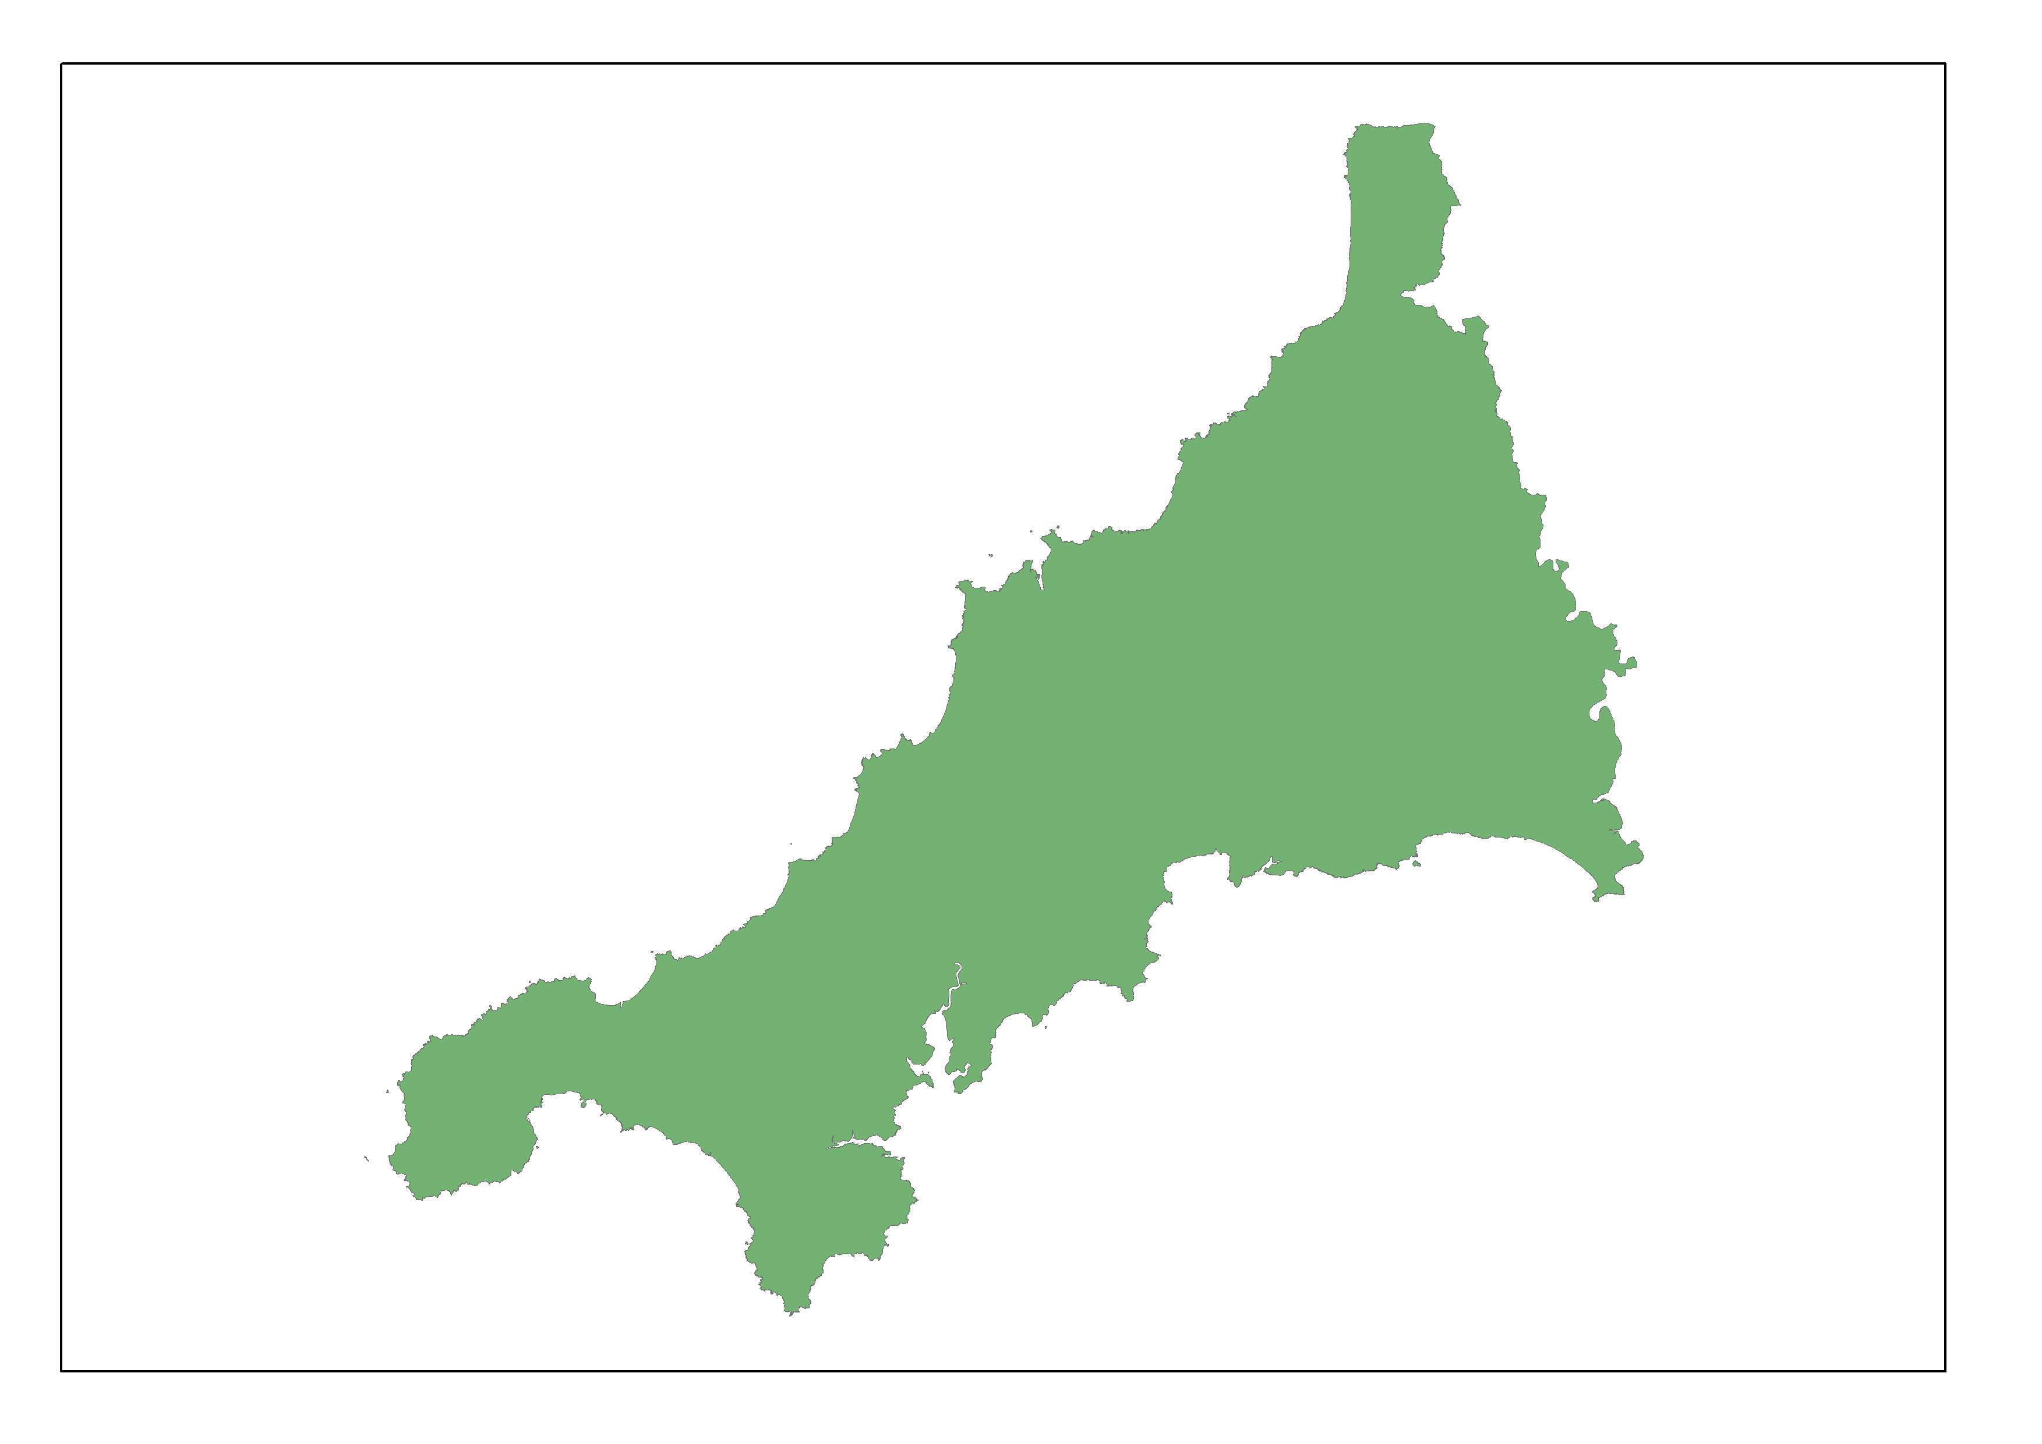
Cornwall 2009
Modifiable Areal Unit Problem (MAUP)!
© Crown copyright and database rights 2016 Ordnance Survey 100019153
Notes:
This spatial bias has been strengthened by the creation of large unitary authorities (e.g. Wiltshire, Herefordshire, Cornwall)
Six Cornish districts were replaced by a single Cornwall UA in 2009.
Any moves between the former districts are now suppressed. This does not mean that migration within the county of Cornwall has ceased. It’s just MAUP.
A move of up to 70 miles can now begin and end in Cornwall and not be registered as a migration.

Slide 17
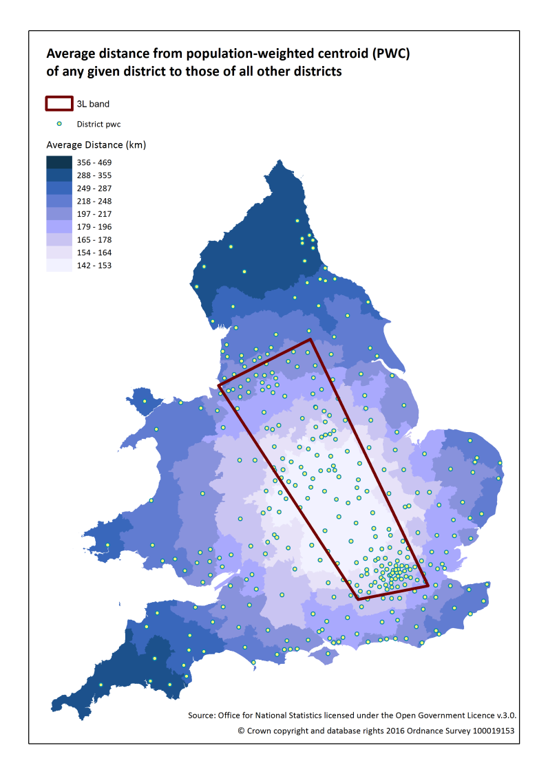
Average distance migrated
Central areas closer to all other areas than areas on the periphery - simple geometry.
In 3L on average, smaller
Moves beginning in smaller areas are more likely to be registered.
In combination, the measure not so much illuminating as an artefact of the inputs.
Notes:
Central areas tend to be closer to all other areas than areas on the periphery. This is simple geometry.
Most of the central areas of England and Wales are located in the 3L band.
They are also, on average, smaller and we know that moves beginning in smaller areas are more likely to be registered.
The resulting measure of average distance migrated is not so much illuminating as an artefact of the inputs.

Slide 18
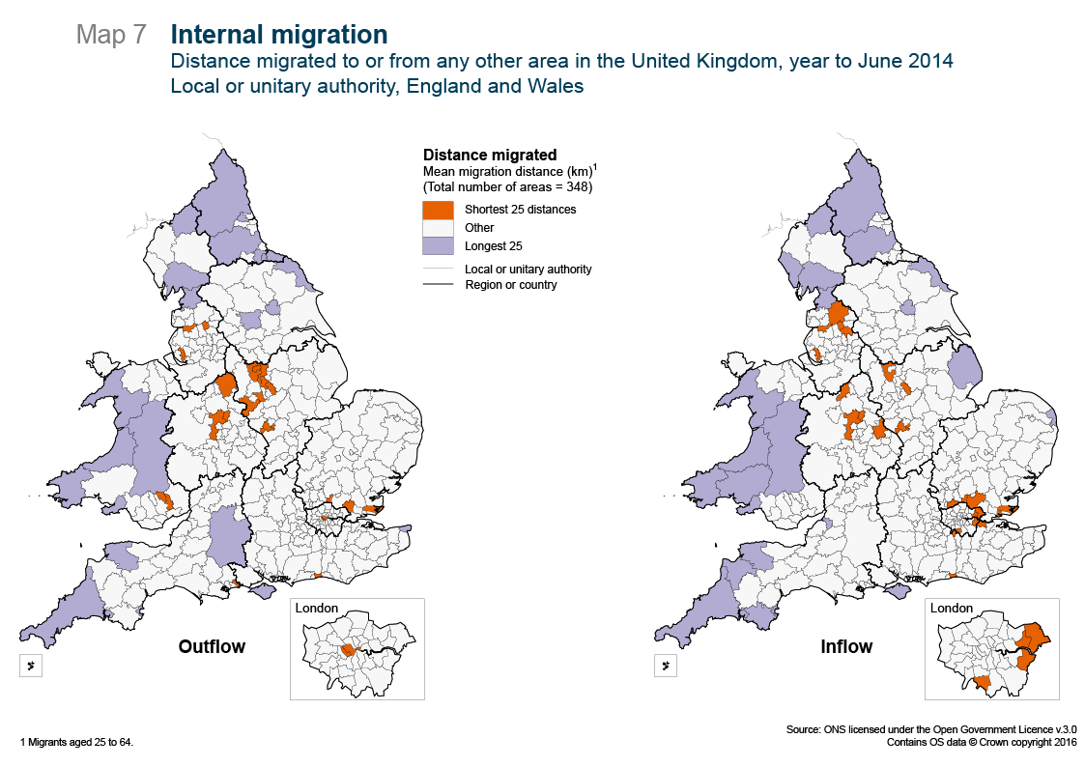

Slide 19
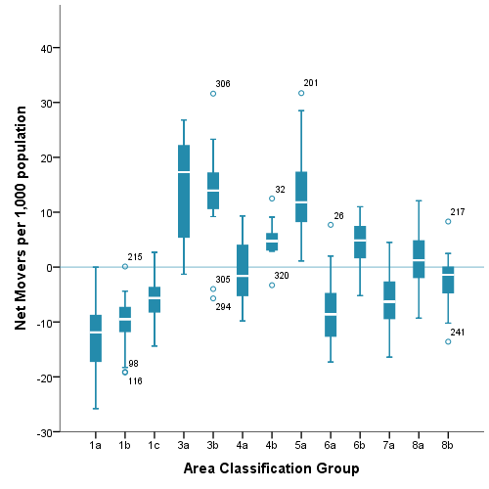
Correlations between Migration and Area Classifications
London Cosmopolitan,
Business and Education
Rural, Mining & Manufacturing,
Coastal, Heritage

Slide 20
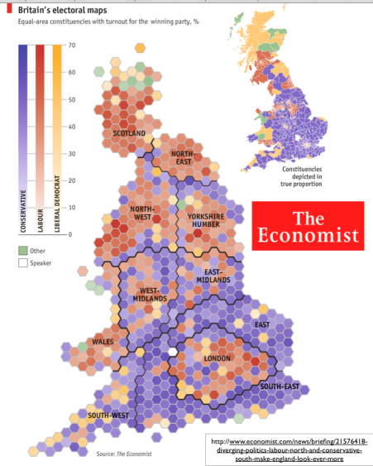
Selected mapping solutions
Choropleth (density shading)
+ Suitable for rate data
Dominated by large areas
Hex (each area represented by
an equally-sized hexagon)
+ Small areas are easily seen
Hard to navigate
Notes:
Hex map - the most easily understood cartogram known to man

Slide 21
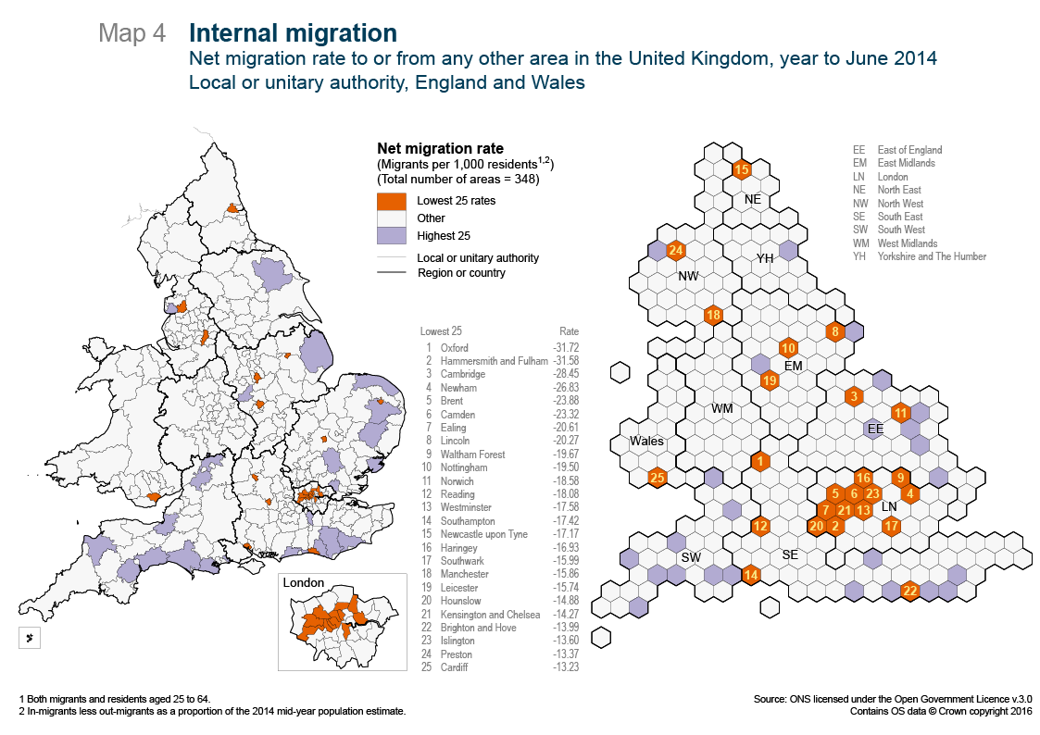
Notes:
ORANGE losing
BLUE GAINING
What seems to be the story – that university cities are losing pop is not so.
Why isn’t Canterbury there?
Partly it’s postgrads.
Mainly it’s empirical proof of what shown theoretically earlier.
It’s a function of the shapes and boundaries of the geography.
The small LADs causing migrations to be recorded.
Also forcing development beyond borders.
If all Oxfordshire were one, it wouldn’t figure in the bottom 25.
Risks of publishing without strong caveats – or even with!.

Slide 24
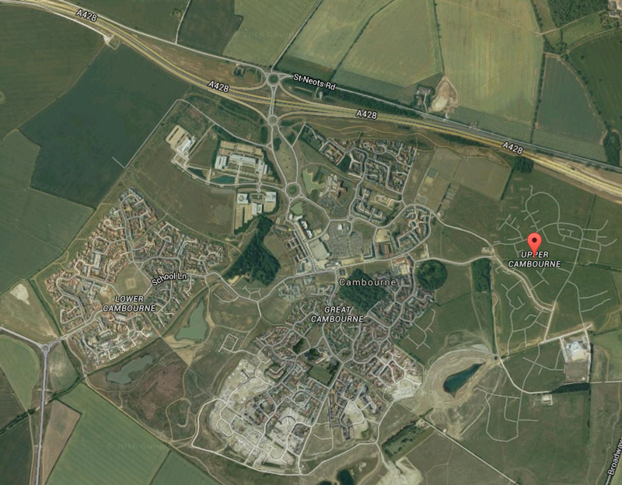

Slide 25
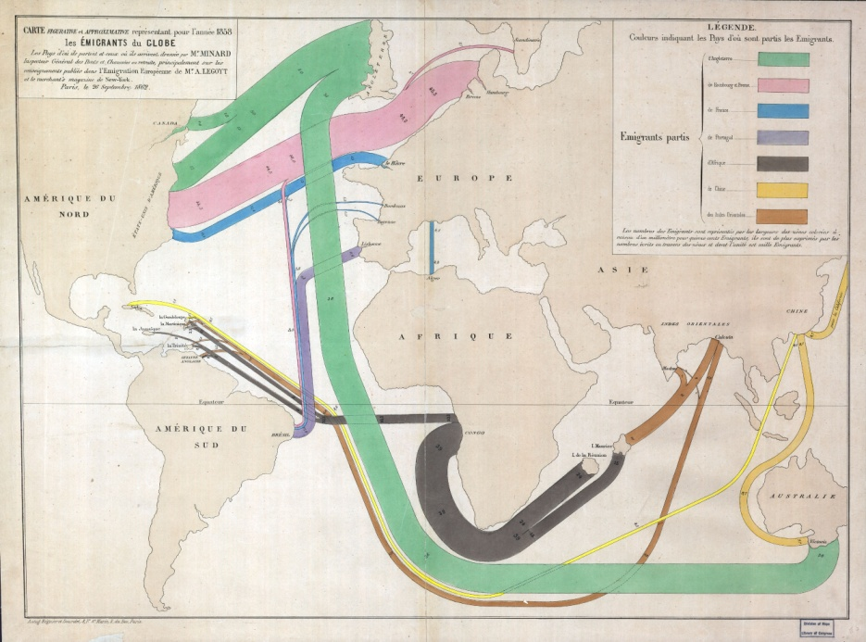
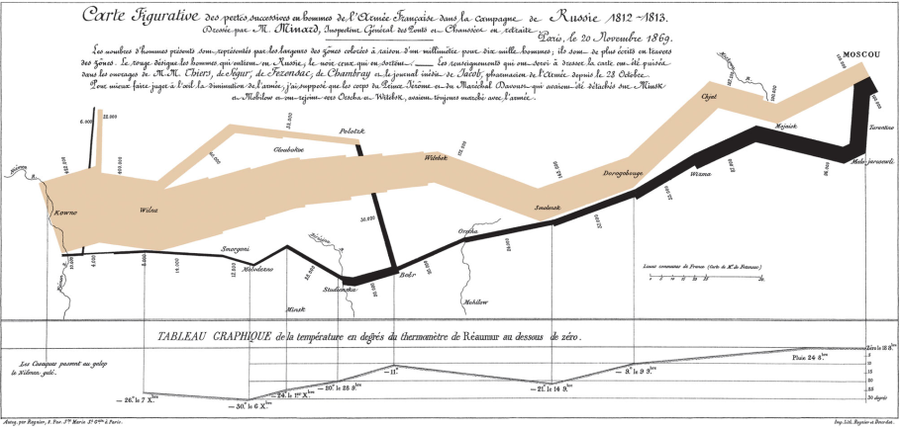
Adding value through non-standard graphical approaches using R
Flow mapping using R (http://spatial.ly/)
James Cheshire
Visualising Migration Flow Data with Circular Plots
Nikola Sander, Guy J. Abel, Ramon Bauer and Johannes Schmidt.
Band or Sankey diagrams
Originated with Charles Minard

Slide 26
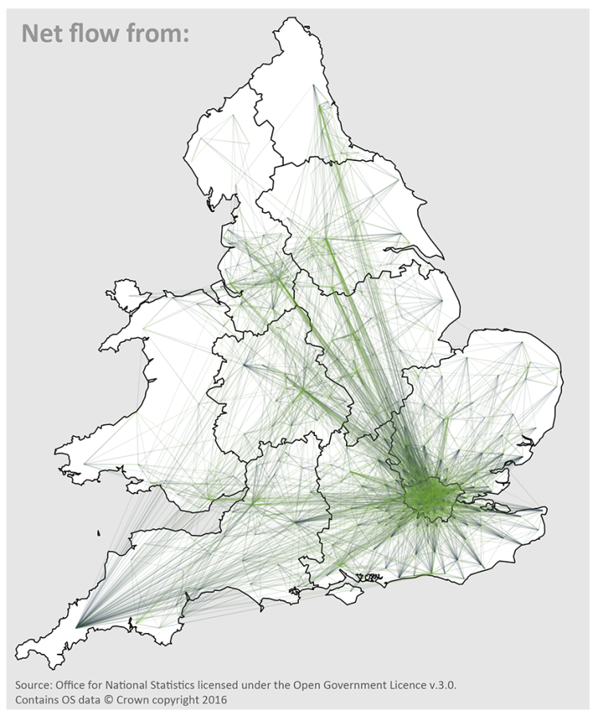
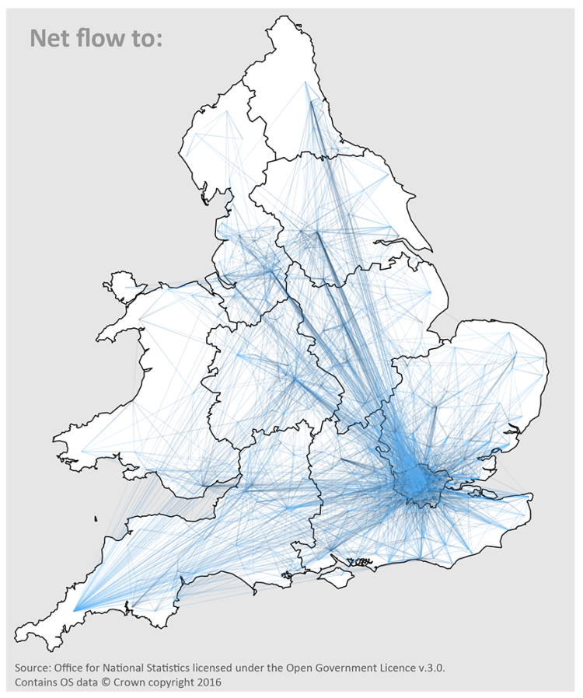
Collaborations with BigData team: 1: Net Internal migration flows, plotted in R
Notes:
Nice so fa=r as it goes, but
migration is dynamic
Impresssion not quantitative
Let’s move onto animated R map
Then nice segue into Chord and Sankey

Slide 28
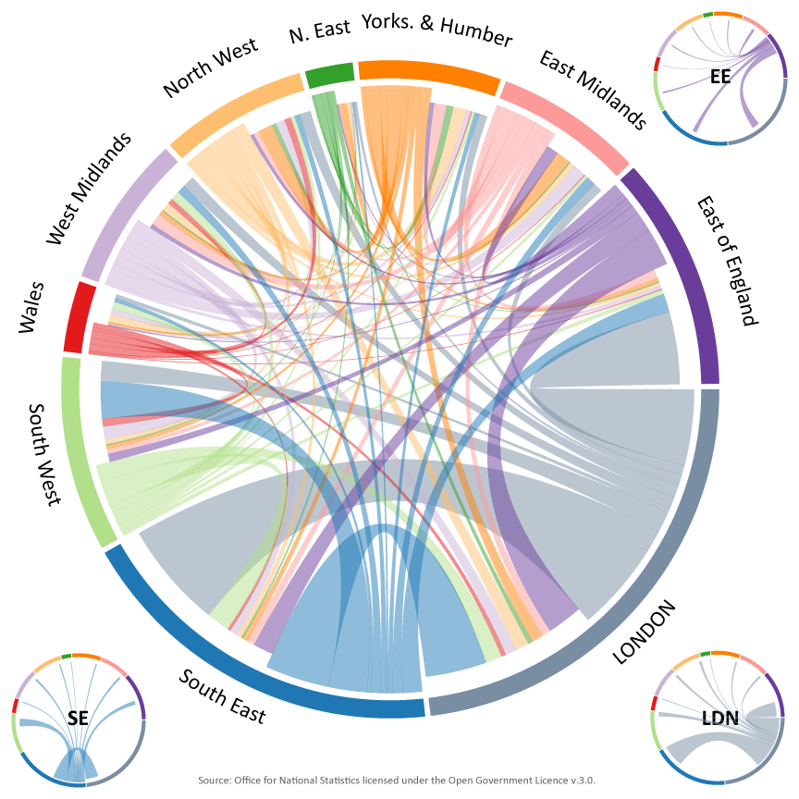
3: Chord diagram - total internal migration flows by region
Notes:
Indent, non indent

Slide 29
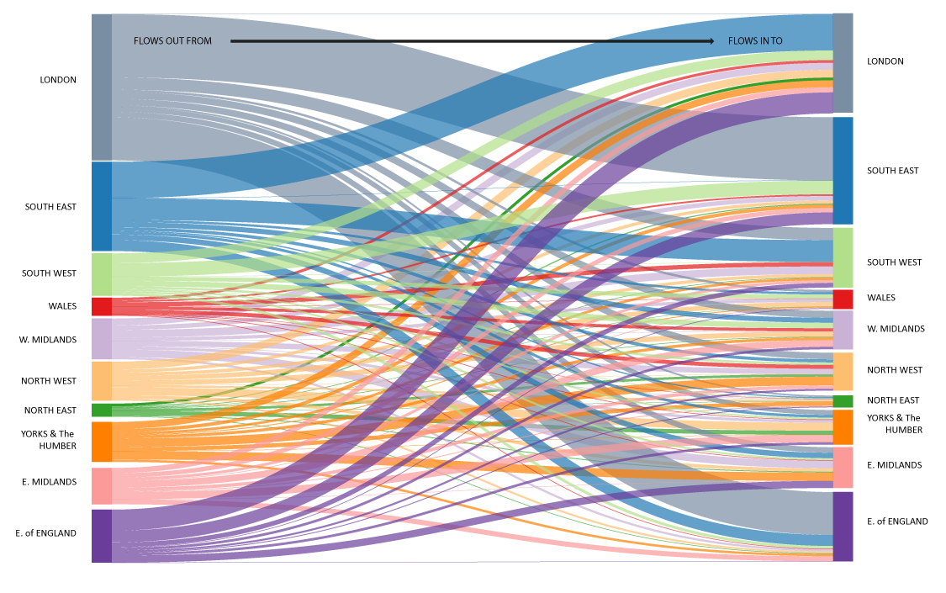
4: Sankey diagram - total internal migrations by region, England and Wales, 2014
Notes:
If so many moving out of London, how come London still growing?
Look at international map.
Very interesting but not here as professional demographer.

Slide 30
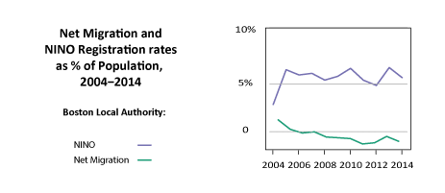
Contrasts with short-term migration

Slide 31
A degree of success
Collaboration across ONS
Spatial variations in labour mobility identified
Correlations with ONS Area Classifications
Rapid turnaround of innovative graphics
“a great example of agile curiosity in action from all sides”
“a very nice case study for how being curious can bring big dividends”

Slide 32
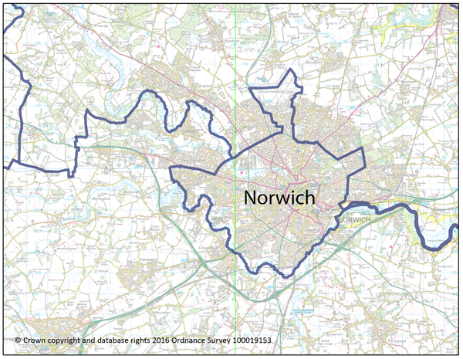
Some aspects of the brief unrealisable with current data
Districts are not towns
Migration ‘catchment areas’ meaningless at LAD level.

Slide 33
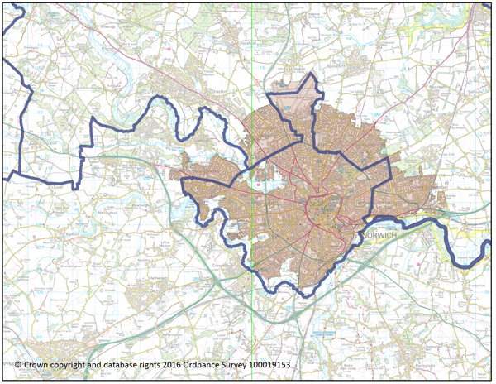
Some aspects of the brief unrealisable with current data
Districts are not towns. See ONS’ new ’Major Towns and Cities’ dataset.
Migration ‘catchment areas’ meaningless at LAD level.

Slide 34
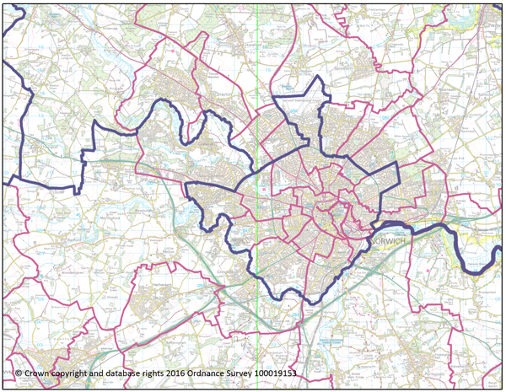
MSOA - a solution to the catchment area problem?
Possible solutions:
Record-level extract from Census 2011 – but more out of date with every passing year..
Disaggregation of current data to a lower geography?
Census statistical geography designed with spatial analysis in mind.

Slide 35
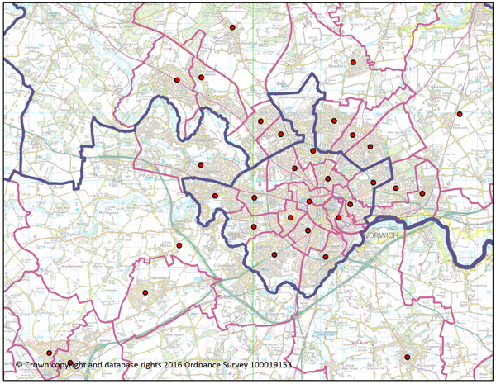
MSOA - a solution to the catchment area problem?
Possible solutions:
Record-level extract from Census 2011 – but more out of date with every passing year..
Disaggregation of current data to a lower geography?
Census statistical geography designed with spatial analysis in mind.

Slide 36
MSOA - a solution to the catchment area problem?
Redistribute future internal migration data down to MSOA?
Accuracy and currency of underlying admin data?
e.g. NHSPR:
Persistent lag
NHS Trusts are not equally efficient
Variable by age and sex

Slide 37
Summary
Understand your geography!
Opportunity to
Train up new team
Collaborate across ONS
Adopt innovative approaches
Acquire new capabilities

Slide 38
Thank you
Any questions?
Contact ONS Geography at: ons.geography@ons.gov.uk Access Open Geography products at: https://geoportal.statistics.gov.uk/geoportal Follow ONS Geography at @ONSgeography

