Slide 1
How can geospatial methodology impact policy and decision making?
Mark Baines (ONS Geography)
July 2017
ons.geography@ons.gov.uk
@onsgeography

Slide 2
Contents
Drivers for geospatial methodology
Creating geographies for workplace
Impact of the Workplace Zone geography on data and analysis
Case studies of Workplace Zone use in decision making and policy
Will not cover the methodology of Workplace Zones

Slide 3
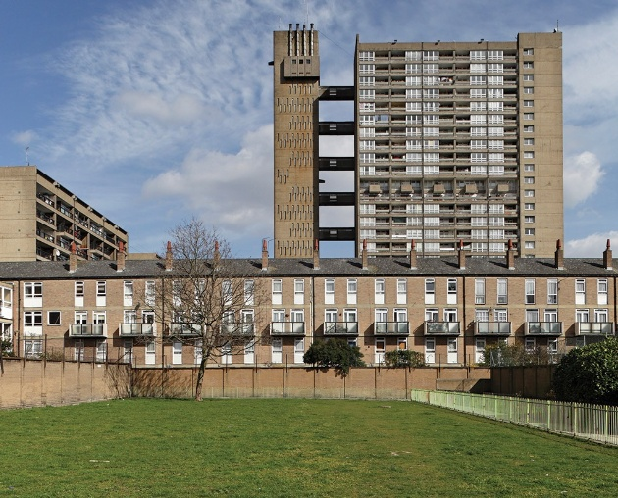
Notes:
Spatial methodology is hugely important in making sure we get the right funding to thr right people in the right places.

Slide 4
Background
Previously statistics were mainly released on administrative or electoral geographies
Inconsistent geographic and population sizes make it hard to compare statistics for these areas.
More geographic change in the UK than the rest of Europe put together
Output Areas:
created as a small area geography to allow release of census statistics
Developed for 2001 Census in England and Wales
Based on consistent residential populations

Slide 5
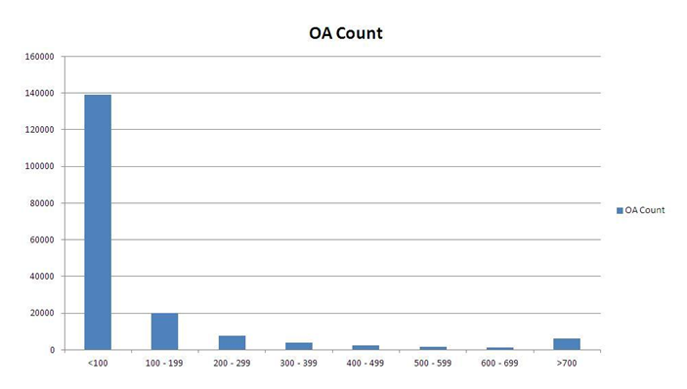
Problems with Workplace Statistics
Number of workers by Output Area
Over 75% of OAs have less than 100 workers,
126 OAs have no workers
Number of OAs
4% (7,256) of OAs have more than, 625 workers, 1 OA has 128,751 workers
Number of workers
Notes:
OAs – not suitable for publishing workplace statistics as based on residential population
Disclosure – only 3 tables released for workplace statistics at OA level (2001 Census)
New geography created 2011 Census for England and Wales based on working population
Disclosure thresholds different for Census and non-Census
OAs reflect the residential population not working population
Inter-departmental business register
Output Areas were as the building blocks to create workplace zones but as we can see from the graph they are not fit for purpose. The most important point to draw to your attention is that 75% of OAs have a working population less than the minimum threshold for releasing workplace statistics.

Slide 7
Workplace Zone Results
Notes:
This graph shows that there are no workplace zones with fewer than 100 workers and it illustrates that Workplace Zones are effective geography for publishing workplace statistics.

Slide 8
Source: Office for National Statistics licensed under the Open Government Licence v.3.0.

Slide 9
Source: Office for National Statistics licensed under the Open Government Licence v.3.0.

Slide 10
Going Forward
Understand user requirements for 2021 Census
Statistical trends are away from Census enumeration to use of alternative datasets.
Business and Employment Survey data not released by WZ:
Design based on 5 addresses
WZs design based on 3 postcodes
However, WZ – cannot become a building block for official statistics without non Census data attached.
Identify use cases on building houses close to work, helping people get from those houses to where they work and providing those people with the services that they need – work/life balance

Slide 11
Impact

Slide 12
Impact – Housing
Workplace Zone data on density of workers used to identify priority areas for affordable housing
Coordinate housing development in Oxfordshire
Lack of affordable housing
Impact on environment and greenbelt
Feeds into corporate plans along with other data every 4 years
– to measure amount of business and employment
Right infrastructure & support for economic growth

Slide 13
Workplace Population Density - Chichester
Link to Consumer Data Research Centre
Contains National Statistics & Ordnance Survey data © Crown copyright & database right 2017.

Slide 15
Impact – Transport
Use method of travel to work data on Workplace Zones from 2011 Census – assess commuting patterns and travel behaviour
Encourage methods of sustainable transport
Environmental benefits - reduces traffic congestion/pollution
Notes:
2021 – How existing workplacez has been used.

Slide 17
Impact - Commercial
Where people buy goods or services influence location of new stores – people shopping/banking in their lunch break
Two case studies:
University of Leeds and Co-Op
Knight Frank Ltd
Lack of available information on how commercial sector are using workplace statistics
Classification of Workplace Zones (COWZ) – area classifications & adds value to statistics
Notes:
As you have

Slide 18
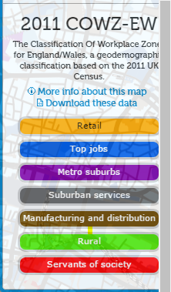
Nearest Co-Op Stores to SW1 0ET
Co-Op Stores near BIS conference centre
Link to Consumer Data Research Centre
Contains National Statistics & Ordnance Survey data © Crown copyright & database right 2014-5.

Slide 19
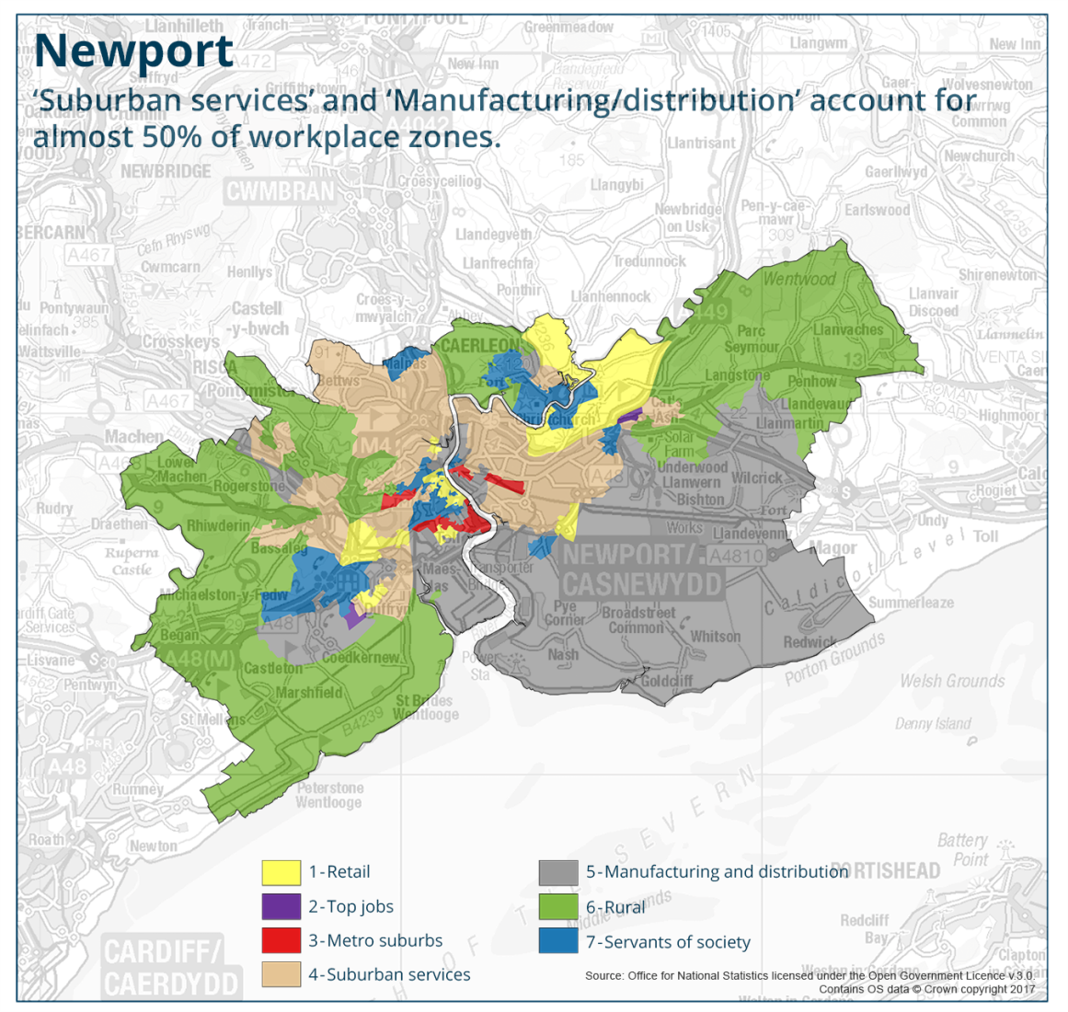
Classification of Workplace Zones (COWZ)

Slide 20
Challenges
Getting value of WZs for Central Government
Updating WZs – as small area geography based using administrative data
Unclear how to do this - research previously focused solely on OAs
Business and Employment Survey data onto WZs – more useful
Lack of comparable datasets at the UK level

Slide 21
Summary
OAs – disclosive not suitable for releasing workplace statistics based on residential pop
Workplace Zones – solves disclosure issues based on working population and allows release of workplace statistics
Requirements to update Workplace Zones unclear and move towards admin data
More useful if non-Census data is published at Workplace Zone level.
Lack of available information from commercial sector on what impact on decision making

Slide 22
Questions?
Come and talk us about whether or not you are using Workplace Zones. We would like to hear from you.
Mark Baines – 01329 444193 or mark.baines@ons.gov.uk

