Slide 1
Using Daily Data to Identify New Holiday Effects: Easter[0]
Brian C. Monsell
U. S. Census Bureau
March 7, 2017

Slide 2
Disclaimer
This report is released to inform interested parties of research and to encourage discussion. The views expressed on statistical issues are those of the author and not necessarily those of the U. S. Census Bureau.

Slide 3
Review: Easter effects
Easter Sunday can fall in March or April depending on the year.
Retail Sales series currently only use an Easter[8] regressor in X-13 models, capturing an increase or decrease in activity 8 days before Easter.

Slide 4
Consider the three following Easter dates:
March
13 | 14 | 15 | 16 | 17 | 18 | 19
20 | 21 | 22 | 23 | 24 | 25 | 26
27
Easter on March 27th
All activity in the 8 days is captured in March.

Slide 5
Daily data provide a unique look at holiday effects
Daily retail data provide a rare opportunity:
To find evidence for/against a larger variety of holidays including Super Bowl Sunday, Easter Sunday, Ramadan, Chinese New Year, and Cyber Monday.
To have greater granularity of when sales increase/decrease on and surrounding holidays.

Slide 6
Rare access to daily retail data
Pilot Project with Bureau of Economic Analysis and Palantir Technologies, Inc. gave access to FirstData’s consumer spending data. The data:
Capture about 45% of all point-of-sale transactions including credit, debit, and prepaid gift card transactions but not cash
Series run 10/1/2012 through 4/30/2016
Daily data has risks
Observed effects in the daily data may be due entirely to the companies that use FirstData payment processing and not representative of the entire country.

Slide 7
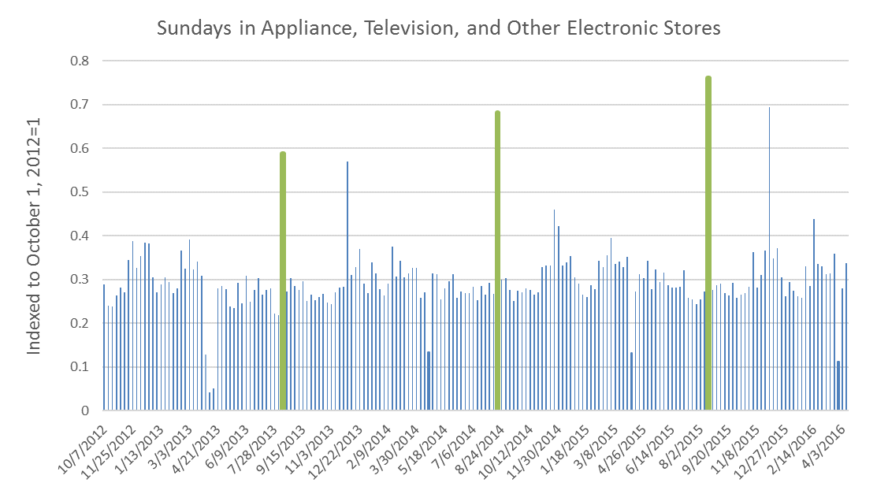
Massachusetts State Tax Holiday’s impact on sales of electronics
Green Bars = Massachusetts Tax Holiday

Slide 8
Fitting daily data into monthly methodology
Visual Analysis
First Data
Daily data by industry
Monthly Retail Trade Survey
Monthly Data by Industry
X-13 Modeling
Apply findings
Numerical Analysis
Make recommendations to Monthly Retail analysts and math stats

Slide 9
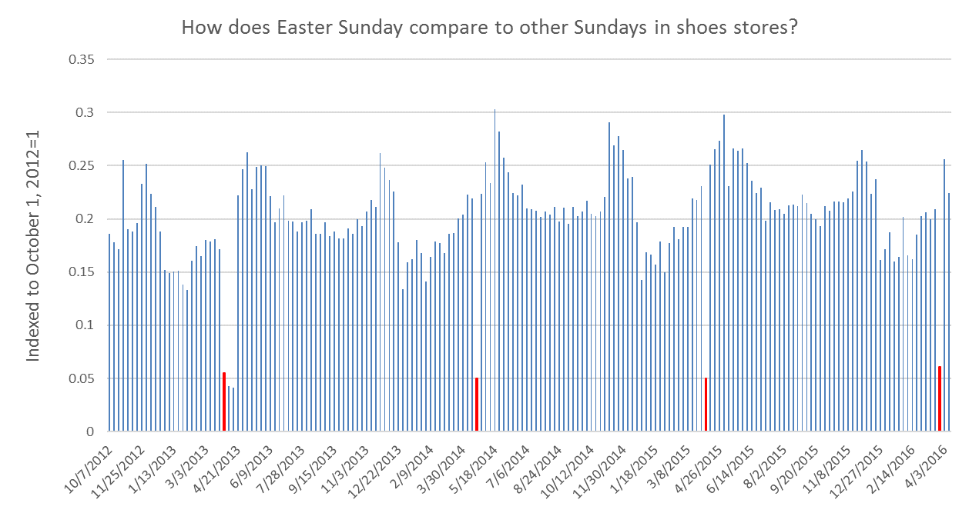
Example: Retail Shoe Stores
Identified depressed sales on Easter Sunday in FirstData shoe store data (Red bars=Easter Sunday):

Slide 10
Easter[0] significant in MRTS Shoe Stores
Tested four Easter holiday effect scenarios:
Table 1: Easter Holiday Effect Regressors for Shoes Stores in Monthly Retail Trade Survey
 | No Easter Effect | Easter[0] Only | Easter[8] Only | Easter[0] & Easter[8]
Easter[0] t-statistic |  | -5.12 |  | -2.40
Easter[8] t-statistic |  |  | 4.52 | 4.24
AICC | 1505.2 | 1502.3 | 1491.9 | 1488.7

Slide 11
Easter Sunday Effect: Home Centers
Note: Our production model for Home Centers currently includes no Easter effects.

Slide 12
Easter[0] significant in MRTS Home Centers
Tested four Easter holiday effect scenarios:
Table 1: Easter Holiday Effect Regressors for Shoes Stores in Monthly Retail Trade Survey
 | No Easter Effect | Easter[0] Only | Easter[8] Only | Easter[0] & Easter[8]
Easter[0] t-statistic |  | -4.6 |  | -2.6
Easter[8] t-statistic |  |  | -3.9 | 0.9
AICC | 3582.6 | 3565.0 | 3570.7 | 3566.6

Slide 13
Conclusions
As a result of this work, all future builds of X-13ARIMA-SEATS software will include a built-in Easter[0] regressor.
Recommendations for inclusion of Easter[0] regressors are considered preliminary for this year.
Will be included in production runs starting in FY2018.

Slide 14
Acknowledgements
Rebecca Hutchinson
Tucker McElroy
Kathy McDonald-Johnson and Demetra Lytras
FirstData for providing the series
Palantir for delivering the data (edited for disclosure avoidance) along with the excellent visualization/analysis tool Octavius.

Slide 15
Thank you
brian.c.monsell@census.gov
rebecca.j.hutchinson@census.gov
tucker.s.mcelroy@census.gov

