Slide 1


Making the most of existing data sources
Informal care in the last days of life : a data linkage study
Kirsty MacLachlan, National Records of Scotland

Slide 2
Context
Ageing population
Addressing inequalities
Provision of health and social care services
Tightening fiscal situation
Brexit..

Slide 3
Projected percentage change in population by age structure 2014-2039

Slide 4
Questions
How have household structures in the final stages of life changed over time and how do they vary across Scotland?
How can we better plan the provision of health and social care services for people in the final stages of life?

Slide 5
Available data
Census – household structure and socio demographic data
Health data – diagnosed illnesses, hospitalisation, drugs, changes in where folk live
Vital event data – place of death, cause of death
BUT there is a greater wealth of information from linking data

Slide 6
Confidentiality of census
(and other) data is paramount
so need:
Robust governance – ethics, Privacy Impact Assessments, Public Benefit and Privacy Panel approvals, legal basis, Data Sharing Agreements etc
Secure access to data at the National Safe Haven at the Bioquarter
Trusted 3rd party linkage facility (at NRS)
Statistical disclosure control

Slide 7
Linkage Processes
Separation of Functions
  Indexing Team see no payload data
Spine Matching
  Deterministic and Probabilistic methods
Index numbers replace local IDs
Master Index of all dataset indexes per project
Summary Reports
  For researchers / research co-ordinators
  Data quality, linkage quality (precision, link rates)
  Potential biases (age/sex/deprivation)

Slide 8
Informal care in the last days of life: a data linkage study - Analysis plan
Death in hospital
(known from death record)
Hospitalized (SMR06 record)
2001 CENSUS
Diagnosed with cancer (SMR06)
Hospitalized
(SMR01 or SMR04)
Death at home
(known from death record)
Comparison of household structures amongst those who died in 2001 relative to 2011
Household structure
(from census records))
Death at home
(known from death record)
Geographical and socio-economic comparisons
Drugs associated with end of life received (prescribing records)
Comparison of those who died to those who survived
2011 CENSUS
Death at home
(known from death record)
Hospitalized
(SMR01 or SMR04)
Survivor – no indication of death
One year pre-census
One year post-census

Slide 9
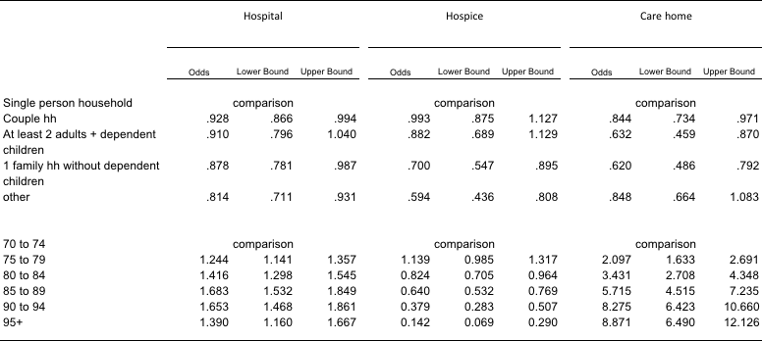
Multinomial regression model for those living independently at census *
(Odds relative to death at home)
* Adjusting for gender

Slide 10
Initial results
Much greater likelihood of deaths in care home for older old than at home, especially if a single person household at time of the census
Greater likelihood of death in hospital for 85-94 y.o. than at home
Greater likelihood of death in a hospice for younger elderly especially if a single person household, less likely if living in a family

Slide 11
Further information
Scottish Informatics and Linkage Collaboration (SILC)
http://www.datalinkagescotland.co.uk/
Data linkage framework in Scotland
http://www.gov.scot/Topics/Statistics/datalinkageframework
2011 Scotland’s Census results
http://www.scotlandscensus.gov.uk/census-results
kirsty.maclachlan@nrscotland.gov.uk

Slide 12
Additional slides if needed

Slide 13
Overview of Indexing Service
Trusted Third Party for Scottish Informatics Linkage Collaboration (SILC)
One of SILC shared services supporting ADRC-S, Farr Institute Scotland, Scottish Government and Urban Big Data Centre
Work closely with other shared services – eDRIS Research Co-ordinators, EPCC Safe Haven

Slide 14
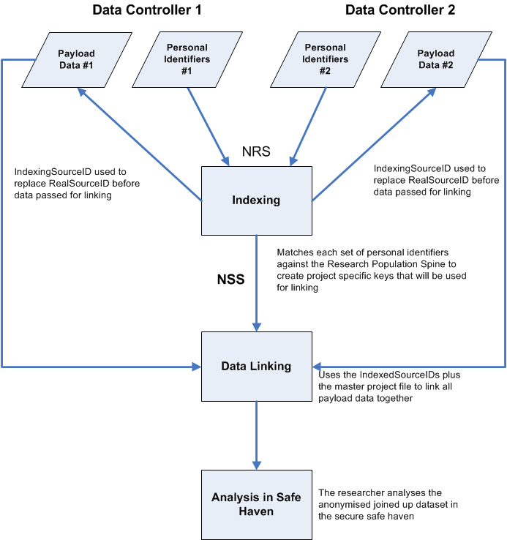
Separation of functions
Data Controller’s Unique Reference Number (SourceID) and PII transferred to NRS Indexing Team
SourceID and IndexedSourceID transferred to Data Controllers
Researcher accesses linked de-identified data in a safe setting
Master lookup file transferred to the Linkage Agent to allow the IndexedSourceIDs from each dataset to be linked
NRS indexing team create the Master Index File which links each IndexedSourceID
Match PII to the Research Population Spine. Randomly generated IndexedSourceIDs assigned to all records
IndexedSourceID and Payload Data transferred by Data Controllers to the Linkage Agent

Slide 15
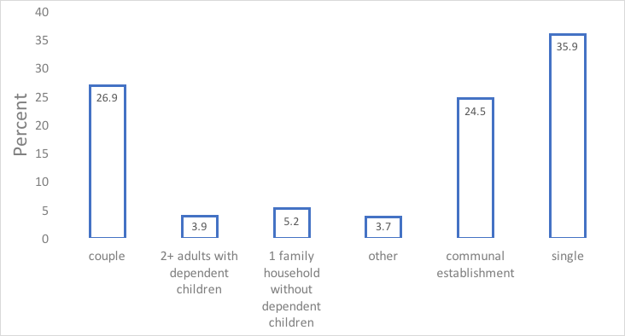
Household types of people aged 70 years+ who died within one year of Scotland’s census
Total households = 34,003

Slide 16
25,658 deaths (age 70+ with linked records who were living independently at time of census)
6,404 at private address
16,091 in hospital
5,295’403 people
1,538 in care home
1,625 in a hospice
One year post-census

Slide 17
The age structure is changing – up to 2039
Projected percentage change in population by age structure 2014-2039

