Slide 1
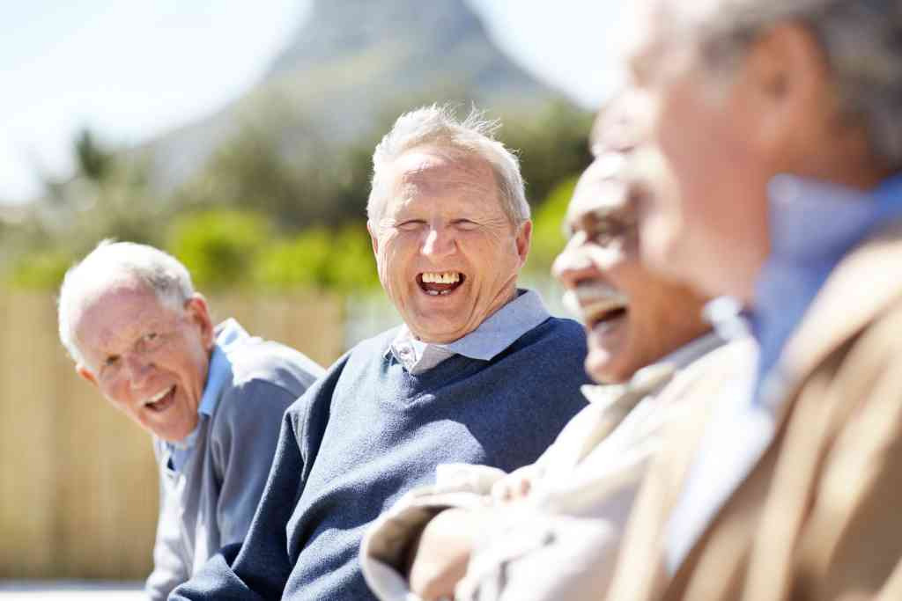
Data gaps and what we have done so far
Anne Vibeke Jacobsen, Denmark

Slide 2
Agenda
Elderly in Denmark
  Why are they interesting?
  What help can they get?
Data gaps
What have Statistics Denmark done?

Slide 3
People at 65 years and above
1,100,000 inhabitants in 2017 at 65 years and above. The elderly is 19 pct. of the total population, and the number is increasing
Share of elderly 1993-2017

Slide 4
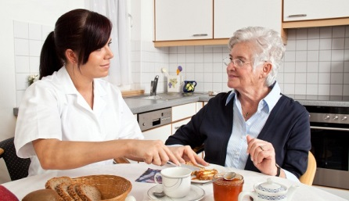
Elderly benefits
In Denmark it is preferred that old people stay in their own home as long as possible
About 123,000 people get home care

Slide 5
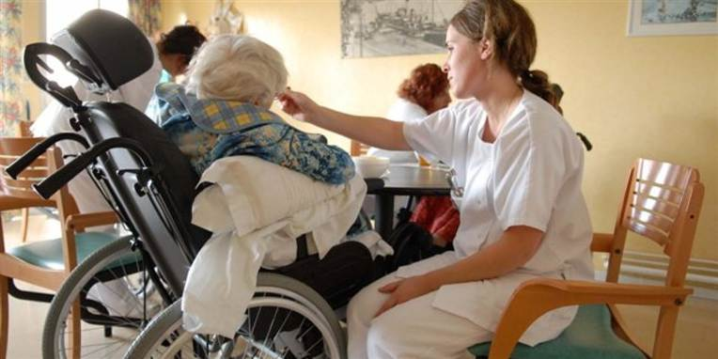
Elderly benefits
About 46,000 inhabitants live at nursery homes

Slide 6
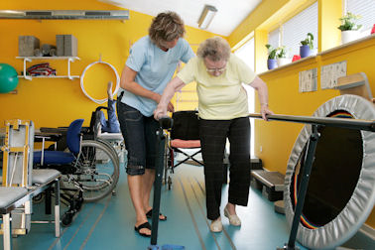
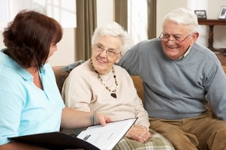
Elderly benefits
You can also get training, if you have been sick and need to recover.
Every year 25,000 people get training
The buzzword these years is rehabilitation. Every year 35,000 people are rehabilitated

Slide 7
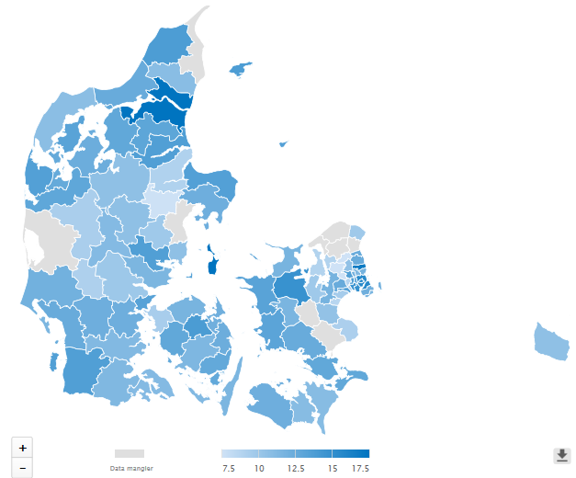
Data gap:
We do not have data for all municipalities
www.dst.dk/kommunekort

Slide 8
Process of collecting data
The municipalities’ EOJ-systems
Validation
Statistics
Denmark
XML-files
Software
Response to the municipalities
Validation
Working up
IT - suppliers
KMD
Avaleo
Statbank
Analysis/articles
CSC
Notes:
FLIS er de samme grunddata som DST bruger og som vi sender tilbage i månedsrapporter

Slide 9
Where are the problems?
IT - Suppliers
  The municipalities get a new system
  New versions
  Takes time to implement new demands
Municipalities
  Not their biggest priority
  Too complex systems
  Not the necessary IT skills
  New employees

Slide 10
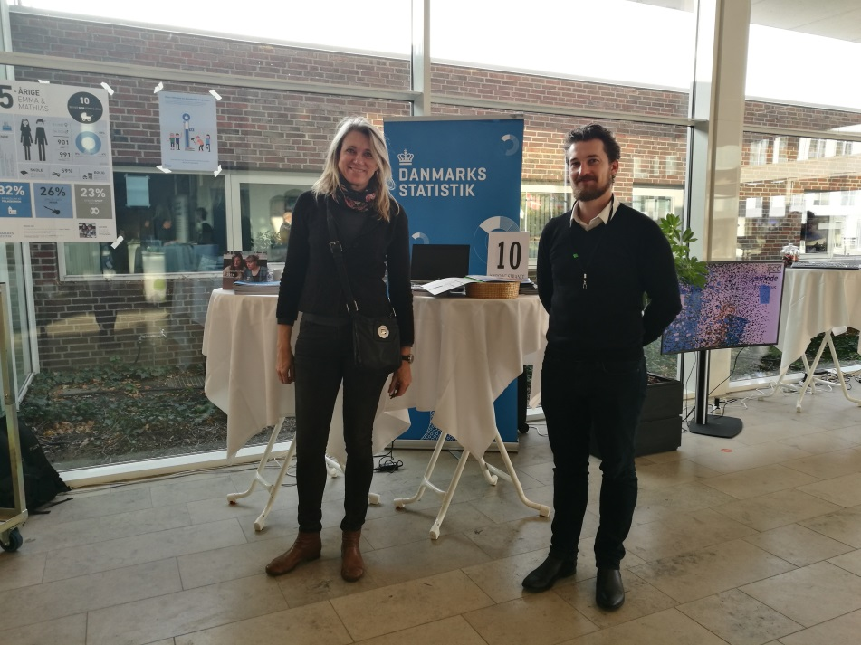
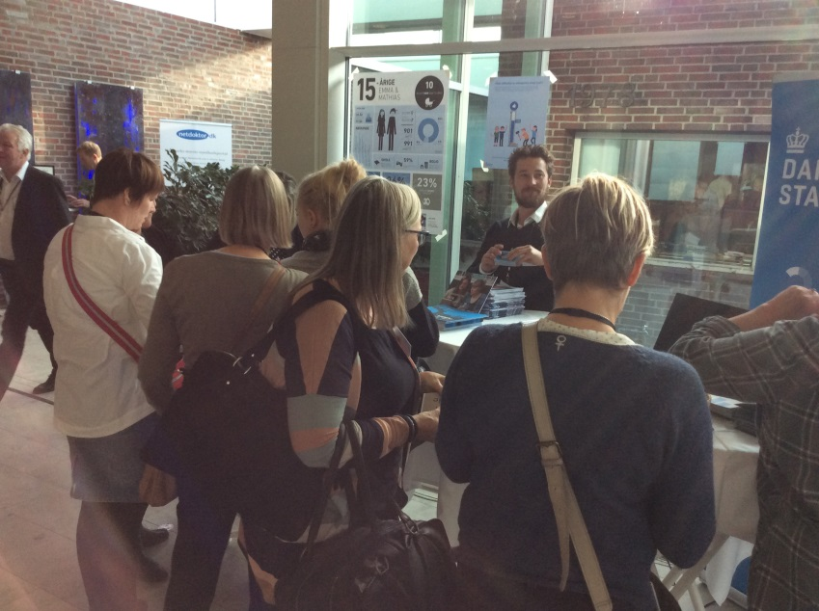
What have we done?
Conferences
Stands
Talks at big meetings
Meetings with individual municipality
Yearly meetings with suppliers

Slide 11
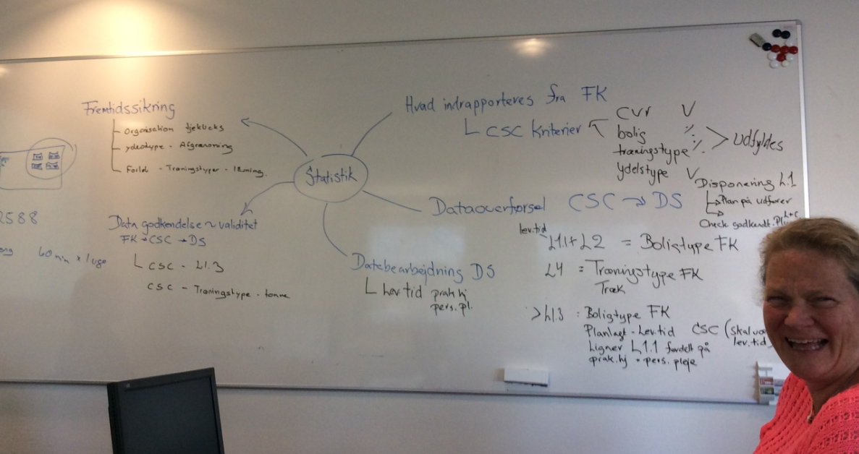
Visiting a municipality

Slide 12
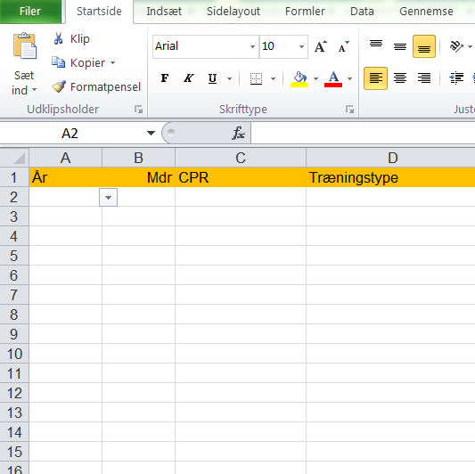
Usage of predefined spreadsheet

Slide 13
Respons to the chief executives every half year

Slide 14
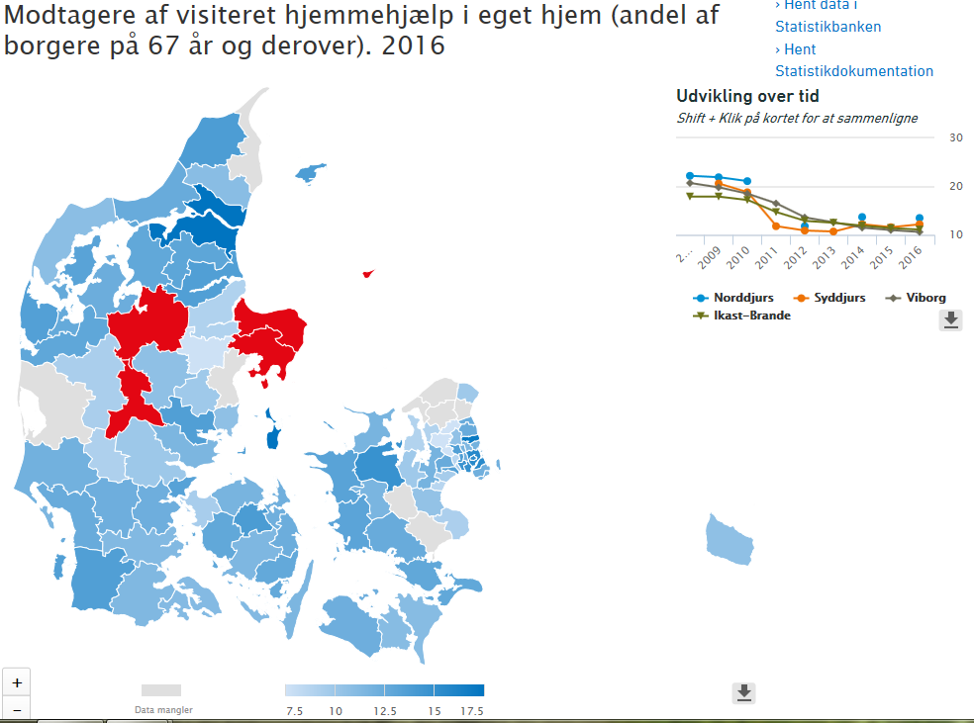
www.dst.dk/kommunekort

Slide 15
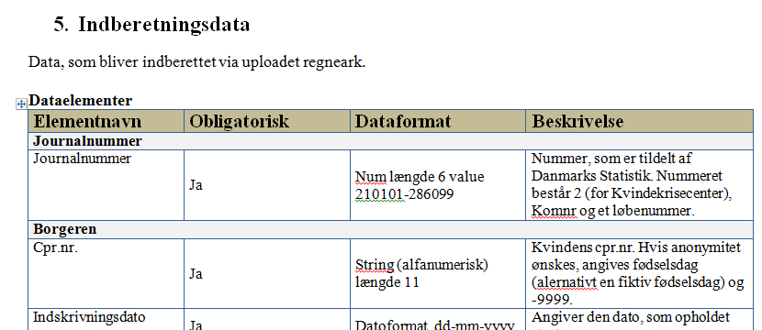
Departemental order
Expansion of the law
If the municipality do not deliver data, they must make a plan to the ministry

Slide 16
Usage of existing datasources
Use data from earlier years
Use population register.
  Fx how much help do they get in municipalities that have reported
  What is the share of the population
  This share is multiplied on the population in municipalities, where we miss data

Slide 17
Use the statistics in new ways
Usage of data in new ways creates more focus on data
  Combination of statistics about elderly and quality of life
 | Men | Women | Men and women
 | score
All at 65 years and above | 8.1 | 8.1 | 8.1
Home care
Not referred home care | 8.2 | 8.2 | 8.2
Both personal care and practical duties | 6.1 | 7.1 | 6.8
Only personal care | 6.4 | 7.0 | 6.7
Only practical duties | 6.9 | 7.5 | 7.3

Slide 18
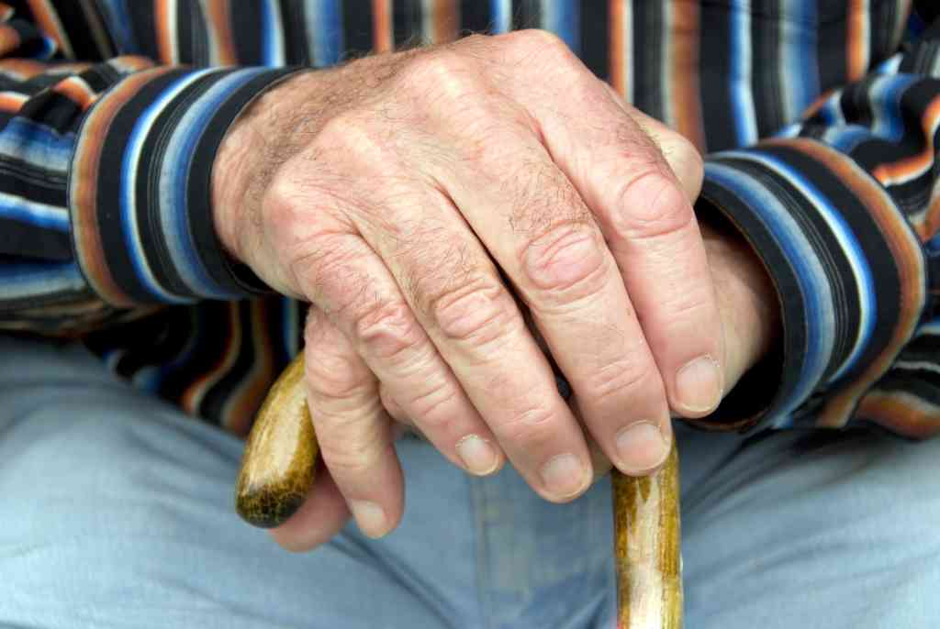
Do you also have system-to-system solutions?
What is your experience, and how can we improve?
Do you have other ways to get missing data?

