Slide 1
49%
Of working age adults lacked level 1 numeracy skills
Skills for life survey, 2011

Slide 2
Our statistical outputs rarely support the questions that ordinary people have

Slide 4
What affects an area’s healthy life expectancy?
https://visual.ons.gov.uk/what-affects-an-areas-healthy-life-expectancy/

Slide 5
How long does my pension need to last?
http://visual.ons.gov.uk/how-long-will-my-pension-need-to-last/

Slide 6
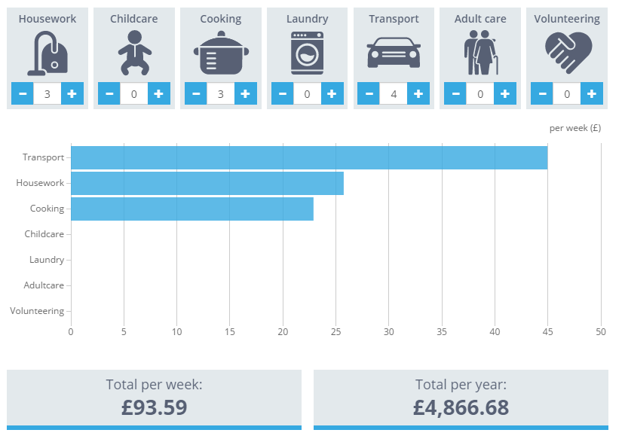
What is the value of my unpaid work?
https://visual.ons.gov.uk/the-value-of-your-unpaid-work/

Slide 7
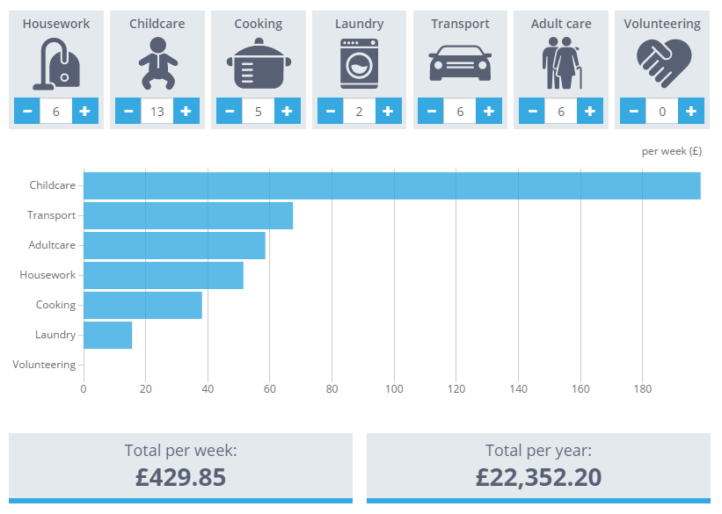
Me in 10 years…?
https://visual.ons.gov.uk/the-value-of-your-unpaid-work/

Slide 8
Cancer survival rates - are they improving?
http://visual.ons.gov.uk/how-do-survival-estimates-compare-for-common-cancers/

Slide 9
Does more spending on healthcare result in longer lives?
http://visual.ons.gov.uk/how-does-uk-healthcare-spending-compare-internationally/

Slide 10
Does affluence contribute to the age at which we die?
Most affluent man outlives the average woman for the first time
http://visual.ons.gov.uk/most-affluent-man-now-outlives-the-average-woman-for-the-first-time/

Slide 11
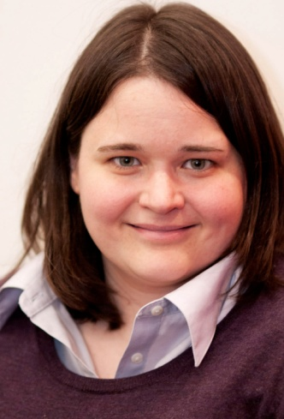
“The best visualizations cause you to see something you weren’t expecting, and allow you to act on it.”
Amanda Cox
Graphics editor at the New York Times

Slide 12
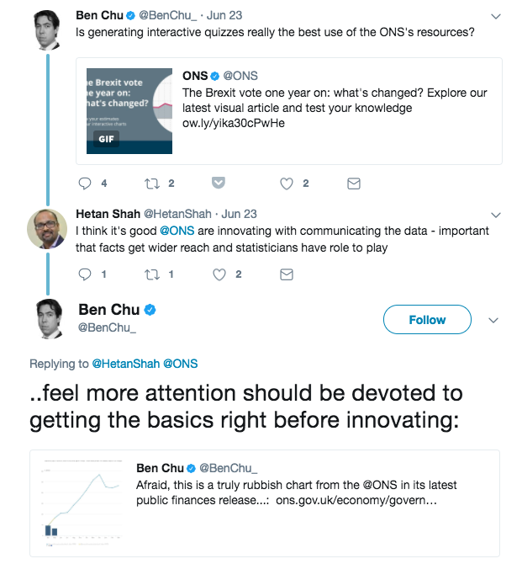
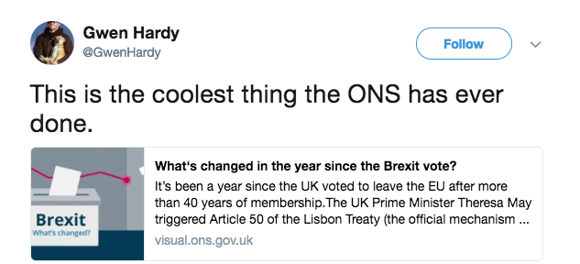
You will get praise and criticism

