Slide 1

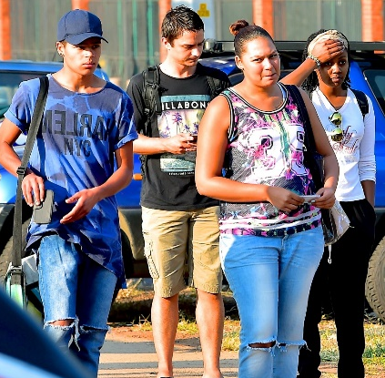

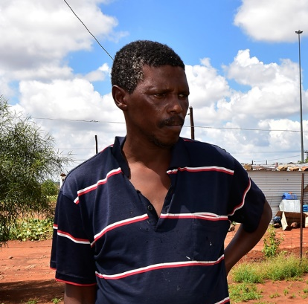
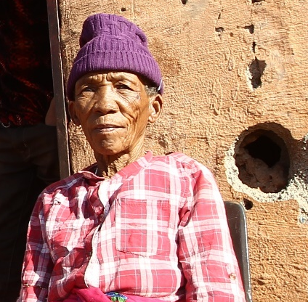
Dynamics of age measurement and estimation
Experiences from Statistics South Africa
Presented by Dr Isabelle Schmidt
Statistics South Africa

Slide 2




Age measurement non-sampling errors
Accuracy of biological age as per respondent’s records (CRVS)
ABC
Low levels of numeracy and literacy
123
Content and phrasing of the question
Data collection methods (proxy versus self reporting and household record method)

Slide 3
Number of birth registrations,1993-2013
After peaking at 78% in 1998, late registrations of births continued declining, dropping to 26% in 2013.

Slide 4

Late or non-registrations consequences
Inaccurate DOB and in the case of social grant recipients especially OAG means the difference between receipt and non-receipt.
Birth registration Completeness: 89%
65% registered within 30 Days after birth in 2015

Slide 5
Age as an important variable in grant provisioning , GHS 2016
Considerable provincial variations are notable. A third or more households in Limpopo, Eastern Cape and Norther Cape are dependent on Social Grants.

Slide 6
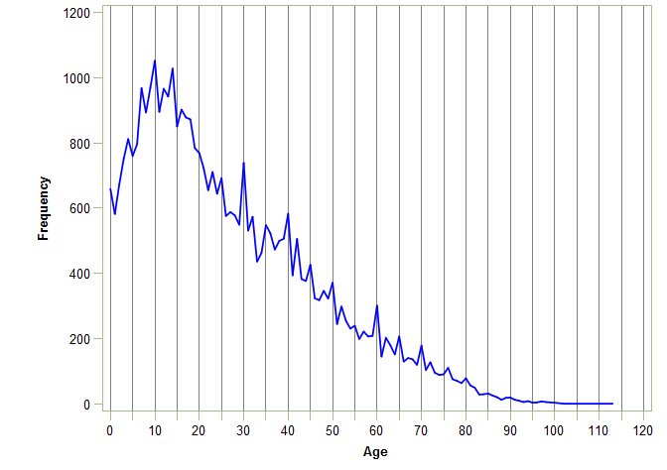
Age Heaping

Slide 7
Age Heaping measurement
Whipple’s Index :
The index can be summarised through the following categories :
Index Value | Interpretation
< 105 | Very accurate
105–110 | Fairly accurate
110–125 | Approximate
125–175 | Rough
≥ 175 | Very rough
United Nations standard to measure Age Heaping using Whipple's Index

Slide 8
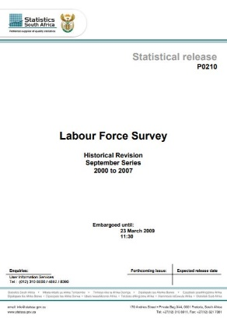
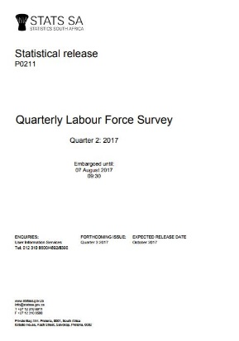
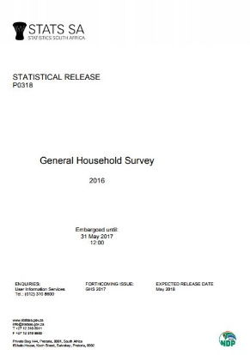
Data from selected surveys
vv
2002-2013
Labour Force Survey (2000 – 2007)
Quarterly Labour Force Survey (2008 – 2014)
General Household Survey (2002 – 2013)
No permanent field staff
Limited editing and imputation
Permanent field staff were appointed.
Date of birth used in addition to age
Automated editing and imputation system
Very strict processing rules regarding age
Date of birth introduced 2009
Automated editing and imputation system (from 2009-)
Processing rules for age not as strict as for QLFS
Permanent field staff were used from 2011

Slide 9
Age Heaping
 | LFS (200-2007) | QLFS (2008-2013) | GHS (2002-2013)
Overall | 108.62 | 101.07 | 104.83
Male | 107.61 | 100.58 | 104.73
Female | 109.47 | 101.43 | 104.98
Self | 107.43 | 100.74 | 104.30
Proxy | 110.25 | 101.57 | 105.60
Black/African | 108.28 | 100.76 | 104.46
Coloured | 106.34 | 101.42 | 104.37
Indian/Asian | 121.57 | 105.40 | 111.07
White | 111.17 | 102.17 | 107.35
Very accurate < 105 | Relatively accurate 105–109.9 | Approximate 110–124.9 | Bad 125–174.9 | Very bad ≥175

Slide 10
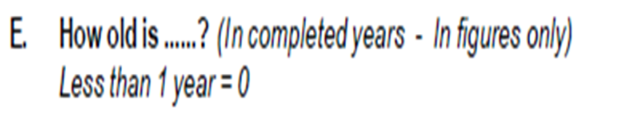
Addition of date of birth in question

Slide 11
Overall Index values: GHS (104.8)
Year | Whipple’s Index
 | Overall index value
 | Heaping on 30,40,50,60 |  | Heaping on 25,30,35,40,45,50,55,60
 | Before Imputation | After imputation | Before Imputation | After imputation
2002 | 104.37 | 104.34 | 104.19 | 104.15
2003 | 107.37 | 107.36 | 108.49 | 108.51
2004 | 105.70 | 105.74 | 105.17 | 105.18
2005 | 106.30 | 106.29 | 113.16 | 113.17
2006 | 101.88 | 101.89 | 104.52 | 104.51
2007 | 100.77 | 100.75 | 107.56 | 107.54
2008 | 103.78 | 103.76 | 108.30 | 108.34
Introduction of DOB question
2009 | 94.59 | 94.86 | 101.57 | 101.47
2010 | 97.50 | 94.92 | 102.94 | 102.93
Permanent field staff
2011 | 91.48 | 91.33 | 99.94 | 99.90
2012 | 98.52 | 98.47 | 100.23 | 100.26
2013 | 99.73 | 99.87 | 101.94 | 101.99
Very accurate < 105 | Relatively accurate 105–109.9 | Approximate 110–124.9 | Bad 125–174.9 | Very bad ≥175

Slide 12
Conclusions - Non-sampling errors age measurement
Birth registrations increasingly earlier – increased accuracy of age in population register
The reporting of age in the QLFS data and the GHS data is overall very accurate
The introduction of DoB question in addition to question on Age improved the accuracy of age measurement
The appointment of permanent field staff and introduction of the record card (QLFS) had no significant impact on the accuracy of age reporting
Proxy respondents increase age heaping, although not significantly
Males and females tend to round ages to 0 and 5 equally

Slide 13
Benchmarking and Age Estimation

Slide 14
Age estimation based on sample surveys
Sample surveys are benchmarked against population estimates
Relatively low impact on proportions and percentages
Most marked impact on absolute number estimates

Slide 15
Example of impact of estimation errors
Education statistics and age

Slide 16
Census 2011

Slide 17
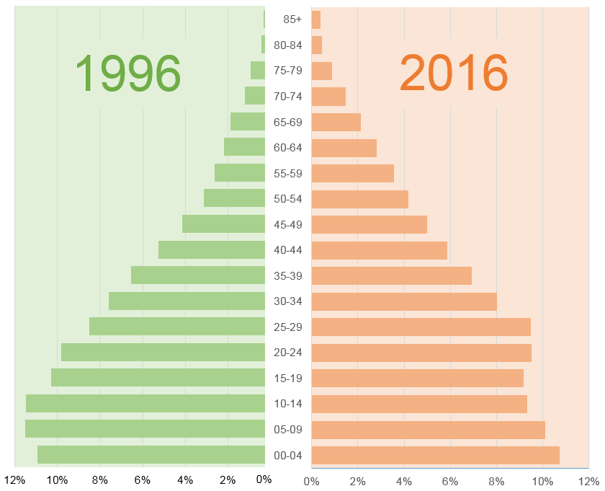
Age Pyramid 1996 to 2016 Compared
The proportion of those of working age increased from 60% to 66% over the same period.
The average age of the population in 1996 was 22 years
In 2016, the average age had climbed to 25 years
34% of the population
aged 0–14.
30% of the
population
aged 0–14.

Slide 18
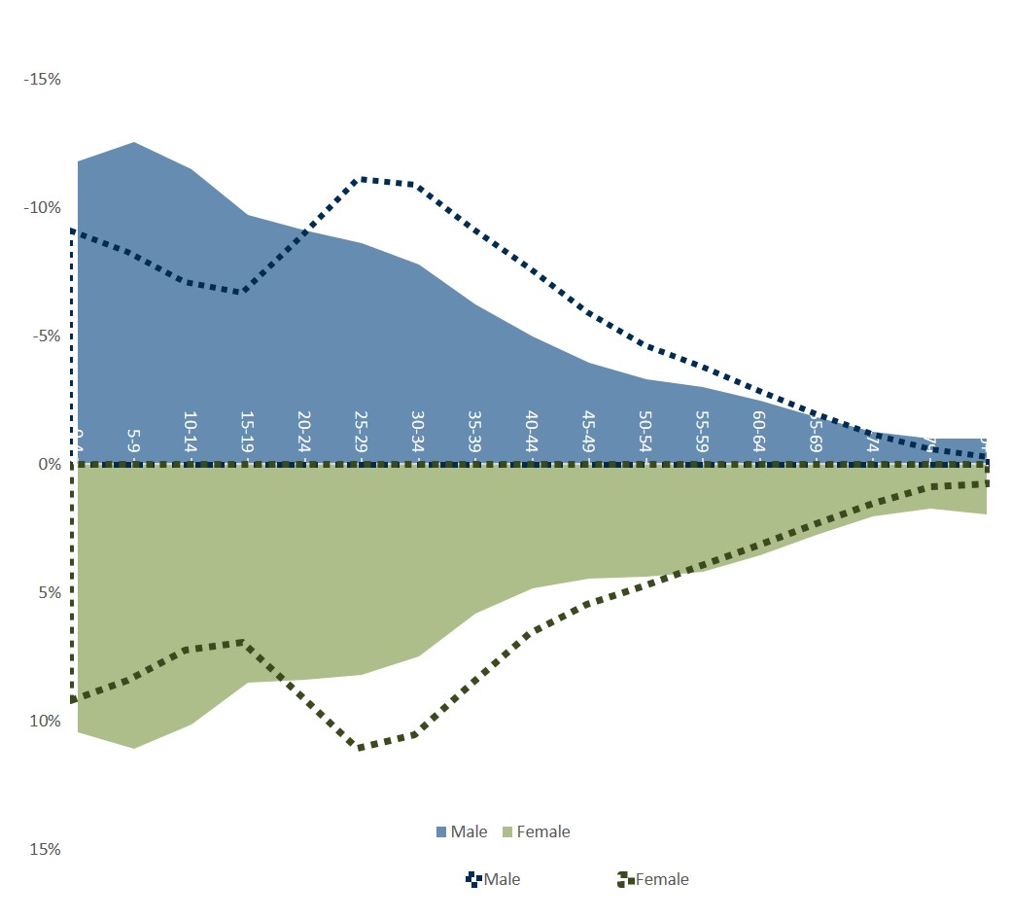
Age profile of Gauteng and Eastern Cape
Gauteng
Eastern Cape
Gauteng
40-44
35-39
The proportion of working age population in Gauteng is significantly greater than the Eastern Cape
30-34
25-29
20-24
15-19
10-14
Eastern Cape has a younger population with more children
5-9
0-4
Male
Female
Source: Mid-year Population Estimates 2017

Slide 19
Percentage of those aged 5 – 24 years who attend educational institution, GHS 2016
Almost universal school attendance in the age group 7─15 years. Noticeable representation of learners who are older than the ideal graduation age in primary and secondary schools.
4,2% of Children are not in education at age 15
At age 21 more learners in Secondary School than University and TVET combined
12,2% of Learners are not yet in some form of structured education by age 5
TVET
University

Slide 20
“
Approximately 13% difference between Official population estimates and age-specific education data from administrative records for school going ages (Gustaafson 2017).

Slide 21

What to make of this
Admin data is inflated through ghost learners???
Census data is incorrect????
Experts investigated…

Slide 22

Possible explanations…
Increase of around 13% in births around
2003-2005 plateauing 2006-2008.
Possible contributing factors could be introduction of ARVs in 2003, reduced mortality of children 0-5 whose deaths are usually underreported, and increased prosperity.
Literature suggests that women with access to ARVs more likely to willingly become pregnant. However, roll out still too limited in 2003 and 2004 to fully explain.

Slide 23
Changes in enrolments 2011-2013
 | 2011 | 2012 | 2013 | % increase
EC | 169 720 | 175 023 | 179 406 | 6%
FS | 55 279 | 59 476 | 62 396 | 13%
GP | 172 915 | 184 175 | 192 322 | 11%
KN | 217 270 | 235 377 | 239 513 | 10%
LP | 118 441 | 131 914 | 138 126 | 17%
MP | 81 059 | 88 594 | 92 047 | 14%
NC | 23 753 | 24 309 | 25 292 | 6%
NW | 68 246 | 73 315 | 74 061 | 9%
WC | 88 432 | 91 526 | 95 795 | 8%
SA | 995 115 | 1 063 709 | 1 098 958 | 10%

Slide 24
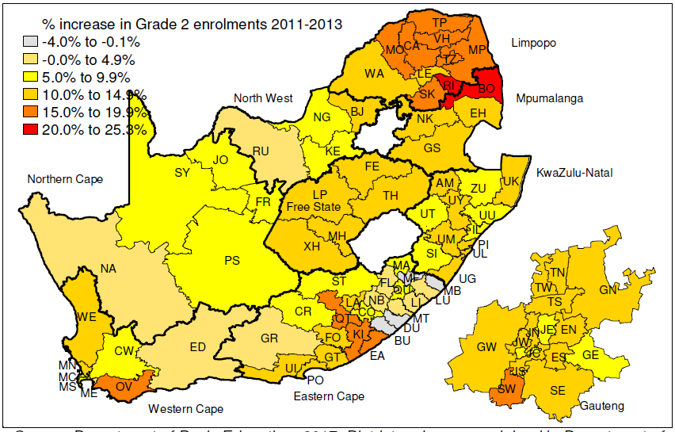
Stats SA and DBE figures at the district municipality level
(Source: Gustaafson, SUN 2017)
*

Slide 25
Population and enrolments (Source: Gustaafson, SUN 2017)

Slide 26
Population and enrolments (Source: Gustaafson, SUN 2017)
Increases of around 15% in births 2003-2005

Slide 27
Consequences of issues with population estimates
NEGATIVE IMPACT PLANNING
Planning for classroom and teacher provisioning
MISTRUST
Created a degree of mistrust in official estimates/statistics provided by the GHS
EVALUATION PROCESS
Affected evaluation process of the completeness of administrative data and triggered investigation into ghost learners

Slide 28
2017 Stats SA Mid-year Population Estimates
Population in 2017 based on the 2013 MYPE series and the 2017 MYPE series

Slide 29
Why did it take so long so align to Census 2011?
Sharp decline 0-5 noted, attributed to underreporting and adjusted
10-14 inward bulge
Census
Census
2001
2014
1
2
3
4
2006
2017
Community Survey
Mid year Population Estimates
Large Sample survey benchmarked against population estimates
Mirror Census 2011
Process of interrogation of births and deaths, HIV/Aids data etc. 10-14 inward bulge

Slide 30
References
Gustafson M, 2017. Understanding the sharp primary level enrolment increases beginning in 2011. Pretoria: Department of Basic Education.
Roberts L, 2015. Age reporting in South African Sample Surveys. Presentation at the 60th ISI World Statistics Congress (WSC), Rio de Janeiro, Brazil, 26–31 July 2015.
Stats SA, 2017a. General Household Survey 2016. http://www.statssa.gov.za/?page_id=1854&PPN=P0318
Stats SA, 2017b. Mid year Population estimates 2017. http://www.statssa.gov.za/publications/P0302/P03022017.pdf

Slide 31

Thank You
https://www.statssa.gov.za
Social Statistics:
Dr Isabelle Schmidt, isabelsc@statssa.gov.za
Mid year Population estimates:
Chantal Munthree, chantalmu@statssa.gov.za
Whipples Index:
Liesbeth Roberts, LiesbethR@statssa.gov.za

