Slide 1
Workshop in support of the establishment of the Titchfield City Group on Ageing and Age-disaggregated Data
22-24 August 2017, Winchester University, United Kingdom
Welcome!

Slide 2
Questions and social media
Sli.do
1. Access Sli.do via https://www.sli.do/ 2. Enter event code: M482 3. Ask your question
Twitter
Tweet about today's event using the ONS’s #tcgAgeing hash tag

Slide 3
Keynote
Rosemary Lane

Slide 4
Perspectives on ageing and agency: implications for policy and data systems
Winchester Workshop to support establishment of City Group on Ageing and Age-disaggregated data
22 – 24 August 2017
Patricia Conboy, HelpAge International

Slide 5
Questions from practice
How do we define old age ?
How do we view ageing and older people ?
What data issues have emerged in our work on policy?
What do we recommend as users of data on ageing and older people?

Slide 6
Old age
“The term we use to describe someone in later life”
.
Notes:
Beyond chronological age
Demarcation of life stages affected by the social, cultural, demographic and economic context in which we live
Response to our own and others older age determined by prevailing social norms
A discussion we’ve had in the context of advancing our work on a UN Convention on rights of older people

Slide 7
Contrasting perspectives on ageing & older people
Global narrative – demographic focus
Burden of population ageing
Decline, dependency, loss, spent economic units
“Them and us”
Older people as passive
Potential – individual & society
Multi-faceted – data critical
Context, nuance, inequality
Life course – “all in”
Ageism recognised
Older people as agents
Notes:
Working definition of agency of older people – Self-belief, autonomy, power to organise and to influence agendas and decision-making. Older people as active agents, shaping the narrative about ageing.
Collective term originated by Butler (1969) to describe (a) how we feel about different age groups (prejudice), (b) what we think about different age groups, i.e. the stereotypes and beliefs held about them, and (c) how we behave towards different age groups, i.e. discrimination, which is the behavioural manifestation of a negative attitude or judgement (Abrams et al, 2015)

Slide 8
Notes:
Frequently results from surveys published for the age group 60+ or 65+

Slide 9
“Seeing” later life with data Work over previous year in Myanmar
Notes:
In low and middle income countries, significant proportions of older people continue to work (here in agriculture and informal sector mainly) though working patterns change and it is the patterns we need to see, understand and respond to.

Slide 10
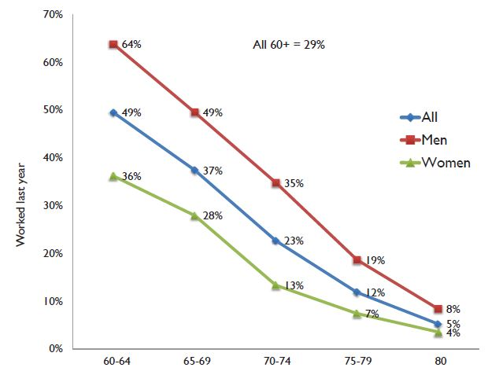
.
.
Knodel, J & HAI staff (2014), Situation of Older Persons in Myanmar
Notes:
Myanmar Survey of Older Persons (2012); sample size of 4,000
Almost 30 % of those aged 60+ had worked in the previous year. Of those, almost half who did so aged 60 – 64; only 5% did so aged 80 and above.
Most interested, of those who hadn’t worked, 30 % would have liked to do so. We don’t know why they stopped. Dynamics of movement in and out of work in later life poorly understood.

Slide 11
“Seeing” later life with data Self-reported health in Thailand
Notes:
Recognise that there is a discussion about self-reported health as a measure and some of its limitations (another issue for the City Group?)
Useful here to see experience of ‘young old’ and ‘old old illustrated. That is progress on 60+
Illness and disability in old age is not a crime. Something we have to plan for – and this includes planning for development of enabling environments which I’m sure John Beard,WHO will speak about later this morning

Slide 12
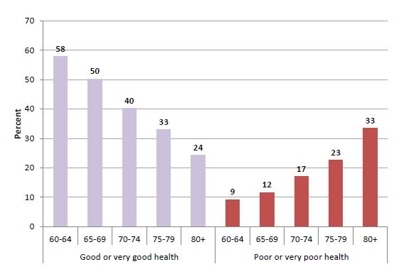
.
Knodel, J et al, (2015), The Situation of Thailand's Older Persons.
Notes:
Survey of Older Persons in Thailand (2014),
Overall, percentage of those reporting health as very good or good higher in younger old age; percentage of those reporting health as poor or very poor highest among those aged 80+. At a minimum, we need to know what is happening to younger old and older old in any setting. And how much of this ill health can be alleviated with better health care and management and an enabling environment – the latter, a focus for WHO in terms of Global Strategy and Plan of Action on healthy ageing.

Slide 13
“Seeing” later life with data Experience of elder abuse in Myanmar
Notes:
There are issues that require a response in terms of policy and programme delivery
In this 2012 survey, of older people in Myanmar, just 30 % of the respondents were asked about elder abuse, so it is a snapshot
Data disaggregated male/female, younger and older, and can see both sexes experience abuse but higher among women; and also an increase in older age.

Slide 14
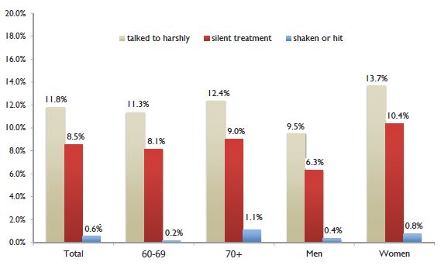
.
Knodel, J & HAI staff (2014), Situation of Older Persons in Myanmar
Notes:
Findings from Myanmar Survey(2012)
30% of survey respondents asked about experience of elder abuse
Majority said they had not experienced abuse – but 12% had.
Mainly took the form of being spoken to harshly; higher among women than men.
With the data, can begin to put the issue – and the need for appropriate policies and responses – on the agenda.

Slide 15
Data informing policy
Agenda setting
Design & choice of policies, programmes
Forecasting
Monitoring & evaluating the implementation of policy
Gelders, B (2015) Good Practice and barriers in the use of Data for Policy and Advocacy in Asia-Pacific
Notes:
Assumptions we make about ageing and older people influence the decisions we make about data we collect, what we measure and how we report on findings.
Gelders identifies role of data in relation to policy
In Help Age, we have 4 strategic pillars to our policy work and what I want to do now is to share some of the data issues that arise in the course of our work on those pillars which relate to income, health and care, safety and security, and voice of older people

Slide 16
Some data issues “I have the income I need”
Poverty measured at household level
Exclusion of homeless, IDPs, refugees, people in institutions
Limits of old age dependency ratios
Life course effects of education, employment, maternity/paternity, health status, disability
Proof of identity
Notes:
Limitations of household level measurement in terms of intra-family distribution of resources
Exclusion of key groups
Old age dependency ratio – perpetuate erroneous idea that older people are not economically active

Slide 17
“I enjoy the best possible health and quality of life”
Age limits on surveys used to measure access to universal health coverage
Financial risk measured at household level
Basis to plan for long-term care – NCDs, disability, functional limitation
Beyond age & health status – social engagement, education, income
Notes:
UHC – financial protection, access to essential healthcare services, medicines and vaccines; silent in Agenda 2030 on long-term care. Age limited surveys – DHS and STEPS
Non Communicable Diseases (NCDs) account for 65% of all years lived with disability in LMICs (World Report on Disability, 2011)
NCD targets focus on premature mortality, 70 years and under
Recognising and valuing unpaid work – SDG 5.4

Slide 18
“I am safe and secure, free from discrimination and abuse”
Limited collection of data on violence, abuse, neglect of older women & men
Existing surveys limited in scope – focus, countries, age limits
National surveys on elder abuse are rare (17% of 133 countries surveyed in 2014)
Lack of harmonised set of questions
Notes:
Recognise work that has been done by UNDESA to take stock of current knowledge on neglect, abuse and violence against older women; & published guidelines on survey design & reporting statistics on violence against older women.
Currently no single survey or range of harmonised surveys measuring violence, abuse, neglect of older women & men
Existing surveys on violence and abuse have been limited in scope: they have either focused on gender-based violence (such as the International Violence Against Women Survey), analysed a few countries or one region (for example, the Prevalence Study of Abuse and Violence against Older Women in Austria, Belgium, Finland, Lithuania and Portugal), or restricted the target population to respondents aged 15-49.
Lack of harmonisation on the inclusion of questions on this difficult topic – one still marked by stigma in many cultures – means that the amount of information gathered varies by survey. Surveys rarely collect data on all main types of abuse: physical, sexual, emotional, financial, or neglect perpetrated by either an intimate partner, carer, or strangers in the case of violence and abuse.
Issues regarding inclusion of older people with cognitive impairment

Slide 19
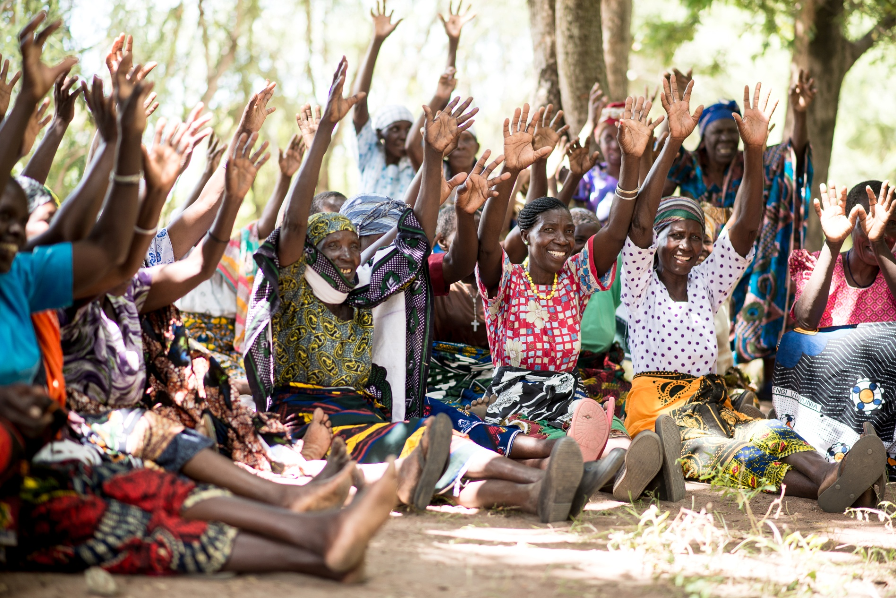
“My voice is heard”
Notes:
Metaphor for autonomy and participation
This image from a project in west of Tanzania, focused on promoting community and older women’s awareness of their land rights
Full and effective participation in all spheres of life: In public, political, cultural, economic and development activities; In decision making at household, community and national levels; in social and leisure activities including within the family, in the community and in long-term care and support settings.

Slide 20
Our call on data
Close data gaps to measure impact of SDGs on older people
Include older people in data collection, analysis, dissemination, utilisation
Disaggregate data & recognise intersections
At a minimum, disaggregate in 5 year cohorts
Conduct surveys with older people; include thematic modules in national surveys and censuses
Notes:
Intersections e.g. ageing and disability. The disability prevalence rate for people aged 60 and over in low income countries is 43.4 per cent. The disability prevalence rate for people aged 18 – 49 in low income countries is 10.4 per cent. In short, disability prevalence among older people is four times higher than for the younger adult population.

Slide 21
Our call on data
Address technical issues – sample size, comparability, linkage with administrative data
Remove age caps from international surveys
Conduct qualitative studies to inform quantitative findings
Explore how we can make better use of composite evidence from longitudinal studies of ageing

Slide 22
Thank You !
www.helpage.org
Patricia.Conboy@
helpage.org
HelpAgeInternational
@helpage
@PatriciaConboy1

Slide 23
Need Slides – Plenary Session 1a (second half)
Papa Seck

Slide 24
Need Slides – Plenary 1b
John Beard

Slide 25
Need Slides – Plenary 2
Asghar Zaidi

Slide 26
Parallel Sessions

