Slide 1


Ensuring Relevance for Statistics on Population Ageing : Results from Statistics Canada’s Ageing Framework
www.statcan.gc.ca
Telling Canada’s
story in numbers
André Lebel,
Demographer / Chief
Demography Division
Statistics Canada
Presented at Parallel Session 4 (Making the most of existing data sources), Workshop in support of the establishment of the Titchfield City Group on Ageing and Age-disaggregated Data
Wednesday August 23rd 2017

Slide 2
Purpose of Statistics Canada’s Ageing Framework
Context
to produce an overall review of the data and analyses produced in recent years on this topic within and outside our Agency.
to identify emerging issues as well as potential improvements in internal (with Subject Matters) and external consultations (with Federal Department and Provincial representatives).
To identify data gaps and look for way to reduce or solve them
To review international and national frameworks within which the agency operates and identify potential improvements in the data collection and statistical analysis
Review / Consultation
(2013-2014)
Issues / Gaps/ Opportunities Identified
Action Plan
(2015-2017)

Slide 3
For the first time in Canada, the share of seniors exceeded the share of children in 2016.
Context
Proportion of the population aged 0 to 14 and 65 and over, Canada, 1851 to 2061
Review / Consultation
(2013-2014)
Issues / Gaps/ Opportunities Identified
Action Plan
(2015-2017)
Sources: Statistics Canada, Census of Population, 1851 to 2016. Data for 2021 to 2061 are population projections from the M1 medium-growth scenario of national projections. The projection data have as a base population the population estimates based on the 2011 Census, adjusted for net undercoverage. For more information, see the report Population Projections for Canada (2013 to 2063), Provinces and Territories (2013 to 2038) (Statistics Canada Catalogue no. 91-520-X).

Slide 4
Canada had a lower proportion of seniors than any other G7 country, except the U.S.
Context
Proportion of the population aged 65 and over, G7, 2016*
Review / Consultation
(2013-2014)
Issues / Gaps/ Opportunities Identified
Action Plan
(2015-2017)
Sources: Statistics Canada, Census of Population, 2016; for the other G7 countries: OECD (2014), "Elderly population" (indicator). DOI: http://dx.doi.org/10.1787/8d805ea1-en (accessed on November 8, 2016) and "Working age population" (indicator). DOI: http://dx.doi.org/10.1787/d339918b-en (accessed on November 8, 2016).
*The most recent year in this chart is 2014 for Germany, Italy, the United Kingdom and the United States, and 2013 for Japan and France.

Slide 5
Canada’s aged population will get older
Context
Proportion of the population aged 65 and older that is aged 85 and older, Canada, 1966 to 2051
Review / Consultation
(2013-2014)
Issues / Gaps/ Opportunities Identified
Action Plan
(2015-2017)
Sources: Statistics Canada, Census of Population, 1966 to 2016. Data for 2021 to 2061 are population projections from the M1 medium-growth scenario of national projections. The projection data have as a base population the population estimates based on the 2011 Census, adjusted for net undercoverage. For more information, see the report Population Projections for Canada (2013 to 2063), Provinces and Territories (2013 to 2038) (Statistics Canada Catalogue no. 91-520-X).

Slide 6
Framework Review | Consultation
Subject matter divisions | 23 Federal Departments + Advisory & F/P/T Committees
Goal was to identify relevant information pillars, issues, data and analysis gaps, and opportunities
Seven Information Pillars Identified: Population and Demography Health and Well-Being Status Family, Community-Based and Institutional Care Social Participation Labour Income, Earnings, and Wealth Enabling Environment and Housing
Main Data Sources: Census, General Social Survey, Canadian Community Health Survey, Canadian Health Measures Survey, Canadian Survey on Disability, Labour Force Survey, Long Term Care Facilities Survey, Longitudinal Administrative Databank, Longitudinal Worker File
Context
Review / Consultation
(2013-2014)
Issues / Gaps/ Opportunities Identified
Action Plan
(2015-2017)

Slide 7
Framework Review | Consultation
Subject matter divisions | 23 Federal Departments + Advisory & F/P/T Committees
Goal was to identify relevant information pillars, issues, data and analysis gaps, and opportunities
Seven Information Pillars Identified: Population and Demography Health and Well-Being Status Family, Community-Based and Institutional Care Social Participation Labour Income, Earnings, and Wealth Enabling Environment and Housing
Main Data Sources: Census, Population Estimates and Projections, General Social Survey, Canadian Community Health Survey, Canadian Health Measures Survey, Canadian Survey on Disability, Labour Force Survey, Long Term Care Facilities Survey, Longitudinal Administrative Databank, Longitudinal Worker File.
Context
Review / Consultation
(2013-2014)
Issues / Gaps/ Opportunities Identified
In good shape
Can improve
Action needed!
Action Plan
(2015-2017)

Slide 8
Context
Examples of Policy-Relevant Issues Identified During Consultations
Family, Community-based and Institutional Care
Caregiving: experience of seniors and their caregivers (HC, PHAC, CIHR, ESDC) Impact of institutional population on profile of seniors (CIHR, PHAC) Senior abuse in LTC institutions (ESDC) Availability of culturally appropriate services for minority groups (PHAC, ESDC) Do services supporting « aging in place » reduce costs? (PHAC)
ESDC: Employment and Social Development Canada HC: Health Canada PHAC: Public Health Agency Canada CIHR: Canadian Institutes of Health Research
Review / Consultation
(2013-2014)
Issues / Gaps/ Opportunities Identified
Action Plan
(2015-2017)

Slide 9
Context
Data and Analysis Gaps Identified
More detailed age breakdowns needed
Concepts and terminology used to designate seniors’ age groups
Characteristics of the population living in seniors’ residences and health care institutions
Financial and administrative characteristics of long term care institutions
Aging and all forms of diversity (e.g. include LGTB)
Housing transitions
Longitudinal survey data to measure life course transitions
Regional and local data
Review / Consultation
(2013-2014)
Issues / Gaps/ Opportunities Identified
Action Plan
(2015-2017)

Slide 10
In conclusion, we believe that we need to put on our seniors’ lens!

We will still need in Census and Surveys for CATI/CAPI/paper options to continue (despite popularity of EQ, over 70% in last census) in relation to issues with impairments that affect the capability of a growing segment of the ageing population and their willingness and capacity to use internet.
Thank you!
Questions are welcomed

Slide 11

An Introduction to the International Family of Health and Retirement Studies
Workshop in support of the establishment of the
Titchfield City Group on Ageing and Age-disaggregated Data
Parallel 1 - August 22nd, 2017
Drystan Phillips

Slide 12
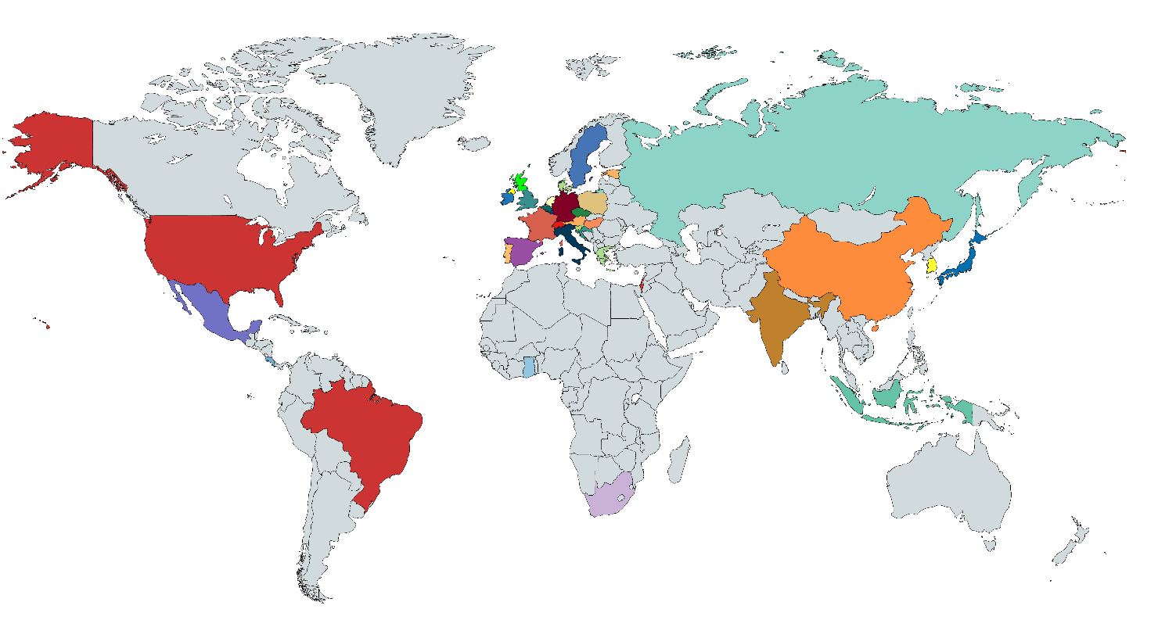
Health and Retirement Studies around the World
The Health and Retirement Study (HRS)
The Mexican Health and Aging Study (MHAS)
The English Longitudinal Study of Ageing (ELSA)
The Survey of Health, Ageing and Retirement in Europe (SHARE)
The Korean Longitudinal Study of Aging (KLoSA)
The Indonesian Family Life Survey (IFLS)

Slide 13
Health and Retirement Studies around the World
The Japanese Study of Aging and Retirement (JSTAR)
The Study on global AGEing and adult health (SAGE)
The Irish Longitudinal Study on Aging (TILDA)
The Costa Rican Longevity and Healthy Aging Study (CRELES)
The China Health and Retirement Study (CHARLS)

Slide 14
Health and Retirement Studies around the World
Health and Aging in Africa: A Longitudinal Study of an INDEPTH Community in South Africa (HAALSI)
The Brazilian Longitudinal Study of Ageing (ELSI)
Healthy Ageing in Scotland (HAGIS)
Northern Ireland Cohort Longitudinal Study of Ageing (NICOLA)
The Longitudinal Aging Study in India (LASI)

Slide 15
HRS Studies: Key Innovations
Multi-disciplinary subject matter
  Demographics, health, economics, etc.
Enhancing quality of economic data
  Nonresponse bias
  Unfolding bracket questions
  Imputation
Integrating biomarkers into social surveys
  Anthropometry, blood pressure, blood specimen

Slide 16
HRS Studies: Core Content Areas
Demographic
Education, marital status, age, resident, birth year, birth month
Health
Cognition, disease, depression, injury, physical functioning, physical measures, health behaviors
Health Services
Insurance, utilization, expenditure, out-of-pocket spending
Work & Employment
Employment status/history, labor force, earnings, disability, retirement, type of work, pension
Economic Status
Income, wealth, and consumption; earnings, asset income, government transfers, housing, non-financial assets, pension
Family Structure & Social Network
Parents’ information, household structure, family exchange, family support, social participation

Slide 17
Gateway to Global Aging Data
The platform for population survey data on aging around the world
The Gateway is a free public resource designed to facilitate
cross-national and longitudinal studies on aging using
the family of health and retirement studies around the world.
www.g2aging.org

Slide 18
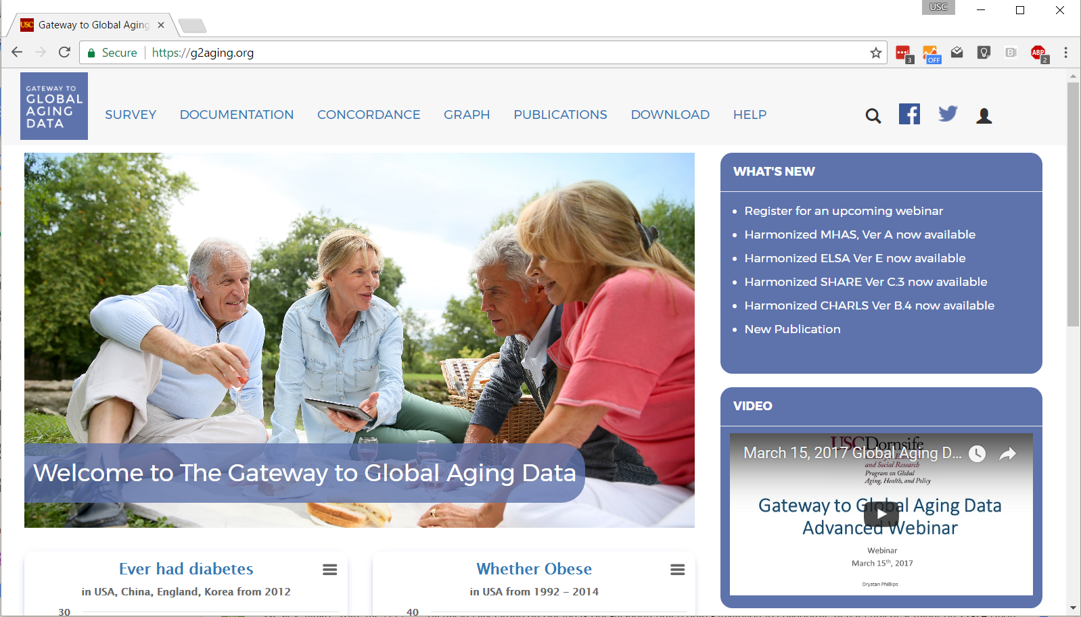

Slide 19
What’s available on the Gateway
Library of all survey questionnaires
Flow-charts illustrating questionnaire skip patterns
Concordance search
Interactive graphs and tables
Documentation of cross-study and longitudinal comparability
Catalog of publications based on HRS family surveys
Harmonized data

Slide 20
Documentation
Domain-specific comparison tables
  Sample / Interview
  Demographics
  Family & Social Network
  Health
  Cognition
  Healthcare Utilization and Insurance
  Income & Consumption
  Financial & Housing Wealth
  Work
  Retirement & Pension
  Stress
  Psychosocial
Domain-specific user guides
  Chronic medical conditions
  Financial transfers
  Expectations
  Employment and retirement
  Income
  Wealth
  Cognition
  Health Behavior
  Informal Care
  Household Expenditure
  Imputation procedures

Slide 21
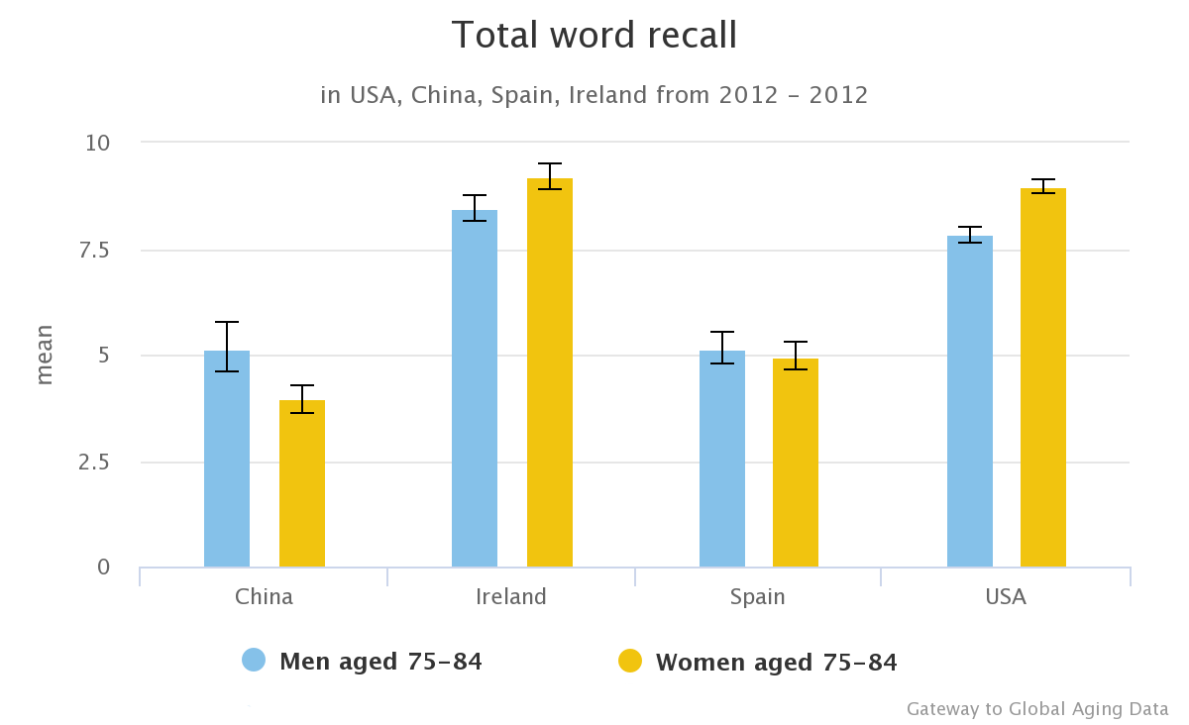

Interactive Graphs and Tables

Slide 22
All Harmonized Data Files
RAND HRS – incorporates the first 12 waves of the HRS (1992-2014)
Harmonized ELSA – incorporates the first seven waves of ELSA (2002 - 2014)
Harmonized SHARE – incorporates the first, second, fourth, fifth, and sixth wave of SHARE (2004, 2006, 2010, 2012, 2014)
Harmonized JSTAR – incorporates the first three waves of JSTAR (2007, 2009, 2011)
Harmonized KLoSA - incorporates the first four waves of KLoSA (2006, 2008, 2010, 2012)
Harmonized MHAS – incorporates the first three waves of MHAS (2001, 2003, 2012)
Harmonized CRELES – incorporates the five waves of CRELES (2005, 2007, 2009, 2010, 2012)
Harmonized TILDA – incorporates the first two waves of TILDA (2010, 2012)
Harmonized CHARLS - incorporates the first two waves of CHARLS (2011, 2013)
Harmonized LASI – incorporates the pilot data of LASI (2010)
Harmonized data files are either distributed through the Gateway or the originating study. In some cases the data files are created by users based on a code provided by the Gateway.

Slide 23
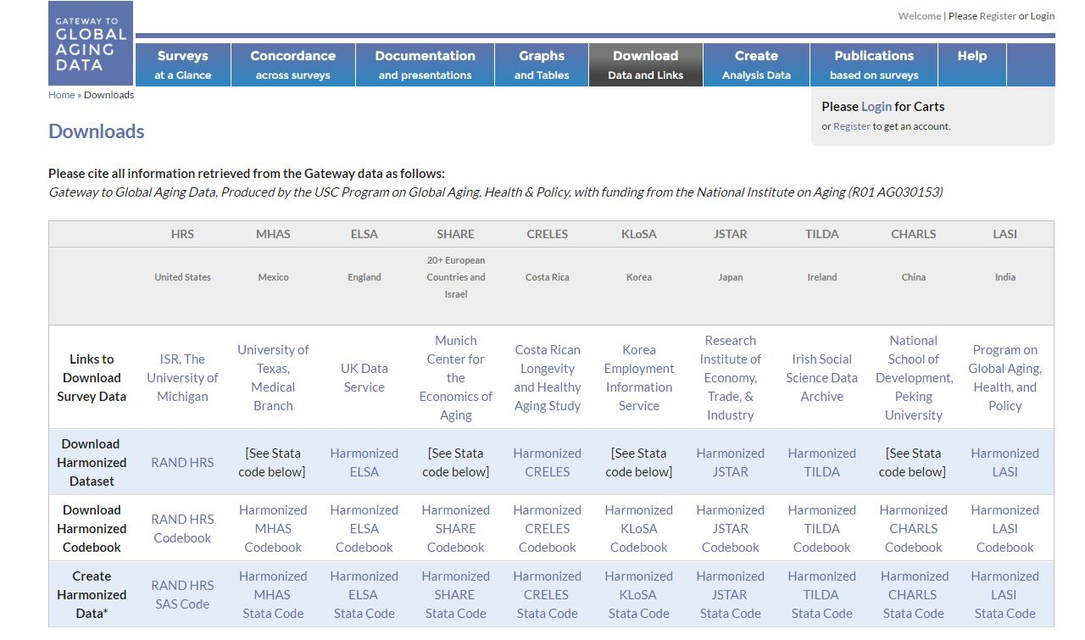

Slide 24
Learn More
Visit us at www.g2aging.org
Email: help@g2aging.org
Notes:
Show overview and Help Tab

Slide 25


Making the most of existing data sources
Informal care in the last days of life : a data linkage study
Kirsty MacLachlan, National Records of Scotland

Slide 26
Context
Ageing population
Addressing inequalities
Provision of health and social care services
Tightening fiscal situation
Brexit.

Slide 27
Projected percentage change in population by age structure 2014-2039

Slide 28
Questions
How have household structures in the final stages of life changed over time and how do they vary across Scotland?
How can we better plan the provision of health and social care services for people in the final stages of life?

Slide 29
Available data
Census – household structure and socio demographic data
Health data – diagnosed illnesses, hospitalisation, drugs, changes in where folk live
Vital event data – place of death, cause of death
BUT there is a greater wealth of information from linking data

Slide 30
Confidentiality of census
(and other) data is paramount
so need:
Robust governance – ethics, Privacy Impact Assessments, Public Benefit and Privacy Panel approvals, legal basis, Data Sharing Agreements etc
Secure access to data at the National Safe Haven at the Bioquarter
Trusted 3rd party linkage facility (at NRS)
Statistical disclosure control

Slide 31
Linkage Processes
Separation of Functions
  Indexing Team see no payload data
Spine Matching
  Deterministic and Probabilistic methods
Index numbers replace local IDs
Master Index of all dataset indexes per project
Summary Reports
  For researchers / research co-ordinators
  Data quality, linkage quality (precision, link rates)
  Potential biases (age/sex/deprivation)

Slide 32
Informal care in the last days of life: a data linkage study - Analysis plan
Death in hospital
(known from death record)
Hospitalized (SMR06 record)
2001 CENSUS
Diagnosed with cancer (SMR06)
Hospitalized
(SMR01 or SMR04)
Death at home
(known from death record)
Comparison of household structures amongst those who died in 2001 relative to 2011
Household structure
(from census records))
Death at home
(known from death record)
Geographical and socio-economic comparisons
Drugs associated with end of life received (prescribing records)
Comparison of those who died to those who survived
2011 CENSUS
Death at home
(known from death record)
Hospitalized
(SMR01 or SMR04)
Survivor – no indication of death
One year pre-census
One year post-census

Slide 33
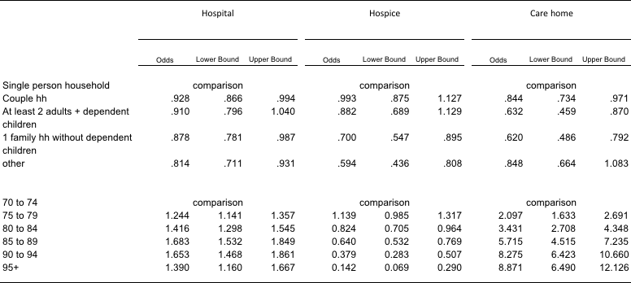
Multinomial regression model for those living independently at census *
(Odds relative to death at home)
* Adjusting for gender

Slide 34
Initial results
Much greater likelihood of deaths in care home for older old than at home, especially if a single person household at time of the census
Greater likelihood of death in hospital for 85-94 y.o. than at home
Greater likelihood of death in a hospice for younger elderly especially if a single person household, less likely if living in a family

Slide 35
Further information
Scottish Informatics and Linkage Collaboration (SILC)
http://www.datalinkagescotland.co.uk/
Data linkage framework in Scotland
http://www.gov.scot/Topics/Statistics/datalinkageframework
2011 Scotland’s Census results
http://www.scotlandscensus.gov.uk/census-results
kirsty.maclachlan@nrscotland.gov.uk

Slide 36
Overview of Indexing Service
Trusted Third Party for Scottish Informatics Linkage Collaboration (SILC)
One of SILC shared services supporting ADRC-S, Farr Institute Scotland, Scottish Government and Urban Big Data Centre
Work closely with other shared services – eDRIS Research Co-ordinators, EPCC Safe Haven

Slide 37
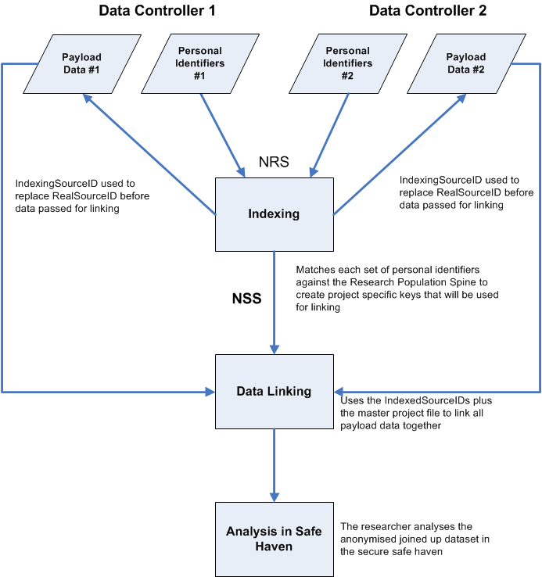
Separation of functions
Data Controller’s Unique Reference Number (SourceID) and PII transferred to NRS Indexing Team
SourceID and IndexedSourceID transferred to Data Controllers
Researcher accesses linked de-identified data in a safe setting
Master lookup file transferred to the Linkage Agent to allow the IndexedSourceIDs from each dataset to be linked
NRS indexing team create the Master Index File which links each IndexedSourceID
Match PII to the Research Population Spine. Randomly generated IndexedSourceIDs assigned to all records
IndexedSourceID and Payload Data transferred by Data Controllers to the Linkage Agent

Slide 38
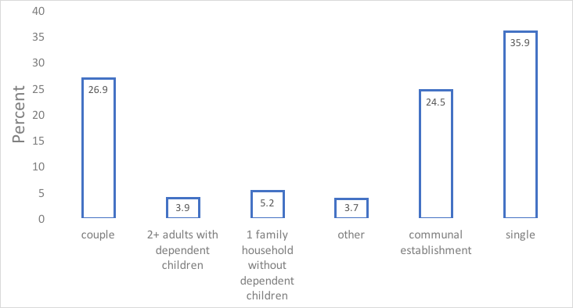
Household types of people aged 70 years+ who died within one year of Scotland’s census
Total households = 34,003

Slide 39
25,658 deaths (age 70+ with linked records who were living independently at time of census)
6,404 at private address
16,091 in hospital
5,295’403 people
1,538 in care home
1,625 in a hospice
One year post-census

Slide 40
The age structure is changing – up to 2039
Projected percentage change in population by age structure 2014-2039

Slide 41
The P20 and Aging: Disaggregated data on the poorest 20%
August 2017

Slide 42
The P20 Initiative
Data on people in the poorest 20% globally through 2030
Focus on disaggregation, not a new poverty measure
Bellwether indicators focus on
  Income/consumption
  Nutrition
  Civil Registration and Vital Statistics
Disaggregated by
  Wealth quintile
  Gender
  Geography
  Age
  Disability

Slide 43
The P20 Initiative
Major Data sources
World Bank’s Living Standards Measurement Study (LSMS)
  Focus on income/consumption
  No particular age focus
USAID’s Demographic and Health Surveys (DHS)
  Household wealth defined by assets (e.g. roofing material, water source)
  Focus on children under 5 and women ages 15-49
UNICEF’s Multiple Indicators Cluster Survey (MICS)
  Household wealth defined by assets (e.g. roofing material, water source)
  Focus on children under 18 and women ages 15-49

Slide 44
Income and age
Major data sources define wealth at household level
Intrahousehold inequality is hard to measure
  Ownership of goods isn’t always clearly defined within a household
  Needs vary significantly within household
Only those in households are surveyed
  Exclude those in institutions, homeless, refugees and other groups.
  The most vulnerable households may combine with other households
Notes:
Poverty rates generally decline as the age of the household head increases. However, households with a person over 50 but a household head under 50 tend to have higher poverty rates.

Slide 45
Income and age
Percentage of population in P20
DI calculations based on most recent DHS, MICS, PNAD (Brazil) and CNPS (China) covering 5.3 billion people
Notes:
Bearing all of the caveats about income measurement, our numbers suggest that generally younger age groups are more likely to live in households in the P20. The microdata set used by the World Bank’s poverty estimates suggests that the poverty rates in 2000 were significantly lower among those over 65 (Batana et al 2013).

Slide 46
Nutrition and age
Basic non-monetary measure of wellbeing
Our baseline report used stunting (low height for age) as bellwether indicator.
  This indicator is not recorded for those over 5.
Some DHS report BMI for women ages 15-49.
  A few countries also measure BMI for men ages 15-49.
DHS may measure anemia among women ages 15-49.
Some LSMS ask questions about hunger at household level.
LSMS surveys may also include measurements of stunting among children.

Slide 47
Other indicators: Education
Those in the rest of the population are more likely to have some schooling, even when comparing the same ages.

Slide 48
Data Quality
Recorded ages are less accurate among the P20 than the rest of the population.
Whipple’s Index is a measure of age clumping around ages ending in 0 or 5.
    Very accurate : < 105:
    Relatively Accurate: 105-110
    Approximate: 110-125
    Rough data: 125-175
    Very rough data: > 175
Whipple’s Index P20 : 149
Whipple’s Index Rest of the population: 123
Notes:
UN recommendations suggest that an Index of <105 is very accurate, 105-110 is relatively accurate, 110-125 is approximate, 125-175 is rough data, >175 is very rough data.

Slide 49
Opportunities
Administrative data
WHO Study on Global Ageing and Adult Health (SAGE)
  Focus on Adults 50 and older
  Surveys in China, Ghana, India, Russia, and South Africa
Some DHS will ask full surveys to older populations
  HIV/AIDS, Domestic violence
  Not likely to ask about pensions, retirement
LSMS exploring intrahousehold measures of inequality
  Primary focus on gender disaggregation

Slide 50
Conclusion
To ensure that no one is left behind, there are significant gaps in aging data.
Major household surveys were designed for specific purposes than monitoring issues related to aging.
Administrative data and improved CRVS systems would improve coverage.

