Slide 1
Automated equal area cartograms
Algorithm-led generation of equal area cartograms for anywhere, any period, and any scale
Bruce Mitchell, ONS Geography
George Tzelepis, Dept. of International Trade

Slide 2
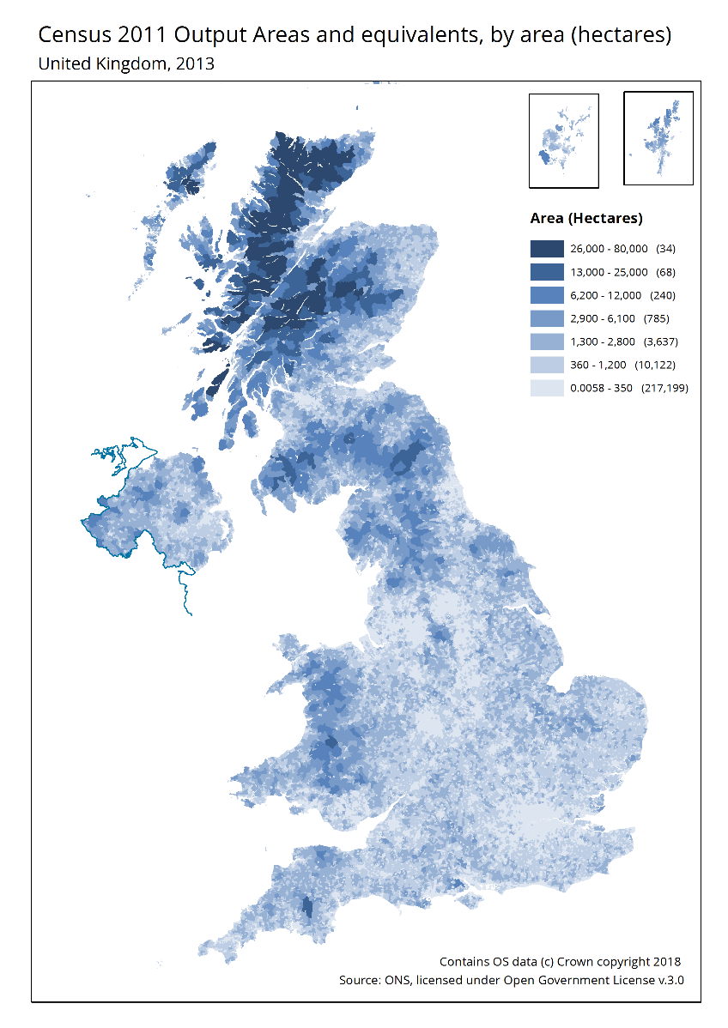
“The tyranny of large areas” Large areas dominate, small areas recede
Affects even
dedicated
statistical
geographies

Slide 3
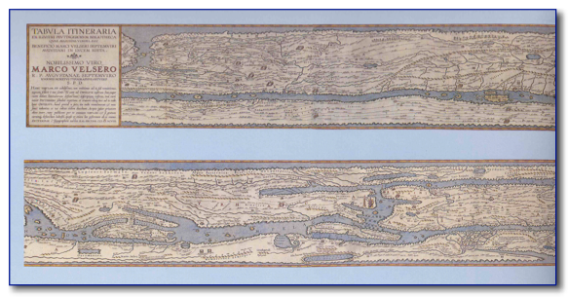
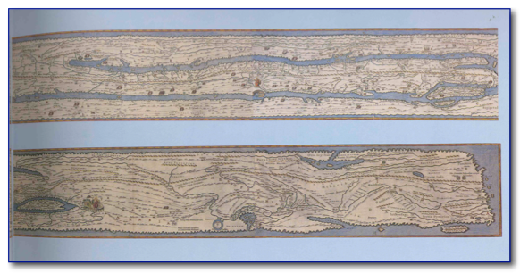
Cartograms
A special form of map
Scaled to a thematic mapping variable other than land area or distance
Data, not geography, drives how the map looks
Tabula Peutingeriana – a 1st C. itinerary of the Roman Empire – scaled (roughly) by travel time
.
http://cartographic-images.net/Cartographic_Images/120_Peutinger_Table.html

Slide 4
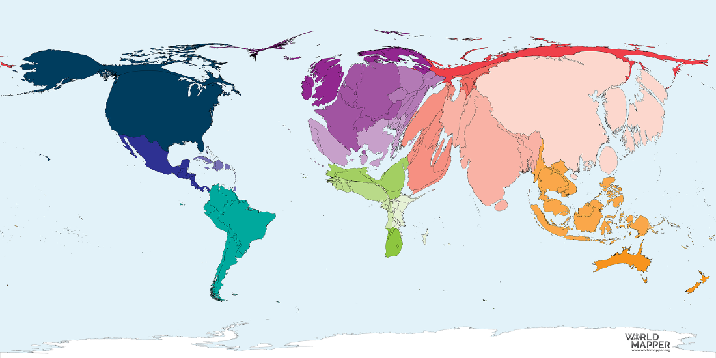
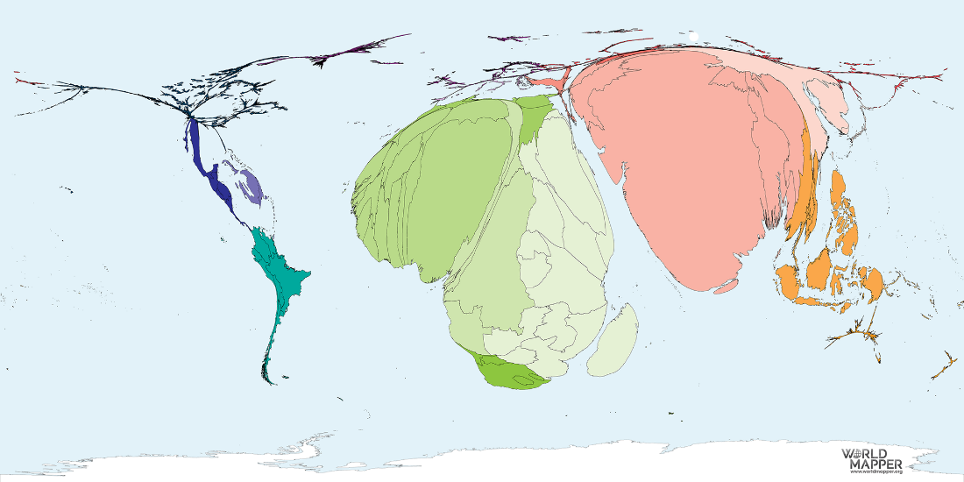
Cartograms: representing data by area
GDP Wealth, 2018
https://worldmapper.org/maps/gdp-2018/
Absolute Poverty
“Living on equivalent of US$1.90 a day or less “ (World Bank)
https://worldmapper.org/maps/absolute-poverty-2016/
Powerful, but the cartogram has to be drawn afresh for every variable.
www.worldmapper.org

Slide 5
Cartograms: representing data by area
“Predicted Distribution for the Estimated World Population in 2050”
Original shapes of all countries, distorted by reference to that value;
https://worldmapper.org/maps/population-year-2050/?_sft_product_cat=population

Slide 6
Equal-area cartograms (EACs)
Advantages
Each area represented by identical symbol, so:
stable representative symbolisation
similar visual impact
Challenges
Geography is replaced by geometry.
Hexes have a maximum of six neighbours, squares, eight;
Where there are more, symbols have to be shuffled
Navigation

Slide 7
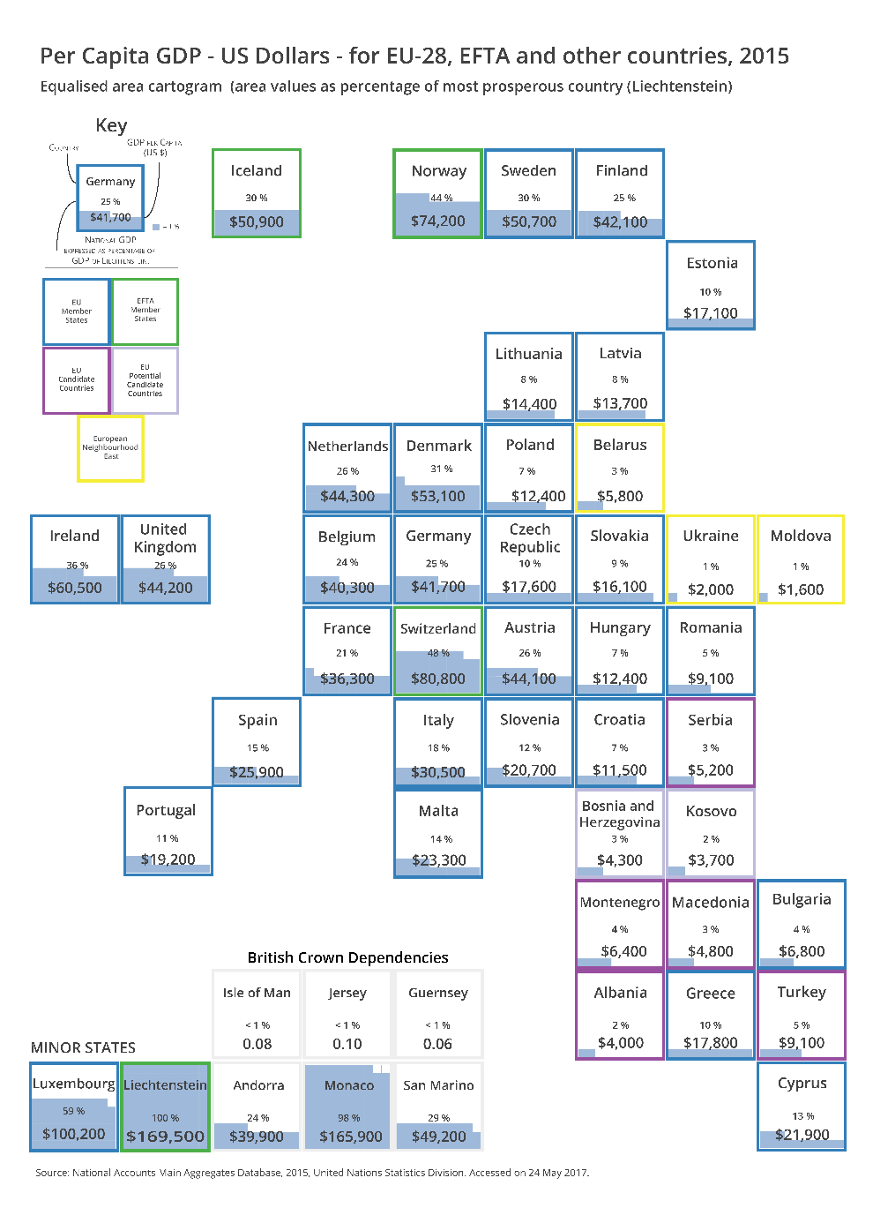
Square-based EACs

Slide 8
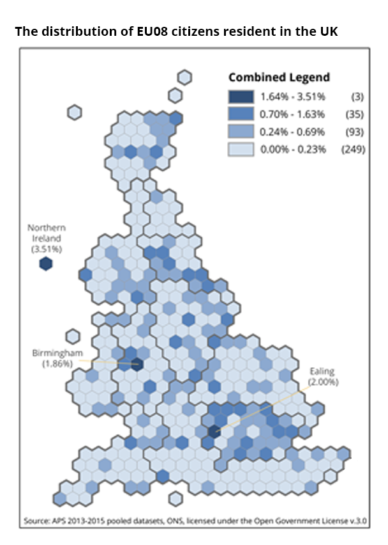
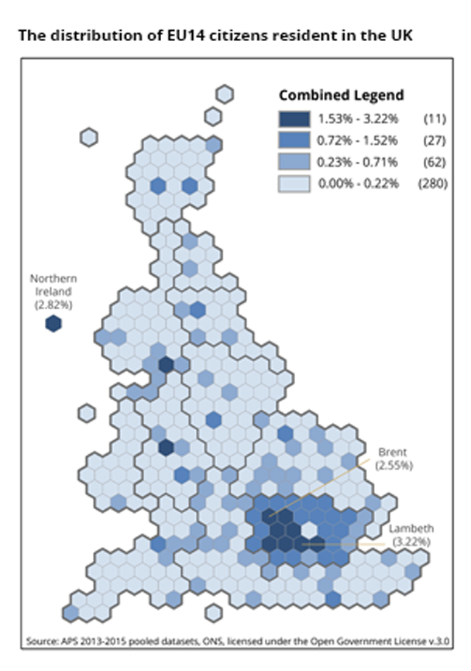
Hex-based EACs

Slide 9
Hexmap automation
The previous EACs were created manually.
Slow and labour-intensive.
An automated method required.
ONS-G’s open source Python-based code generates hexmaps in seconds, not hours.
Boundary file (any format) and a few parameters.
GitHub.

Slide 10
Projection and units RUSSIA: district centroids
Web
Mercator
(decimal
degrees)
Lambert
Polar
Conformic
(meters)

Slide 11
Shape and orientation

Slide 12
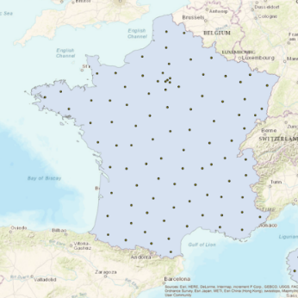
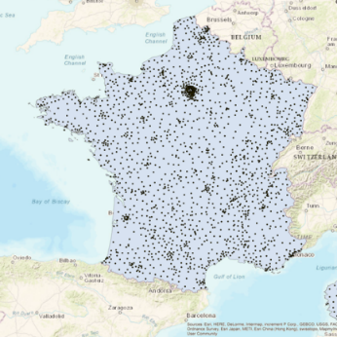
Density of the geography
Number of the target subunits (district or locality) within the overall geography (country);
Median centroid location of the sub-geography units
Spatial distribution of the ‘target’ sub-geography;
uniform
clustered
multi-clustered

Slide 13
Hexagon configuration
Orientation ( or )
Size - set in units of the projection:
Optimal where
Hexmap pattern most like the original geographical shape;
Hexes overlay accurately on background mapping;
Hexes as large as possible;
Proportion maximised of area of all hexes still contained within the original geography.

Slide 14
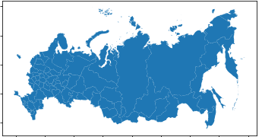
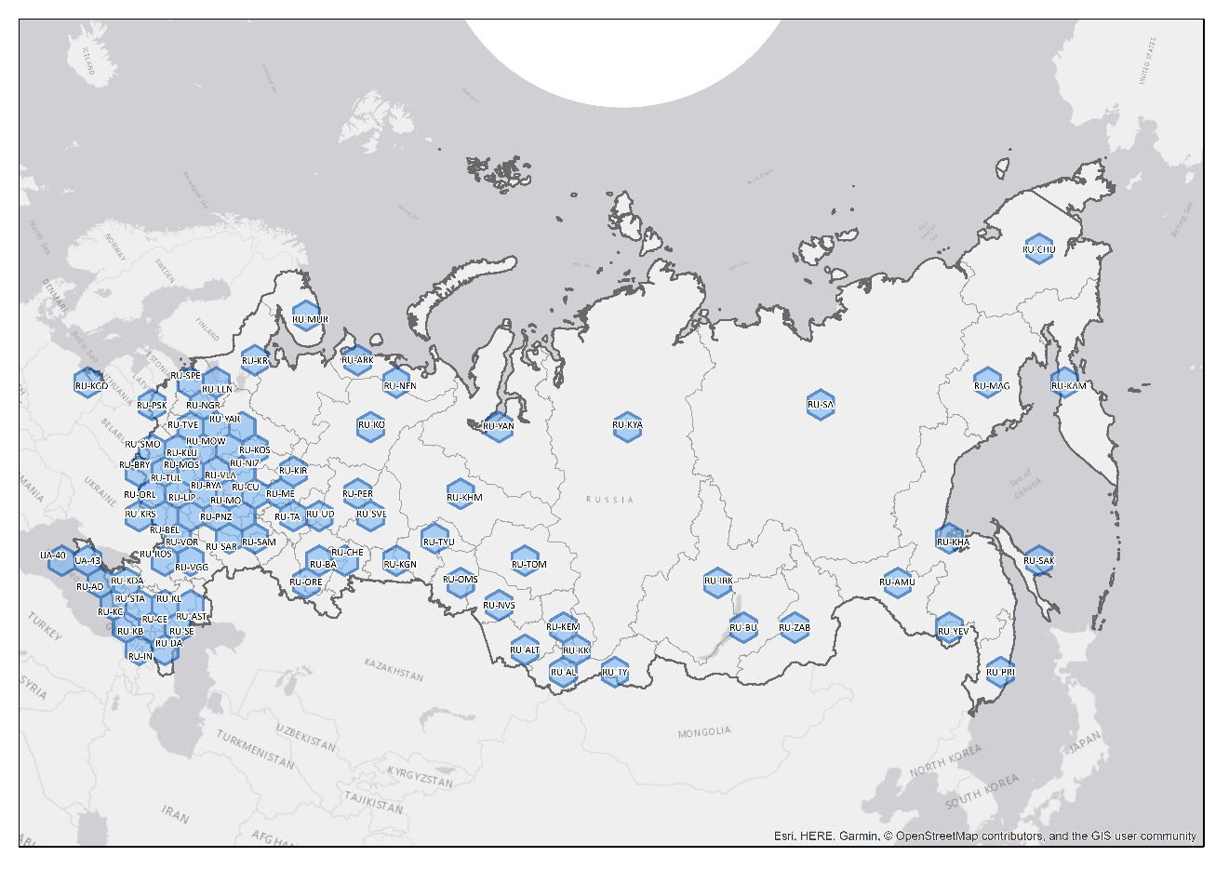
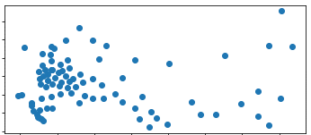
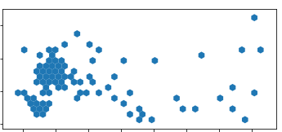
RUSSIA: districts Hex size = 190,000 METERS

Slide 15
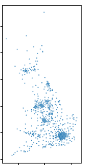
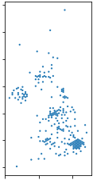
UK: LAD, Parl. Constituencies, MSOAs
LADs
Hex size = 12,500 m
ParliCons
Hex size = 6,500m
MSOAs
Hex size = 2,500m

Slide 16
Hexmap compression
Drawbacks:
A geographically faithful hexmap can incorporate large areas of empty space.
Small hexes = hard to label and read.
Challenge:
Compress the hexmap - larger hexes while still retaining similarity to original shape.
Solution:
Shift hexes towards the median centre of the dataset
Apply gravity and friction functions;
More compact stand-alone graphic (will no longer overlay on geographic basemap).

Slide 17
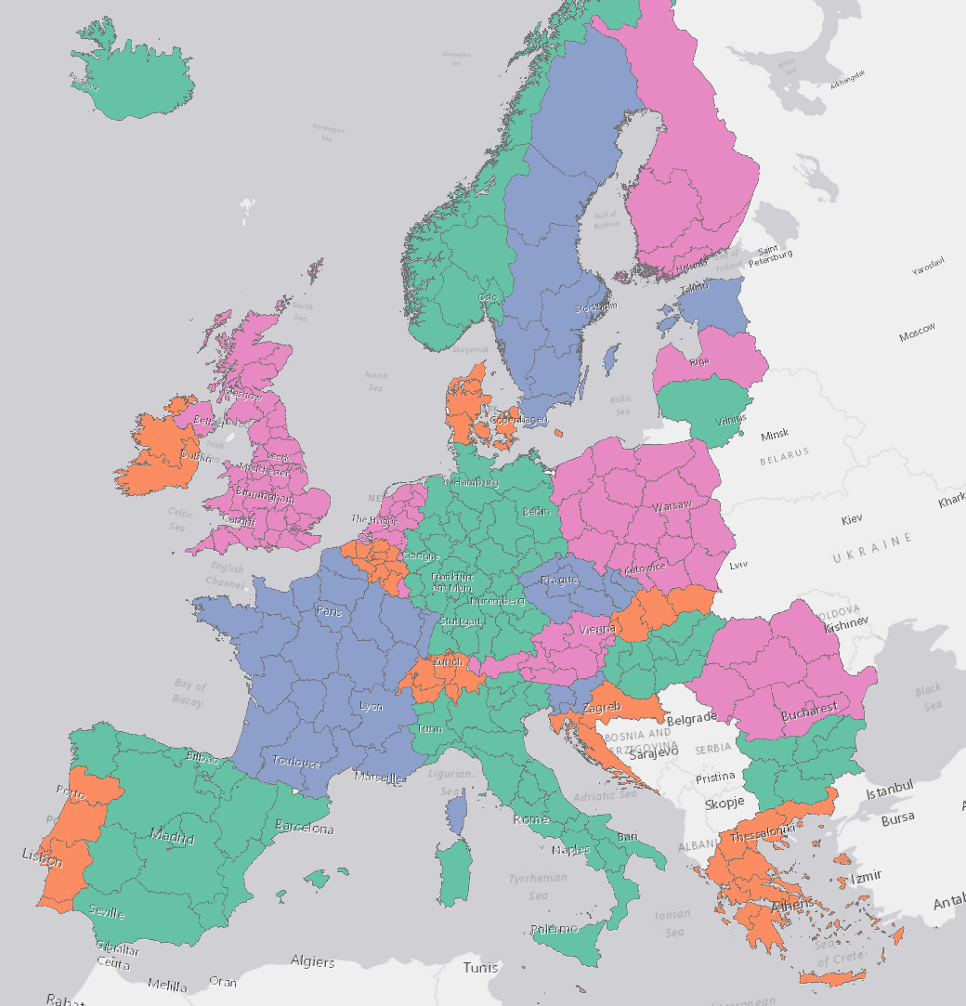
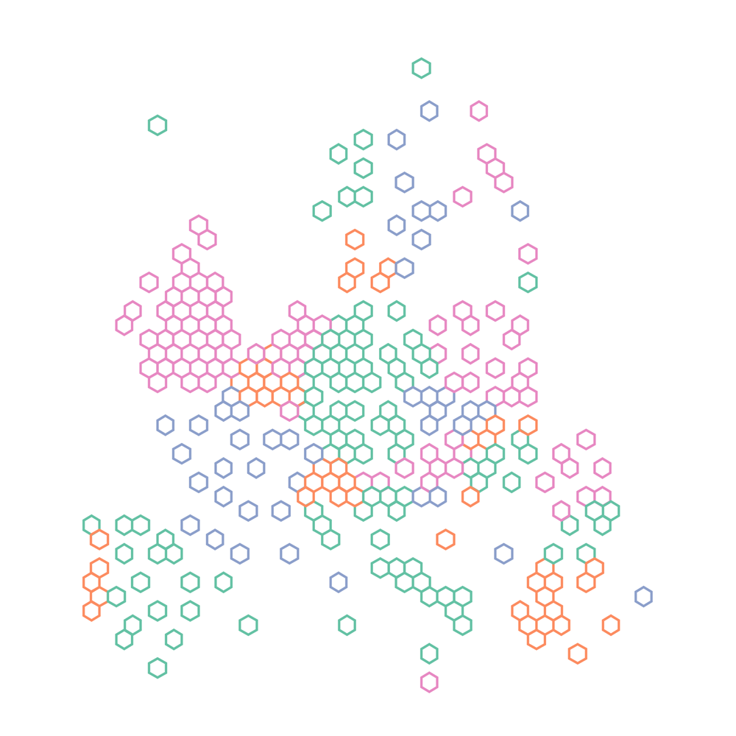
Compressed hexmap: Europe at NUTS2 level

Slide 18
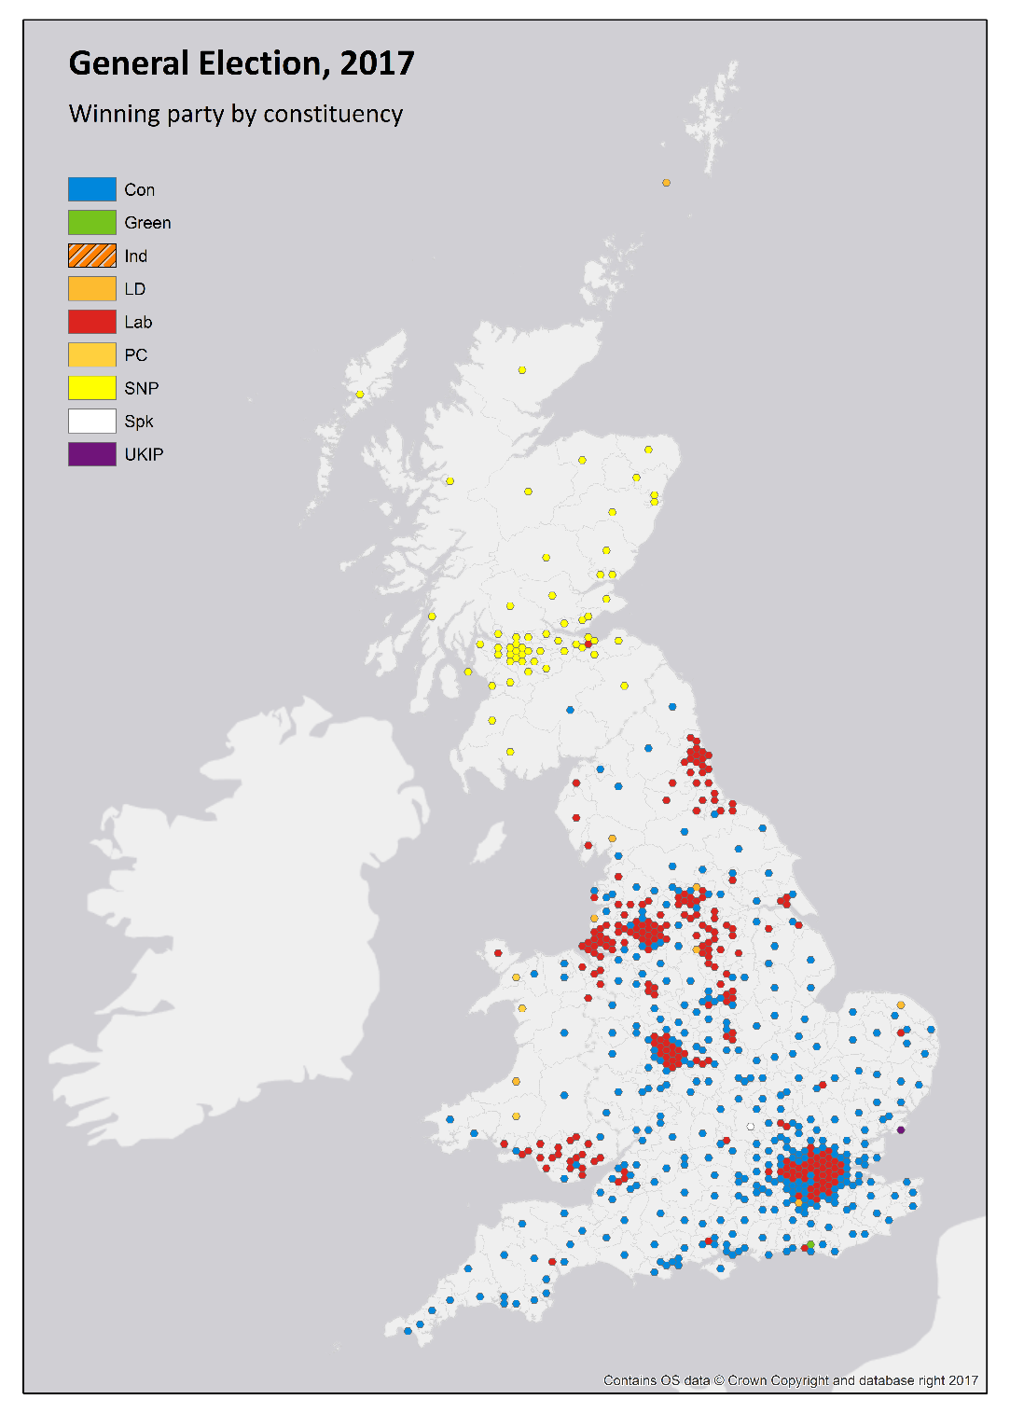
Uncompressed hexmap: UK General Election, 2017
Source: Electoral Commission
https://odileeds.org/projects/ge2017/

Slide 19
Next steps
Re-engineer the compression code;
Automatic calculation of optimal hex size;
Code refinements (functions);
Identification and processing of clustering patterns;
Creation and distribution to GSS of hexmap templates for common UK geographies.
Publication on GitHub

Slide 20
Thank you
Bruce Mitchell
bruce.mitchell@ons.gov.uk
George Tzelepis
george.tzelepis@Trade.gov.uk

