Slide 1
Using R for variance estimation in social surveys
Eleanor Law and Vahé Nafilyan, ONS

Slide 2
Social surveys
Crucial for key indicators:
Employment and unemployment rates (Labour Force Survey)
Spending (Living Costs and Food Survey)
Pension/financial/property wealth (Wealth and Assets Survey)
Many more!
Sampling frame is usually the postcode address file (PAF)
Notes:
Explain what a sampling frame is
We don’t have a list of all the people
You don’t know who you will find at a given address until you go and look, and an address can have multiple households.
We have some idea about car ownership and some other variables at the level of postcode sectors

Slide 3
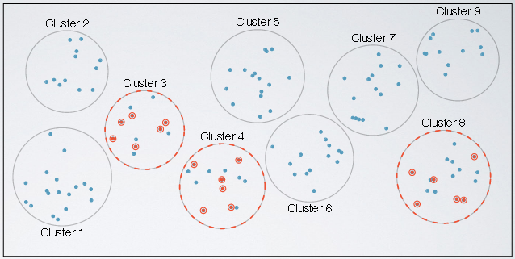
Complex sample design
Multistage sampling e.g. WAS
Primary sampling unit is a postcode sector
Systematic sampling after ordering by social demographic indicator/car ownership
Image credit: http://researchhubs.com/post/ai/data-analysis-and-statistical-inference/observational-studies-and-experiments-sampling-and-source-bias.html
Notes:
Clustering increases cost effectiveness by reducing travel
Clustering increases variance of estimates compared to SRS
Systematic/stratified sampling reduces variance of an estimate, if it correlates with the stratifying variable

Slide 4
Calibration
Limited control over the make up of the sample
Non-response rates differ between different groups
Weighting can compensate for over/underrepresentation of sex/age/region groups in the sample
Calibration can reduce standard error of estimates if poststrata correlate with variable of interest

Slide 5
Variance in complex surveys
Established formulae for calculation of variance, accounting for strata and clustering
Implemented in the R “survey” package
These do not consider the effect of calibration
Notes:
There are some methods that do account for calibration, and we use the linearised jackknife which does this, and in addition, also accounts for variation in the weights

Slide 6
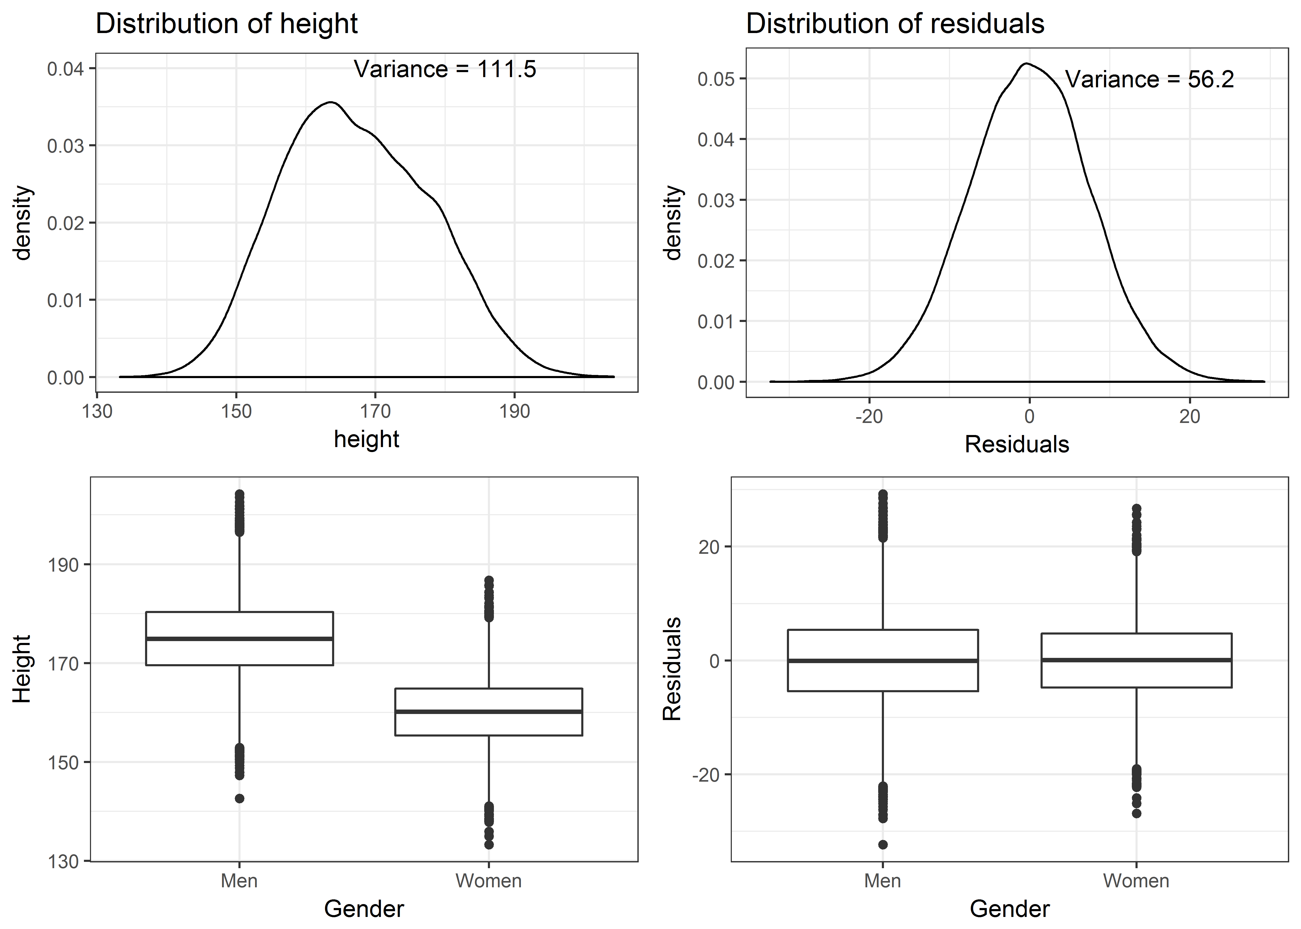
The linearised jackknife

Slide 7
The linearised jackknife
Fitting a linear model for the variable of interest as a function of the poststrata
This establishes how much of the variance is accounted for by the poststrata as explanatory variables
Variance that exists in the residuals, after the poststrata have been accounted for, is what we want to know

Slide 8
History of implementations in ONS
Lots of existing weighting code for a range of surveys
Widely used across ONS in business areas
Holmes & Skinner for LFS
Generic STATA
SAS
2000
2005
2010
2015
R
Free and open source!
Increasing use of R and python across ONS

Slide 9
Implementation in R
Notes:
Our aim was to develop a user-friendly R function to perform SE estimation.
We created documentation which can be accessed like that of any R function
User-friendly focus in definition of arguments:
An argument defines whether standard errors are required for “total”, “mean”, or “ratio” estimates
Poststrata can be passed as a categorical variable (factor)
Another user-friendly feature : Built-in checks to make sure that arguments are correctly specified and that there is no missing values for key variables
R can read in SAS- or STATA-formatted databases to pass into the function

Slide 10
Developing a package
Standard formatting for R packages
Automatically generated documentation:
library(devtools)
load_all("D:/glinjack_git/Glinjack/glinjack")
document("D:/glinjack_git/Glinjack/glinjack")
User-friendly focus in definition of arguments

Slide 11
Reproducing standard errors - APS
Personal well-being in the UK
Calibration to age X sex, local authorities
Four well-being variables:
Life satisfaction, happiness, sense of worthwhileness and anxiety
Estimates of average and percentage with very high/high/medium/low levels
Estimates by age, gender, country and local authority
Very time consuming in SAS
Notes:
We first tested the new R function on data from the Annual Population Survey.
APS is a good survey to test the new function because it is the largest household survey in the UK and has many calibration variables
The personal WB release focuses on four variables. Estimate Standard errors for the four well-being variables, and derived variables indicating percentage with very high/high/medium/low levels
Estimates by many domains.
The SE calculations was performed in SAS and it was very time consuming

Slide 12
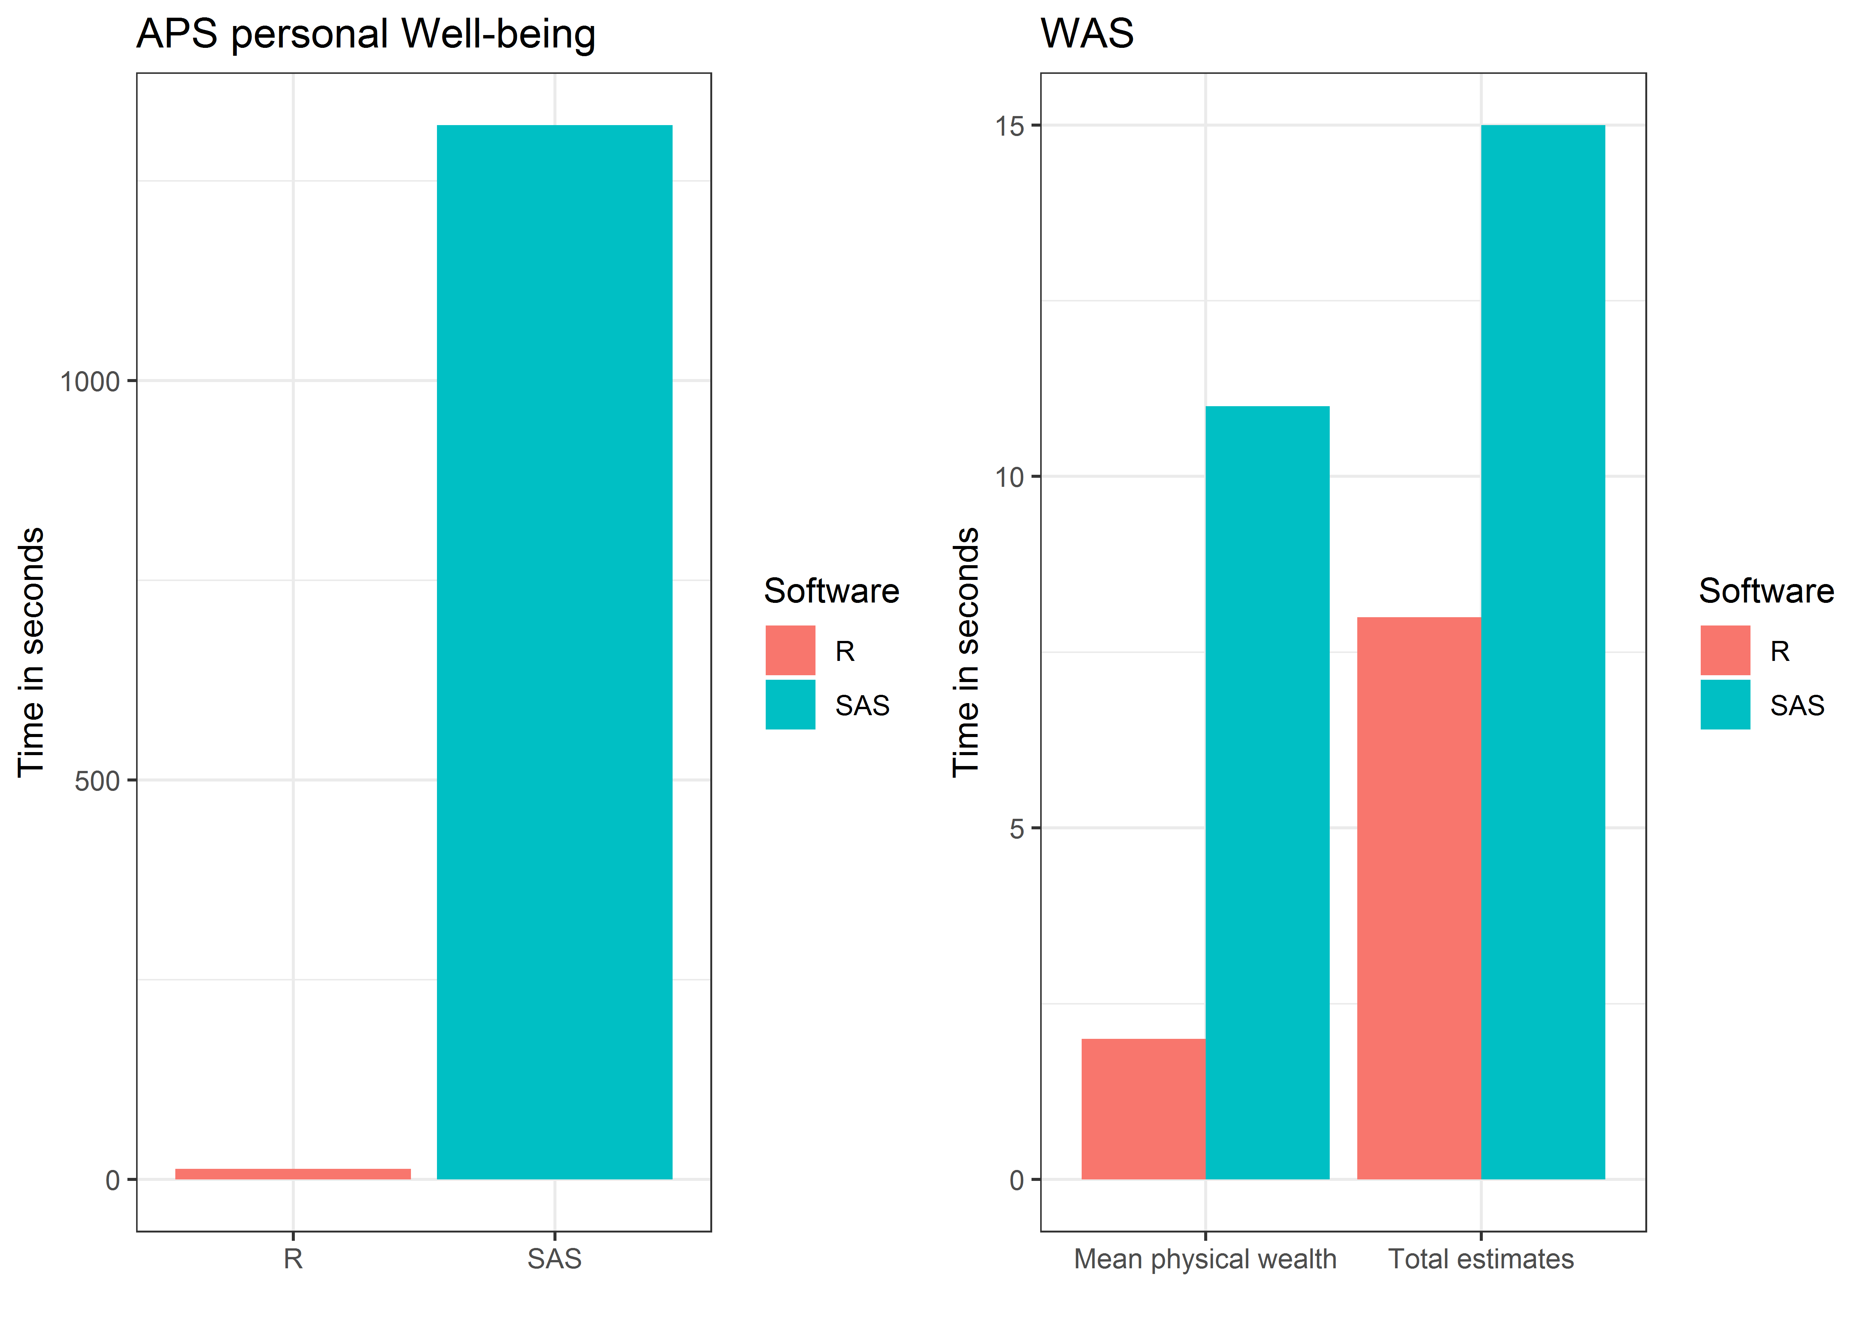
Computational efficiency
 | APS personal well being (headline estimates) |  | WAS mean physical wealth (1) | WAS total estimates (6)
SAS | 1320 |  | 11 | 15
R | 40 |  | 2 | 8
Notes:
APS:
It takes about 20 minutes to estimate the SE for the 4 WB variables in SAS, 13 seconds in R. Gains are smaller for the Wealth and assets survey
Gains depends on the size of the dataset and the number of calibration variables

Slide 13
Computational efficiency
?
Notes:
The efficiency gains are due in part to the way we adjust the variables / estimate the residuals
Traditionally done using linear regression (costly to estimate so many coefficients)
We use a command that demean the data

Slide 14
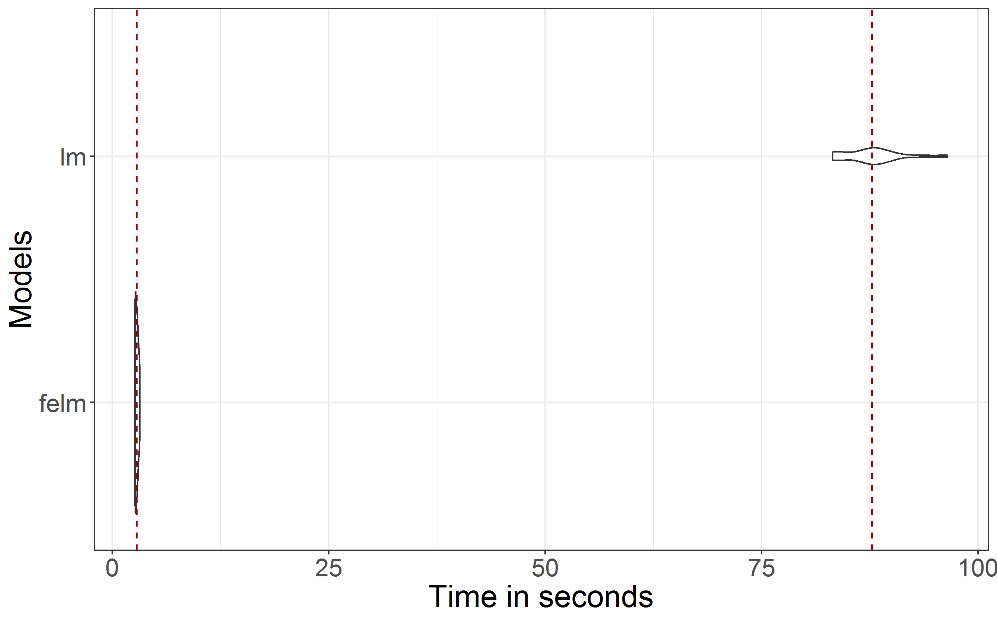
Importance of estimation methods
Notes:
Results from a benchmark exercise comparing glinjack functions with 2 different estimation methods
Average running time (dashed line) + distribution
Felm : 3 secs
Lm(): 87 secs
Glinjack function

Slide 15
Variance estimation for households
Poststrata are usually either
One categorical variable OR
Split into dummy binary variables
Household level data are aggregated:
 | Region 1 | Region 2 | Sex/age group 1 | Sex/age group 2 | Sex/age group 3
Person 1 | 0 | 1 | 0 | 0 | 1
Person 2 | 0 | 1 | 1 | 0 | 0
Person 3 | 0 | 1 | 0 | 0 | 1
Household total | 0 | 3 | 1 | 0 | 2
Notes:
For household level data, poststrata are aggregated over households
Poststrata take integer values, but they are continuous
Must be handled differently and not split into dummy variables

Slide 16
Reproducing standard errors - WAS
Wave 5 (2014-2016) estimates of total/financial/property/physical wealth etc
Standard Errors originally calculated in SAS
Quality assured by reproduction using R
This highlighted a problem with the parameter definitions passed to the SAS macro

Slide 17
Reproducing standard errors - WAS
Waves 3-5 (2010-2016) estimates of the percentage of dependent children in households with problem debt
Originally calculated in SAS
Attempted reproduction using R
Very similar, but not identical, results obtained, indicating there was a slight methodological difference
SAS method aggregates members of a household before calculating residuals

Slide 18
Future Developments
Further testing including collaboration to get user feedback
Ratio estimates for domains
Aggregation over households within the R function
Variance of change
Very similar method, using input of two datasets
Could be combined with glinjack into one R function and package

Slide 19
Acknowledgements
Ria Sanderson
SD&E(S) team

