Slide 1
Statistical modelling of arrears history data for decision support in Social Housing Management
Farida Mustafazade, Shirley Coleman,
Jaume Bacardit

Slide 2
Outline
Background
Challenges
Data Preparation
Exploratory Data Analysis
Statistical Analysis and ML
Future Extensions

Slide 3
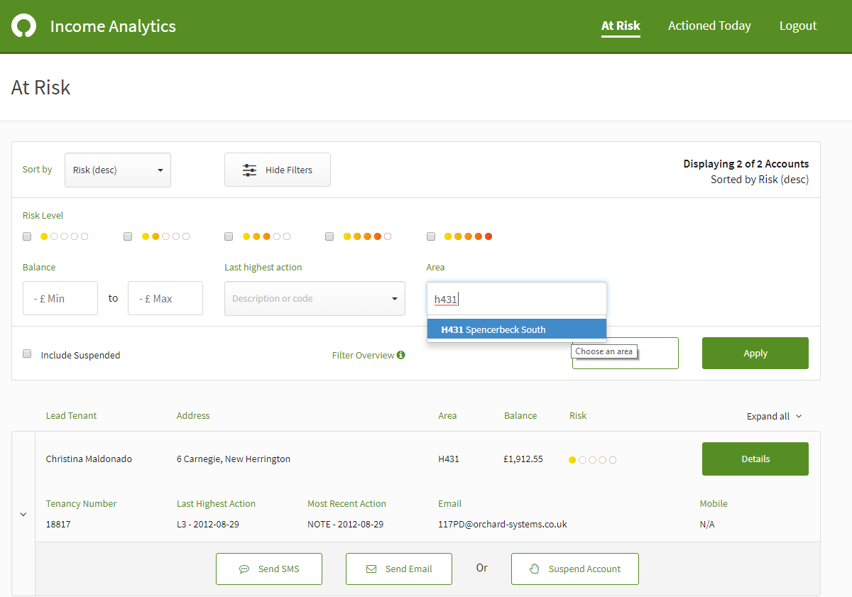
1
Background
Goal?
Find the accounts that are at high risk of rent arrears
Why?
Reduce arrears caseload
Reduce the account processing time
Increase income collection
For confidentiality purposes, dummy data has been used

Slide 4
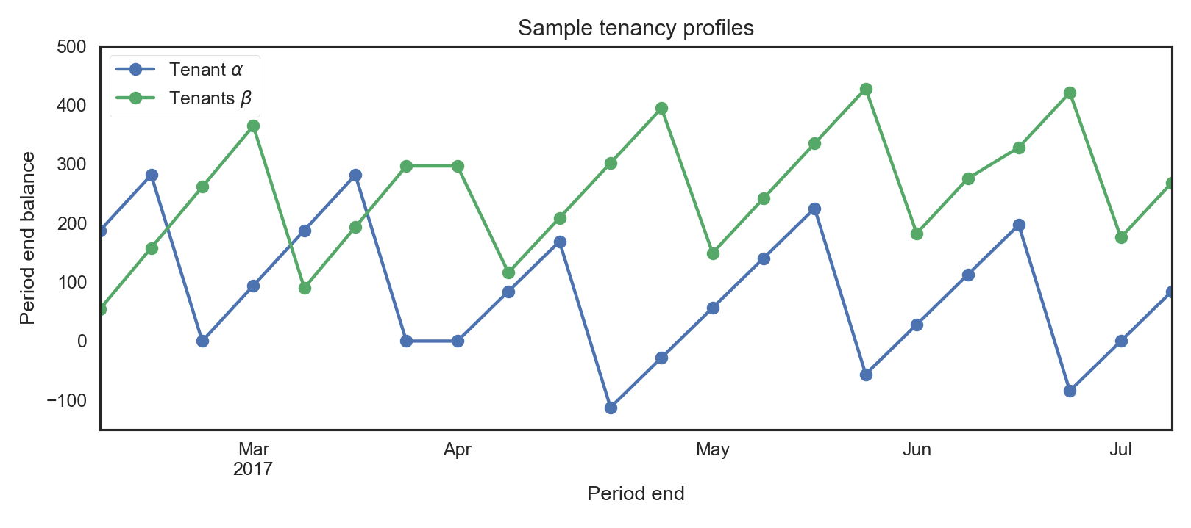
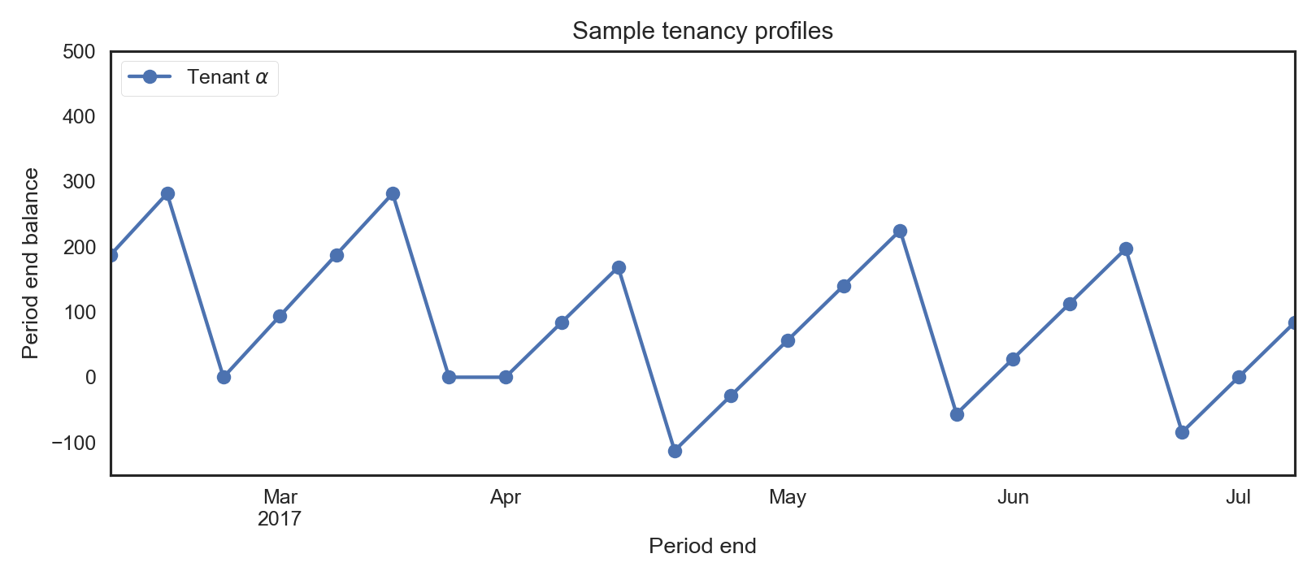
Typical tenancy profiles
1
Undesirable, needs no intervention
Undesirable, needs an intervention

Slide 5
2
Challenges
Problem definition
Data quality
Legal hurdles to accessing and integrating different datasets
High-dimensional and unintegrated data
Business logic constraints on data interpretation
Complex data preparation pipelines
Configurability of the housing management systems (HMS)

Slide 6
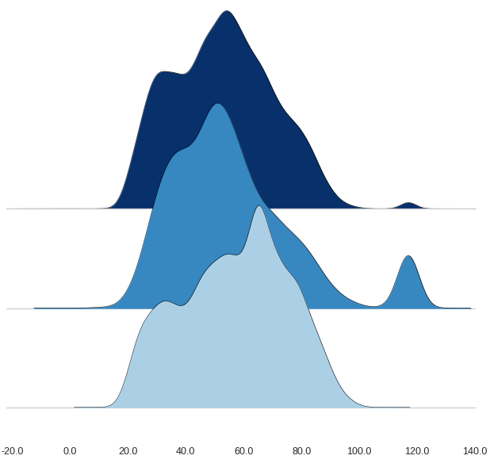
2
Ensuring Data Quality
Customer A
Customer B
Customer C
Age Distribution

Slide 7
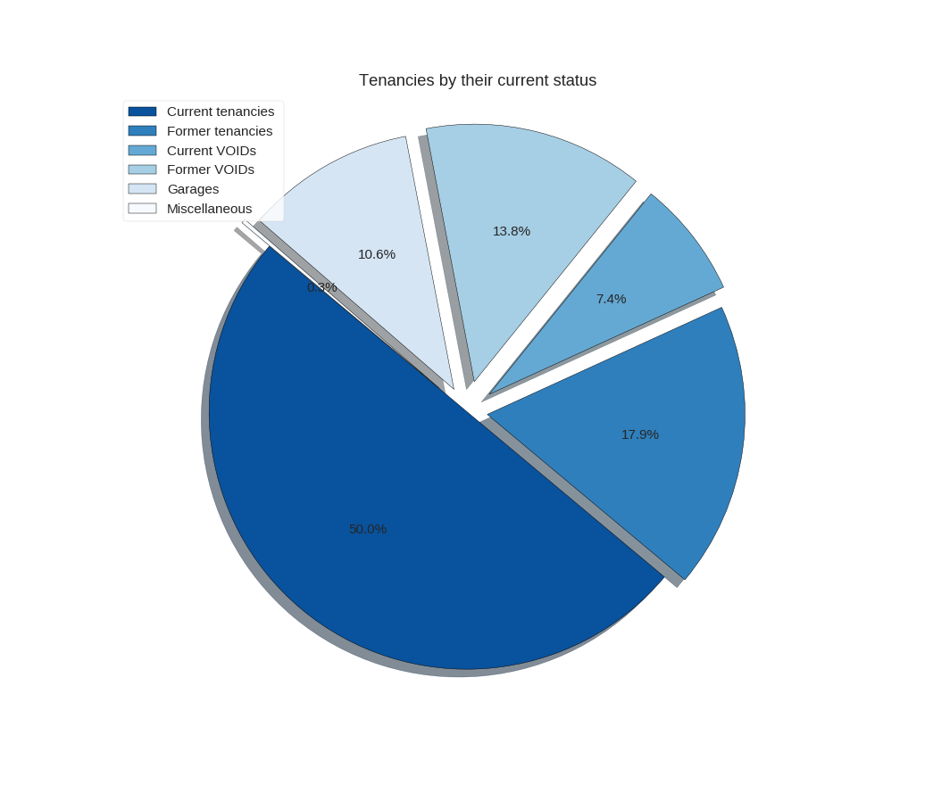
3
Data Preparation
Focusing on a subset of tenancy records
Combining information from different datasets

Slide 8
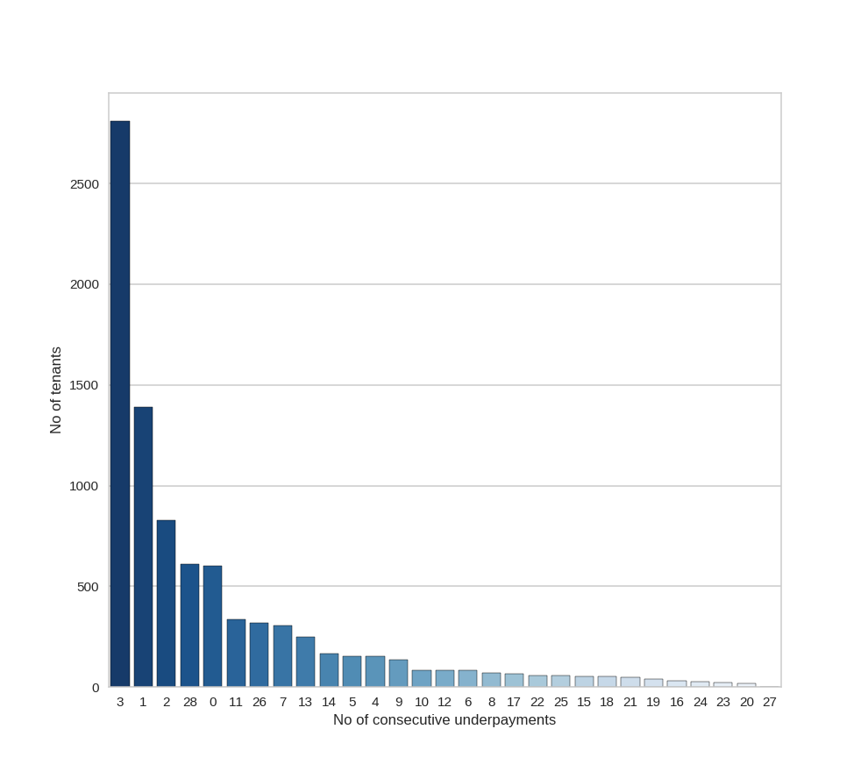
Exploratory Data Analysis
4

Slide 9
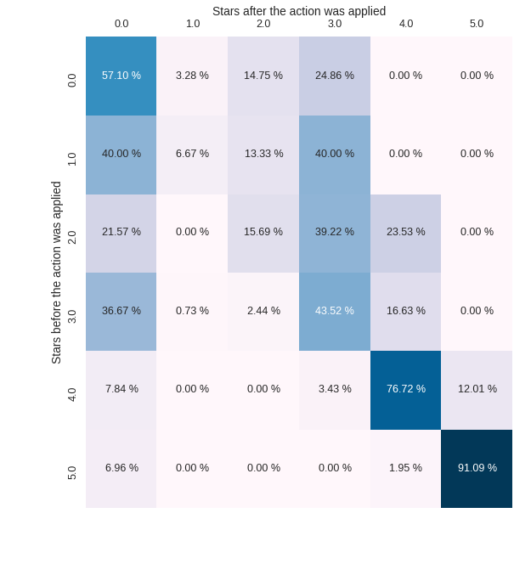
4
How effective was giving a call?
Exploratory Data Analysis

Slide 10
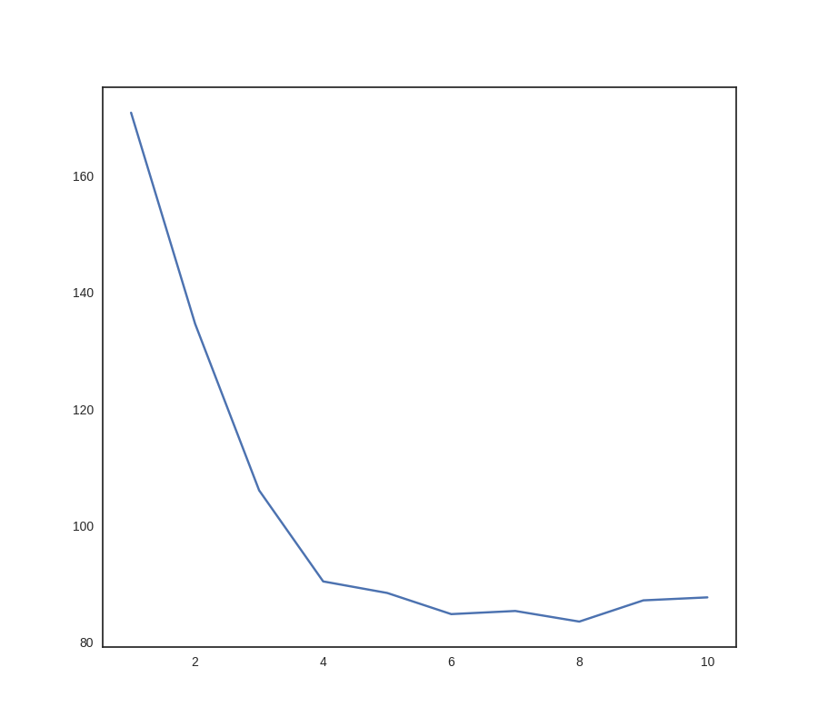
Regression Analysis
5
Statistical Analysis and ML
Tree depth versus RMSE
Linear Regression
Decision Tree Regression
Random Forest Regression

Slide 11
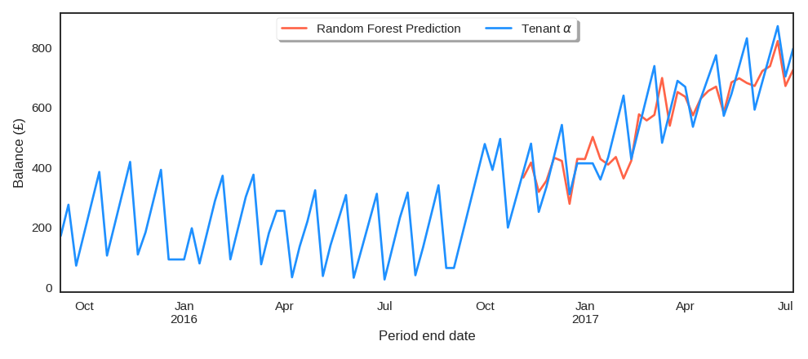
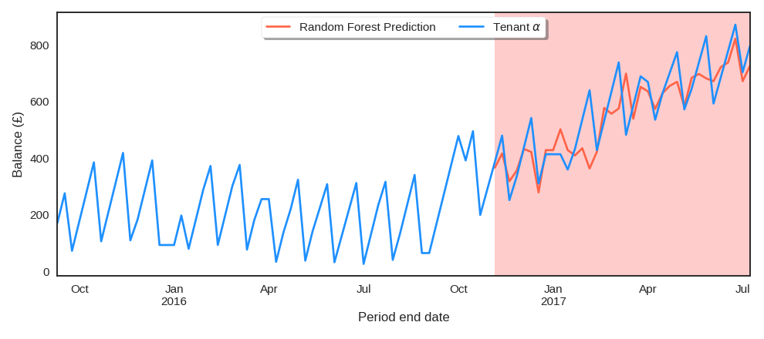
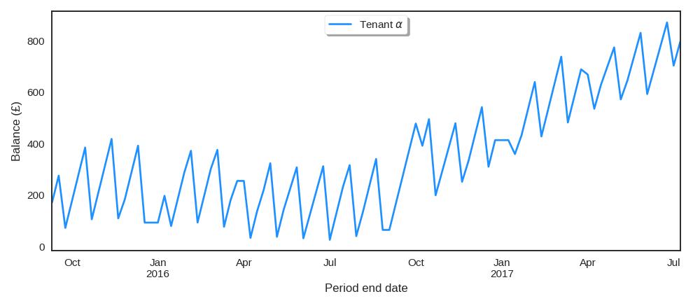
5
Sample Tenant Balance Prediction

Slide 12
5
Cluster analysis
Goal
Identify different types of weekly balance time series
Identify distinct groups of tenants
Tenants segmentation, interventions, communication, etc.
Use of an unsupervised clustering algorithm
Identify distinct groups of tenants
No a priori definition of ‘bad tenant’
Cluster size/quality controllable via parameter α.

Slide 13
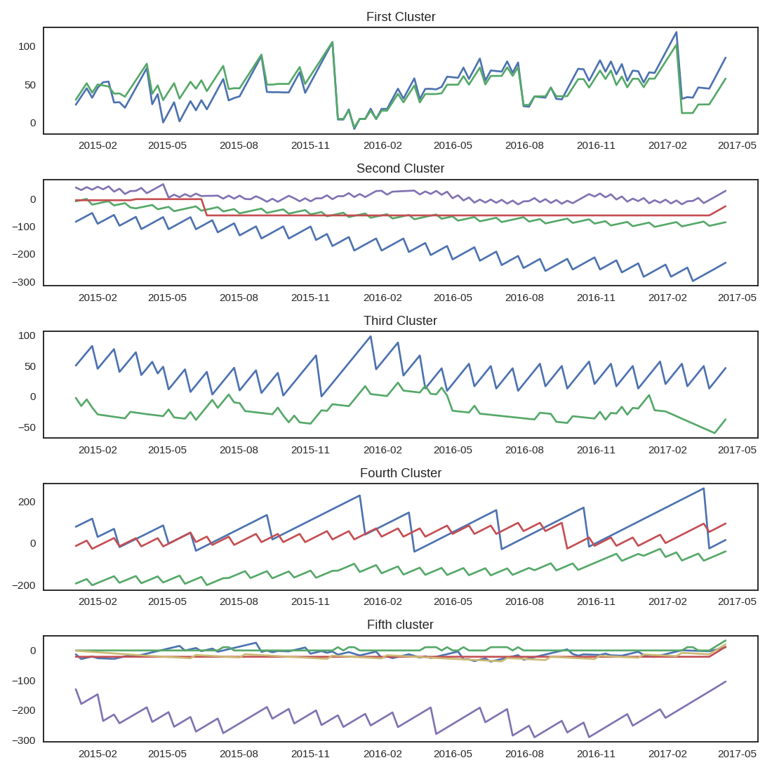
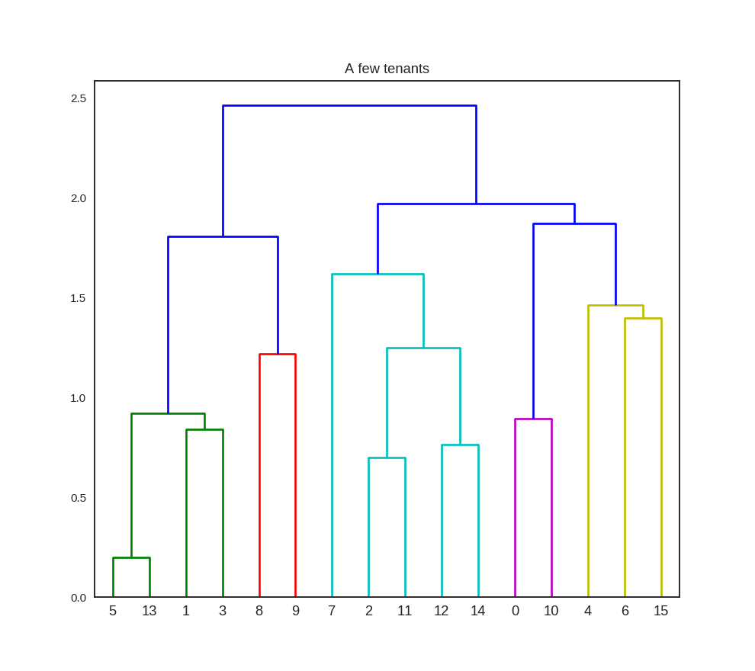
Hierarchical Clustering
By similarity patterns
Linkage: Complete
Distance : Correlation

Slide 14
Summary
5
Tenancy records
Intervention Impact
Data Selection
Forecast of next period balance
Tenant Segmentation

Slide 15
Future Work and Extensions
6
Apply to arrears and other areas of Social Housing
Redefine ‘Risk’
Explore the Clusters for improved Predictions

Slide 16
Thank you!
Any questions?
farida.mustafazade@ncl.ac.uk

